Slide 1

Youth Engagement in Sister Cities
Lessons from Aotearoa New Zealand
Taylor Marston – Global Cities New Zealand

Slide 2
“If you want someone to remember your message in a presentation, an article, or a report – tell them a story”
—Rachel Gillett

Slide 3
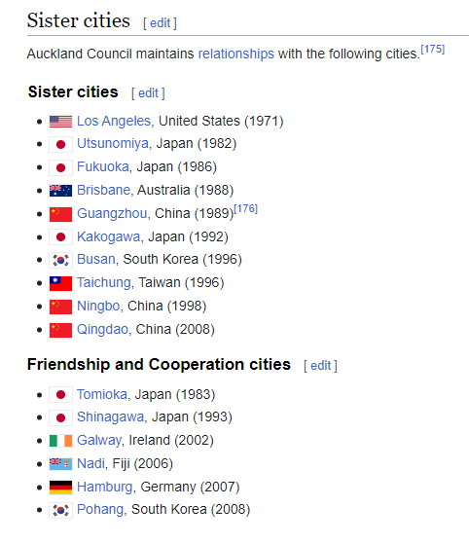
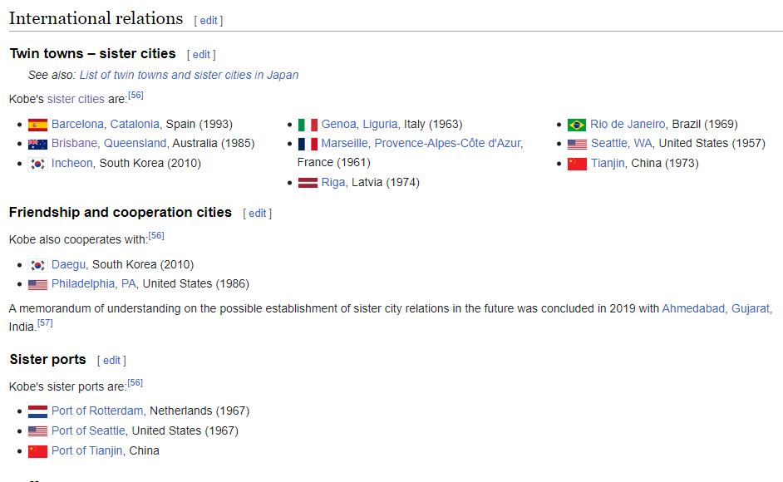
It all started with a Wikipedia page…

Slide 4
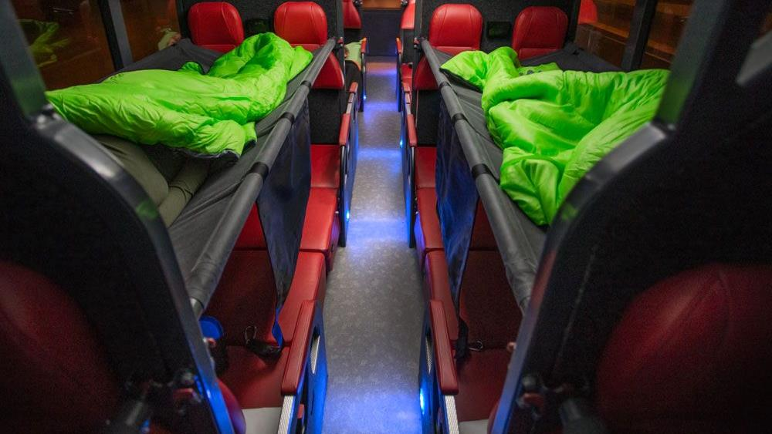
… an overnight bus

Slide 5
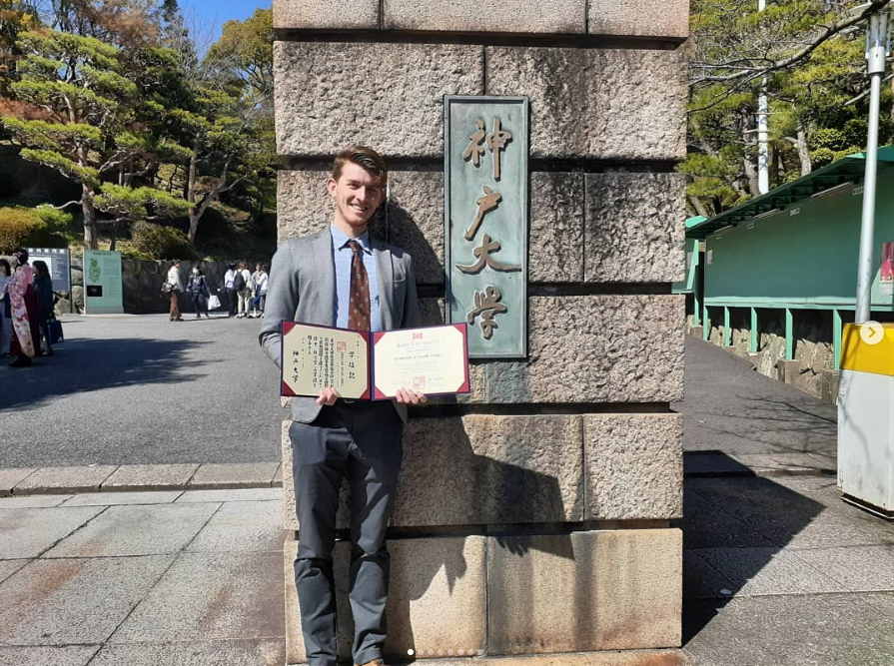
… a university on a hill

Slide 6
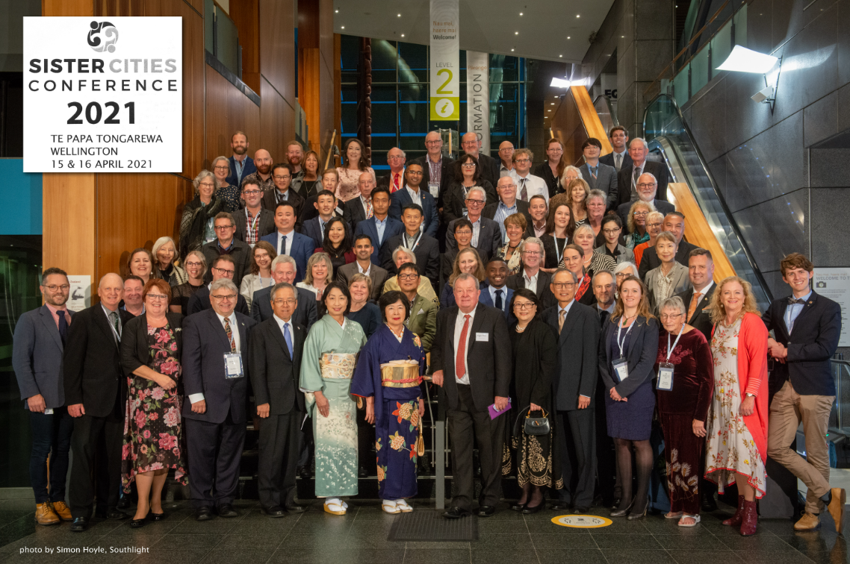
… and finally, a conference

Slide 7

What I’ve learnt
Thinking practically about youth engagement

Slide 8
Please be aware that, in the interest of simplicity, I will be making numerous generalisations about youth that in many cases might not hold true – please take my advice with a grain of salt

Slide 9
Youth engagement in sister cities is transitory, transactional, and time-sensitive

Slide 10
My Advice
1
Maintaining an online presence
2
Understanding intentions
3
Mattering
4
Being timely
5
Lead by example

Slide 11
Maintaining an online presence
An online (web) presence is any publicly accessible content or info on the internet associated with a person, business, or any other entity
The most likely means by which youth will find out about a sister city is online - If a young person cannot find what they are looking for in a few clicks, they will likely stop looking
Sister Cities relationships need their own websites and social media accounts where information is curated - local council websites generally do a poor job at this
Get a young person to google your sister city relationship, then ask them to give you feedback – you will likely find that accessible content and info online about your sister city relationship is outdated and scattered, and in most cases, limited
What content and information about your sister city relationship exists online, and how easy is it to find?
Notes:
Youth spend a lot of time online; Aussie youth (between 12 and 17) spend on average 2 hours a day online (esafety, 2012)
The most common use of the internet according to this same study is “researching topics of interest” at 95%
Most sister city relationships in New Zealand have very limited if any online presence or visibility
– if you do not have an online presence (with decent visibility) not only are you missing the boat, but you also don’t know where the wharf is.

Slide 12
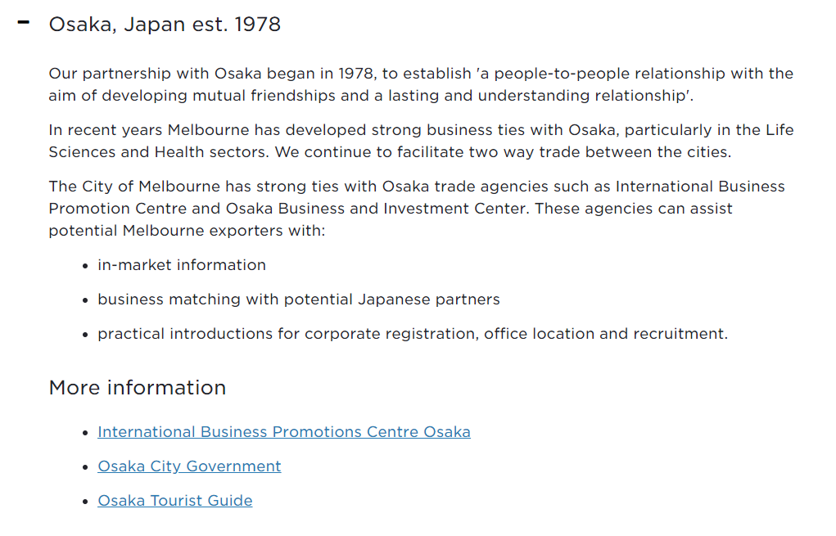
An example from Melbourne
Notes:
On further digging I found the following:
There is a “Melbourne Osaka Cup” yacht race held every four years
In 2018 a sister street relationship between Midōsuji and Swanson street was established
An MOU was signed between Melbourne Health and the Osaka City University in 2018
The University of Melbourne and Osaka University became “Global Knowledge Partners” in 2022
Melbourne led a business mission to Japan in 2018 on which there is a 34-page report (you wont find this unless you search exact terms).
Melbourne become the only Australian member of the Business Partner City Network in 1999 at the invitation of the City of Osaka
Key educational exchanges such as the annual Melbourne Osaka Award at the Japanese Language Speech Contest
Launched in 2017, the Health Innovation Partners platform is a formal exchange program between hospitals, health systems and innovation precincts that supports innovators and entrepreneurs to develop new patient focussed clinical technologies and services.
As part of the inaugural 2018 program, healthtech startups in Melbourne and Osaka will be invited to participate in the Health Innovation Exchange, where teams that address specific health system problems shared by the two cities pitch to a panel of experts. Successful startups will be awarded an opportunity to travel to Osaka, Japan to further collaborate with local health system stakeholders including representatives from local government, hospitals, industry and startup counterparts. The program will then be reciprocated in Melbourne in late 2018.

Slide 13
An example from Melbourne
The “Melbourne Osaka Cup” yacht race is held every four years
Melbourne became the only Australian member of the Business Partner City Network in 1999 at the invitation of the City of Osaka
In 2018 a sister street relationship between Midōsuji and Swanston Street was established
An MOU was signed between Melbourne Health and the Osaka City University in 2018
Melbourne led a business mission to Japan in 2018 on which there is a 34-page report
The University of Melbourne and Osaka University became “Global Knowledge Partners” in 2022
There are key educational exchanges such as the annual Melbourne Osaka Award at the Japanese Language Speech Contest
The Health Innovation Partners Platform was launched in 2017 which sees health-tech startups in Melbourne and Osaka participate in a Health Innovation Exchange
Notes:
Launched in 2017, the Health Innovation Partners platform is a formal exchange program between hospitals, health systems and innovation precincts that supports innovators and entrepreneurs to develop new patient focussed clinical technologies and services.
As part of the inaugural 2018 program, healthtech startups in Melbourne and Osaka will be invited to participate in the Health Innovation Exchange, where teams that address specific health system problems shared by the two cities pitch to a panel of experts. Successful startups will be awarded an opportunity to travel to Osaka, Japan to further collaborate with local health system stakeholders including representatives from local government, hospitals, industry and startup counterparts. The program will then be reciprocated in Melbourne in late 2018.

Slide 14
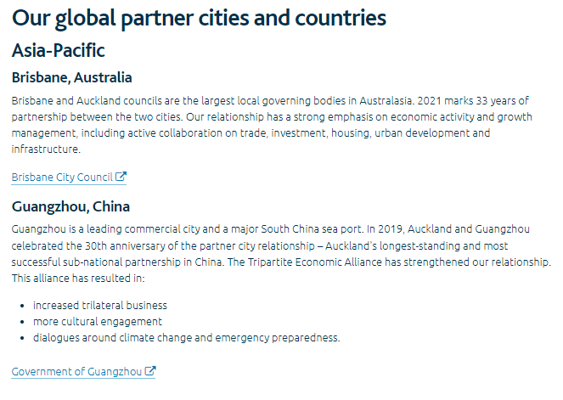

Slide 15
Understanding intentions
While altruism is certainly a motivator for many youth, it is usually not the only, nor necessarily the strongest motivator
Understanding the intentions of youth who might involve themselves in a sister city relationship is pivotal to achieving sustainable levels of youth engagement
Sister city relationships have much to offer to youth, but to know what to offer, you need to first understand what youth want
For example, for many youth, especially those new to the workforce, any time spent that is not leisure is often measured in terms of how it increases one’s employability – “Will it look good on my C.V?”’
What skills and experiences could your sister city relationship offer a young person?

Slide 16
Mattering
“To matter, people must feel valued — heard, appreciated and cared for — and they must feel like they add value in ways that make them feel capable, important and trusted” - Isaac Prilleltensky
A 2015 study found that the most common motivation shared by volunteers and activists over hundreds of interviews was a sense or feeling of “making a difference” (Pancer, 2015)
Youth, perhaps more than anyone, like to feel like they matter, that they both are valued and add value – that they are making a difference
How could youth add value to your sister city relationship? Alternatively, what does your sister city relationship do to “make a difference” and how could this involve youth?
Notes:
Mention Shinagawa Auckland

Slide 17
Being timely
An unfortunate reality for youth engagement is that youth tend to move around a lot and given that sister city relationships are place-based, when youth move any involvement they might have had is generally lost
Youth may appear completely eager at one point, then radio silent the next– ghosting is also not uncommon
Youth engagement in sister cities needs to consider the reality of young people’s lives which are often sporadic, spontaneous, and sometimes chaotic - usually, half the battle of youth engagement in sister cities is timing
The biggest advice I can give is to have the expectation that any engagement you receive will be transitory, and to specifically engineer any engagement accordingly
What opportunities can you offer to youth that are both short and sweet and flexible in timing?
Notes:
Discuss environmental marches – short and sweet

Slide 18
Lead by example
If you want a young person to value your sister city, you need to value it that much more – and value it not just in terms of effort, but also in terms of funding and promotion
The amount of support, funding and promotion sister cities receive compared to other local council endeavours is often minuscule
What example are you setting to youth about your sister city relationships (both intentionally and subliminally)?

Slide 19
Maintaining an online presence
Understanding intentions
Mattering
Being timely
Lead by example
What content and information about your sister city relationships exists online, and how easy is it to find?
What skills and experiences could your sister city relationships offer a young person?
How could youth add value to your sister city relationships?
What opportunities can you offer to youth that are both short and sweet, and flexible in timing?
What example are you setting to youth about your sister city relationships?

Slide 20
I would love to hear from you!
Youth@globalcities.org.nz

