Slide 1
Sister cities: in context
Sister Cities Australia 2023 National Conference
12 October 2023
OFFICIAL

Slide 2
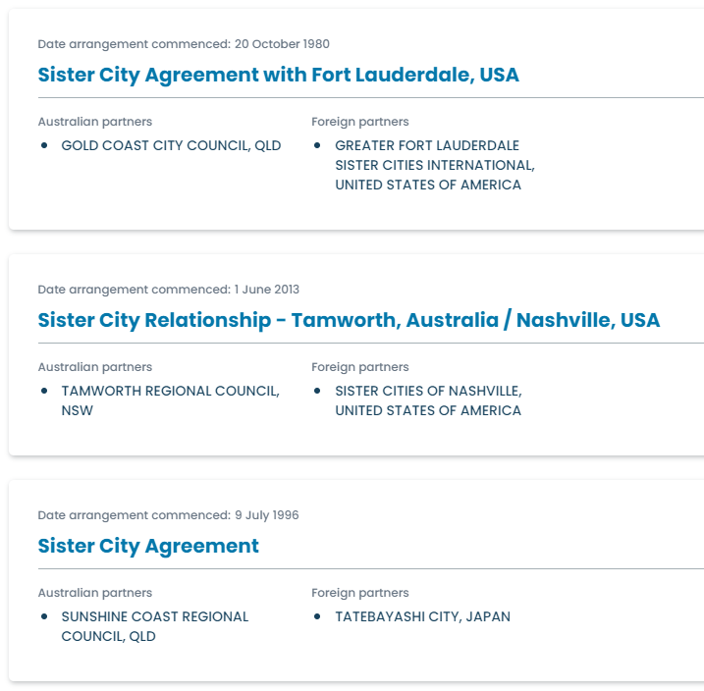
Value of sister city relationships
Australia’s local governments advance Australia’s interests globally.
Sister city arrangements:
Economic ties
Cultural exchange
People-to-people links
The Australian Government seeks to support local governments in their international engagement.
OFFICIAL

Slide 3
Foreign Arrangements Scheme
Overview – Local governments
OFFICIAL

Slide 4
Why DO we need a foreign arrangements scheme?
Australia’s foreign policy is set by the Australian Government. ​
The Scheme is a mechanism through which the Minister for Foreign Affairs can ensure that international engagement by states, territories, local governments and public universities is:​
consistent with Australia’s foreign policy, and ​
not adverse to Australia’s foreign relations.
Minister for Foreign Affairs
Senator the Hon Penny Wong
OFFICIAL

Slide 5
How the Scheme works
Established by the Australia’s Foreign Relations (State and Territory Arrangements) Act 2020.
Requires Australian State/Territory governments, local governments and universities to notify ‘foreign arrangements’ with certain foreign entities.
A foreign arrangement may be ‘pre-existing’ (prior to the Act coming into force) or ‘prospective‘ (after this date).
A foreign arrangement may be a ‘core’ or a ‘non-core’ arrangement, depending on the parties to the arrangement:
A core foreign arrangement is an arrangement between a core State/Territory entity and a core foreign entity.
A non-core foreign arrangement is an arrangement between:
a core State/Territory entity and a non-core foreign entity,
a non-core State/Territory entity and a core foreign entity, or
a non-core State/Territory entity and a non-core foreign entity
Notification obligations differ for ‘core’ and ‘non-core’ arrangements.
State/Territory
& Local Gov
Universities
Corporations
Hospitals
OFFICIAL

Slide 6
Local governments under the Scheme
Australian local governments are ‘non-core’ entities under the Scheme.
Australian local government arrangements, including their sister city arrangements, are ‘non-core’ arrangements for the purposes of the Scheme, irrespective of whether the foreign party is a national government or a subnational government.
Check the Foreign Arrangements Scheme website for guidance.
Notification requirements for ‘non-core’ arrangements:
­The arrangement must be notified prior to entry through the Scheme’s online portal,
­and the signed arrangement must be notified through the Scheme’s online portal within 14 calendar days of signature.
OFFICIAL

Slide 7
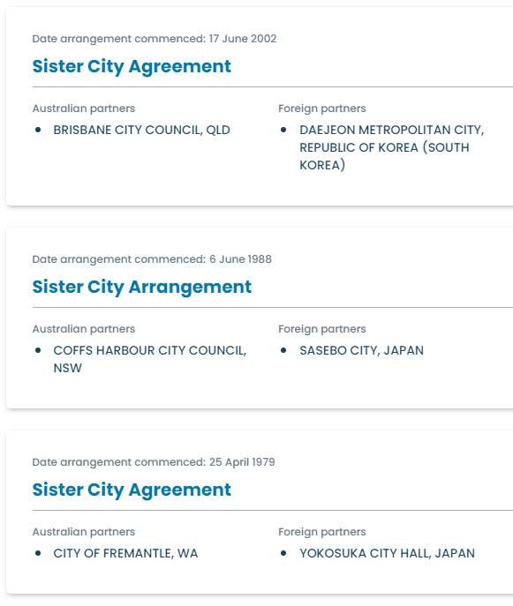
The Public Register
The Minister must publish:
the title of the arrangement,
the parties to the arrangement,
whether any decisions were made by the Minister in relation to the arrangement and the date of any such decision, and
if the arrangement has been entered – the date the arrangement was entered.
The Minister must not publish information that the Minister is satisfied:
is commercially sensitive,
would disclose Cabinet documents or deliberations,
is the subject of legal professional privilege,
is protected by public interest immunity, or
affects national security.
foreignarrangements.gov.au/public-register
OFFICIAL

Slide 8
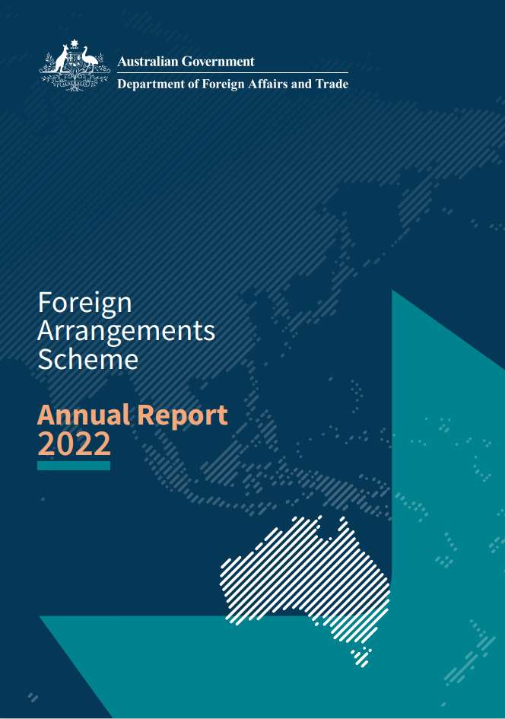
Update on Scheme
Received notification of over 15,000 arrangements by state, territory and local governments and universities.
Over 8,900 arrangements have been identified as in-scope of the Scheme.
Over 8,200 of these have been published to date.
Currently receiving notifications of approximately 300 prospective foreign arrangements per month
including many sister city arrangements.
OFFICIAL

Slide 9
Foreign arrangements scheme advice and review
Guidance materials including frequently asked questions available on website: foreignarrangements.gov.au
Training is available:
­in-person and virtual sessions via outreach program
e-learning module will be released shortly.
Scheme will be reviewed
­as soon as possible after 10 March 2024
­there will be an opportunity for consultation as part of the review.
If you have concerns about your foreign arrangements, please reach out to foreignarrangements@dfat.gov.au
OFFICIAL

Slide 10
sister city arrangements: Advice
Overview – Local governments
OFFICIAL

Slide 11
Behaviours of concern and advice
National Security Hotline
Call: 1800 123 400
Email: hotline@nationalsecurity.gov.au
Important to be cognisant of, and vigilant for, behaviours of concern
threats to our democratic institutions;
pressure to act in a certain way or adopt particular viewpoints;
­threats to, or coercion of, members of our community;
sowing division, including through disinformation.
If you have concerns, then please reach out.
NITRO
‘Notifiable Incidents, Threats or Reportable Observations’
Secure portal to report potential espionage, foreign interference or insider threats.
Website: nitro.asio.gov.au
Department of Foreign Affairs and Trade
Behaviour of diplomatic or consular officials:
Protocol.branch@dfat.gov.au
OFFICIAL

Slide 12
OFFICIAL

