Slide 1
Australia-Japan Local Government Collaboration: Enriching communities through international engagement
Dr Charlie Huang
Co-director, Sustainable Global Business Operations and Development Research Group, RMIT
Charlie.huang@rmit.edu.au
2023 National Conference of Sister Cities Australia
12 Oct 2023

Slide 2
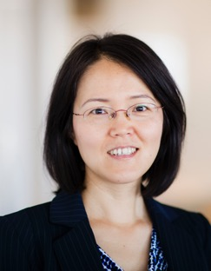
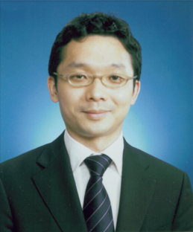
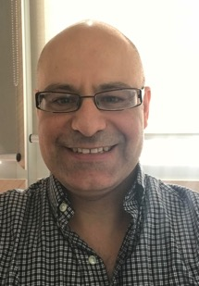
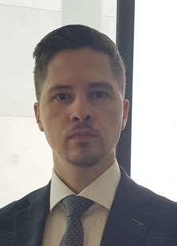
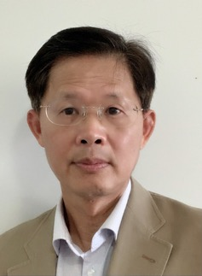
_
Project Team
Australia-Japan Foundation sponsored grant
Project period: 2020-2022
Dr. Shea Fan
Prof.
Hiroaki Mori
Dr. Tse Leng Tham
Prof.
Timothy Bartram
Dr. Matthew Walker
Dr. Charlie Huang
Japan Local Government Centre (CLAIR, Sydney)

Slide 3
_
Research Facts
Interviews
Cross-nation Survey
7 interviews in Japan
13 interviews in Australia
43 responses Japanese local governments
43 responses Australian councils
7 paired
sister cities

Slide 4
_
Top 3
Insights from the Survey

Slide 5
_
Strengths
Top 3
Key strengths of local Australian council's relationship with Japanese counterparts
Increasing student exchange opportunities
Promoting cultural awareness
Cultivating language exchange
1
2
3

Slide 6
_
Strengths
Top 3
Key strengths of local Japanese council's relationship with Australian counterpart
Increasing student exchange opportunities
Promoting cultural awareness
Advancing internationalisation
1
2
3

Slide 7
_
Strengths
Bottom 3
Key strengths of local Australia council's relationship with Japanese counterparts
Increasing staff exchange
Promoting sustainable development
Promoting issues around community safety
3
2
1

Slide 8
_
Strengths
Bottom 3
Key strengths of local Japanese council's relationship with Australian counterpart
Promoting sustainable development
Promoting issues around community safety
Developing trade opportunities
3
2
1

Slide 9
_
Strengths
Key Takeaways
Promoting sustainable development as one of the least common key strengths
Student exchange & cultural awarness are common key strengths

Slide 10
_
SDGs Capabilities & Collaborations
Key Takeaways
Environmental sustainability is a potential area for Australia-Japan sister city collaboration as this appears to be one of the Japanese local council’s strongest capabilities, whilst an area which Australian local councils have less reported capabilities.
Supporting vulnerable communities is another potential area for collaboration given this is one of Australian local councils’ top capabilities.

Slide 11
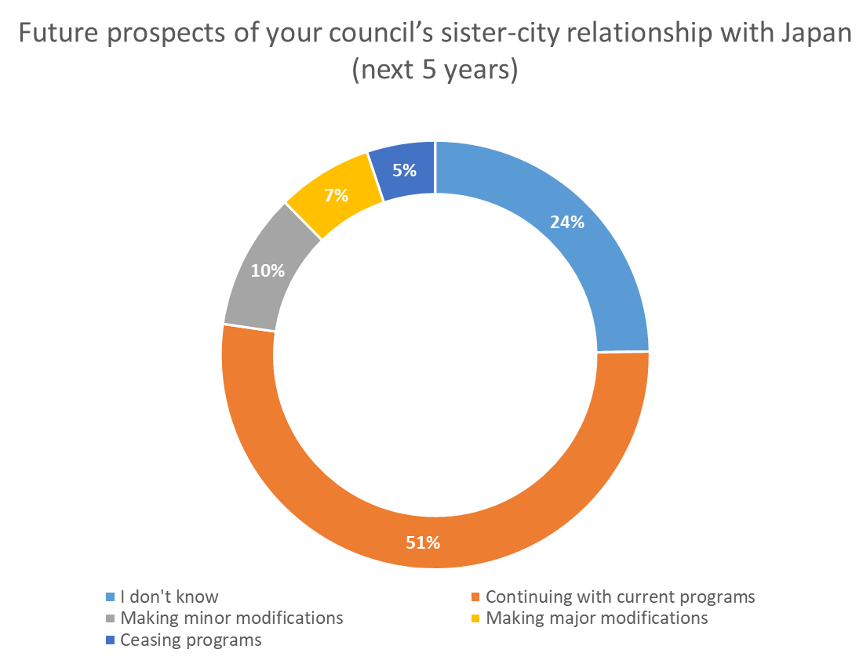
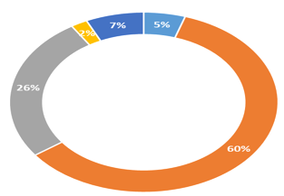
_
Assessment of Future Prospects
The majority of respondents (51% AU; 60% Japan) indicated that the SCR is likely to continue with current programs
Twenty-six percent of Japanese local council respondents indicated that their SCR with Australia will likely be making minor modifications to their program
Comparatively, Japanese local councils reported less uncertainty as compared to Australian counterparts (Australia: 24%; Japan: 5%)

Slide 12
_
Top 3
Insights from the interviews
Education and culture exchanges are the key activities
Goodwill, trust, and mutual understanding are the foundations of long-lasting relationships
New emerging collaborations:
Knowledge Exchange
Environmental protection

Slide 13
_
Key Success Factors – AU Perspective
Top 3
Factors Australian local councils rated as key in the success of the SCR
Support from the sister-city
Support of local councillors
On-going activities between the two cities
1
2
3

Slide 14
_
Key Success Factors – JP Perspective
Top 3
Factors Japanese local councils rated as key in the success of the SCR
On-going activities between the two cities
Allocation of human & financial resources
Support of the sister-city
1
2
3

Slide 15
_
Key Success Factors
Key Takeaways
On-going activities between the two cities & support from the sister-city are consistently top key success factors for both AU & JP
For AU, support from local councillors appears to be a unique key success factor
For JP, allocation of human & financial resources appears to be a unique key success factor

Slide 16
_
Key Challenges
Key Takeaways
For AU, budget constraints, system differences, new directions are key challenges
For Japan rapid growth & bandwagon effect, resource allocation, and integrating the Sustainable Development Goals (SDGs) into Sister Cities are key challenges

Slide 17
Key factors influencing SCRS – An overview
Council and community Support
KSFs: Golden Triangle
Intra-council issues
Support from key stakeholders (council and communities)
Strategic focus (programs and activities)
Capabilities and resources
Inter-council issues
Understanding and trust
Mutual support
Differences and similarities
Context, priorities and resources
Macro-environment
Domestic (Home and abroad)
International
On-going activities
Strategic focus
Capabilities and resources
Macro-environment
Inter-city factors
The focal city
The sister city
Notes:
In summary, key factors influencing SCRS are

Slide 18
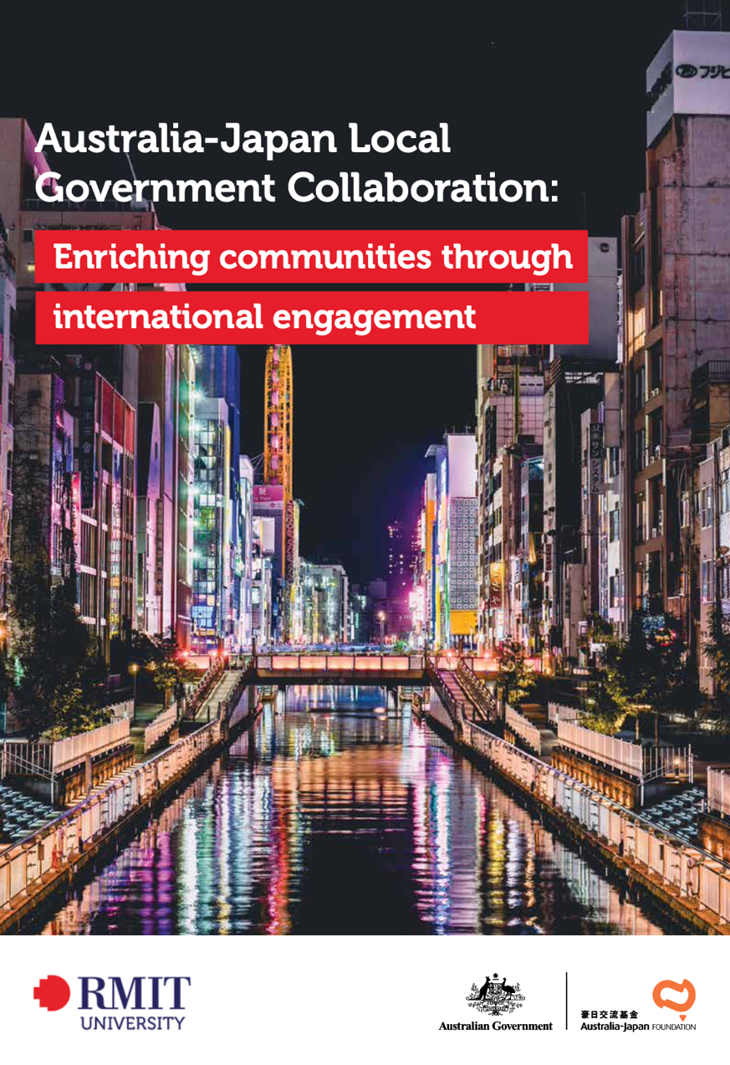
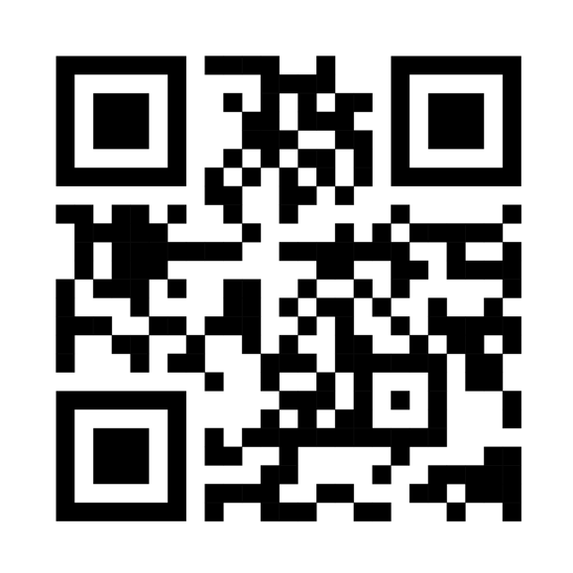
_
Thank You!
scan to download the full report
https://www.researchgate.net/publication/373041344_Australia-Japan_Local_Government_Collaboration_Enriching_Communities_through_International_Engagement
Full report

Slide 19
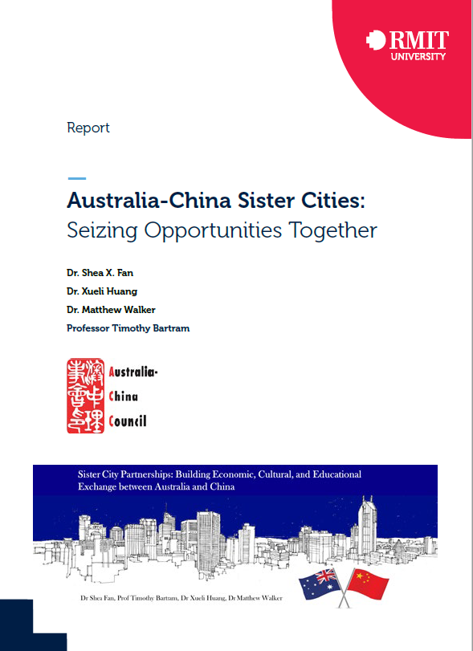
_
Full report can be downloaded from the following link
OR contact
Charlie.huang@rmit.edu.au
https://researchrepository.rmit.edu.au/esploro/outputs/9921862006701341
Full report

