Slide 1
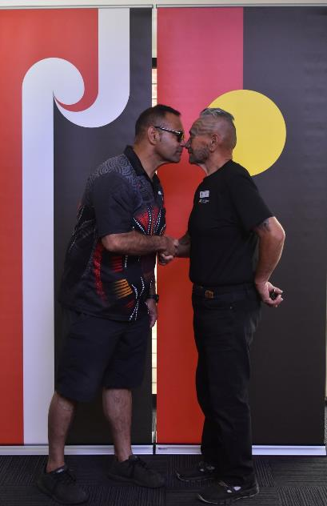
INTERNATIONAL LINKS AND SISTER CITIES
A
CASE STUDY

Slide 2
OUR PARTNERS
PORIRUA, NEW ZEALAND 1984
SUESONG- GU , SOUTH KOREA 1994
LIAOCHENG, CHINA 2003
LIVERPOOL PLAINS NSW 2005
LEAGUE OF CITIES PHILIPPINES 2010 ***
ENNISCORTHY, WEXFORD, IRELAND 2023
*** LEAGUE OF CITIES PHILIPPINES PARTNERSHIP CURRENTLY UNDER REVEIW

Slide 3
O
A QUICK OVERVIEW
Our formal Sister Cities Relationships range from 40 years to two (2) months in length. The longest in terms of years is Porirua a city in the north island of New Zealand and our most recent is the city of Enniscorthy in the County of Wexford, Ireland just 2 months old – but as you will hear in the next presentation, a relationship that was in many ways over 200 years in the making.
The Sister Cities agreement with the League of Cities formed in 2010 is now under review. An intention is underway to form a Sister City relationship with one(1) city rather than with the League of Cities – an organisation which has 149 members. After a period of research and consultation with the community a City has been identified and formal discussions will commence shortly once the local elections are completed in that City next month.

Slide 4
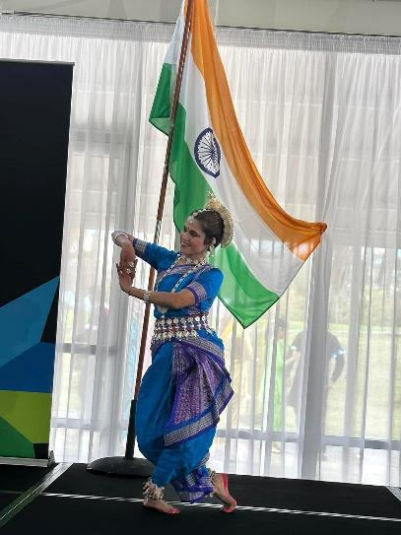
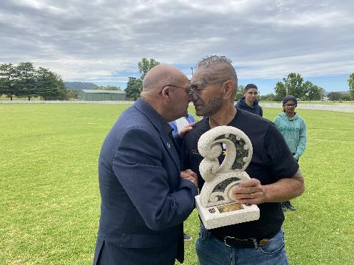
Blacktown City is arguably the world’s most multicultural city. Over 180 countries are represented by residents that now call Blacktown home. 10 000 new residents call Blacktown City home every year. To recognise the growing multicultural and demographics of our community - a decision has been made to form relationships with nations on the basis of international links – points of interest between our community and those countries of origin.
INTERNATIONAL LINKS

Slide 5
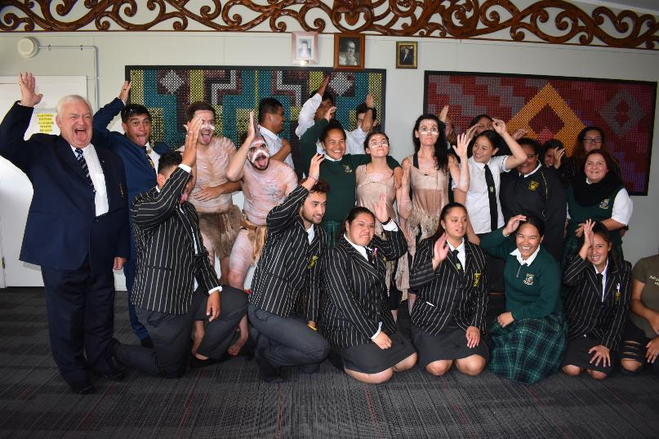
Common interest or historical links may exist within a community group or demographic where a traditional Sister Cities Agreement may not be practicable, then an International Link or Friendship arrangement may be a good start in forming a community to community relationship.
Examples may include:
Sport
Youth Ambassador Programs
Education
Medical Technology / Science Medicine
Arts
Performance
Technology
Indigenous connection
Business opportunities
Community Service Groups

Slide 6
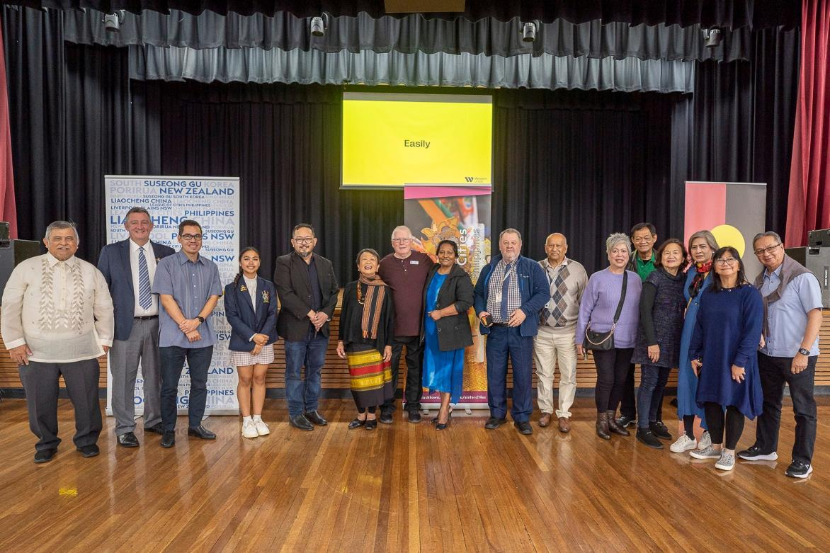
Celebrating Philippine Independence Day 2023

Slide 7
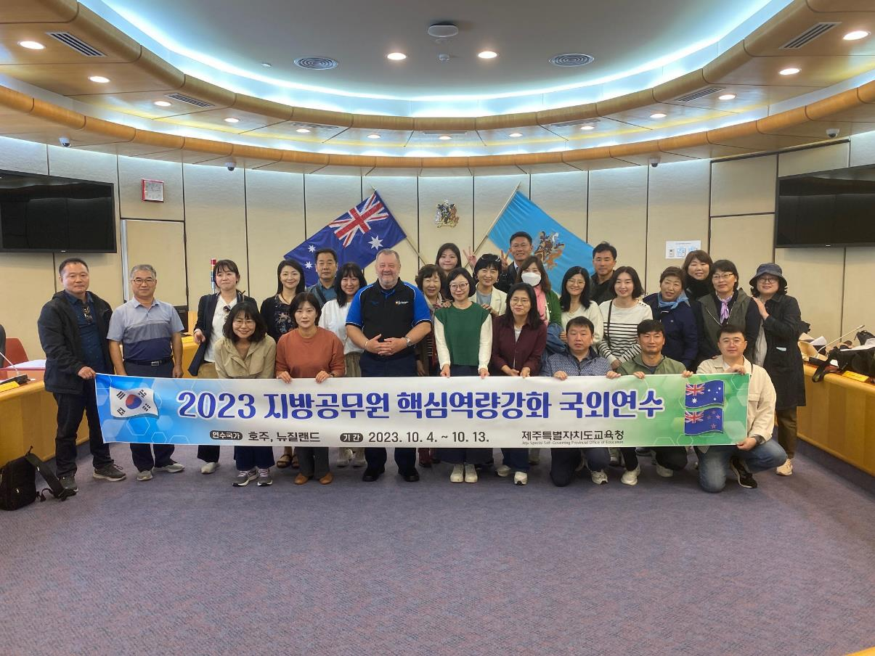
Blacktown City Council hosts over 40 Korean Delegations per year.

Slide 8
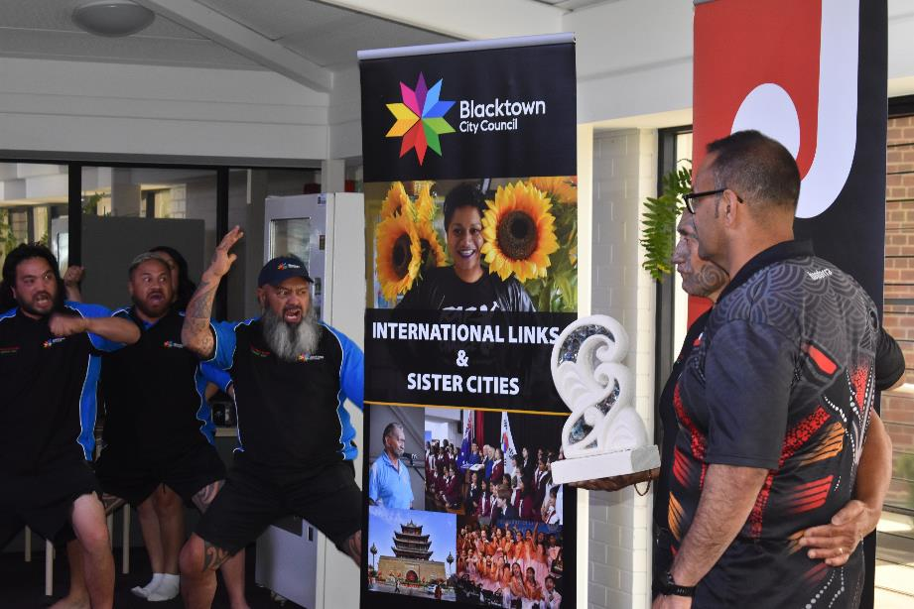
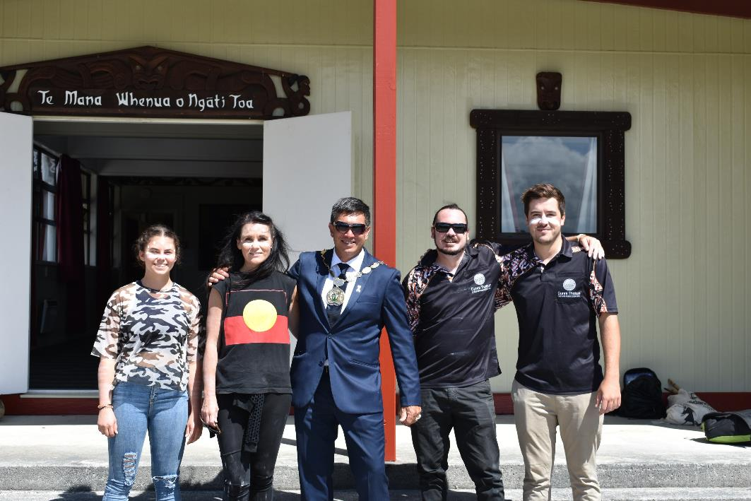
PORIRUA NZ
LIVERPOOL PLAINS NSW

Slide 9
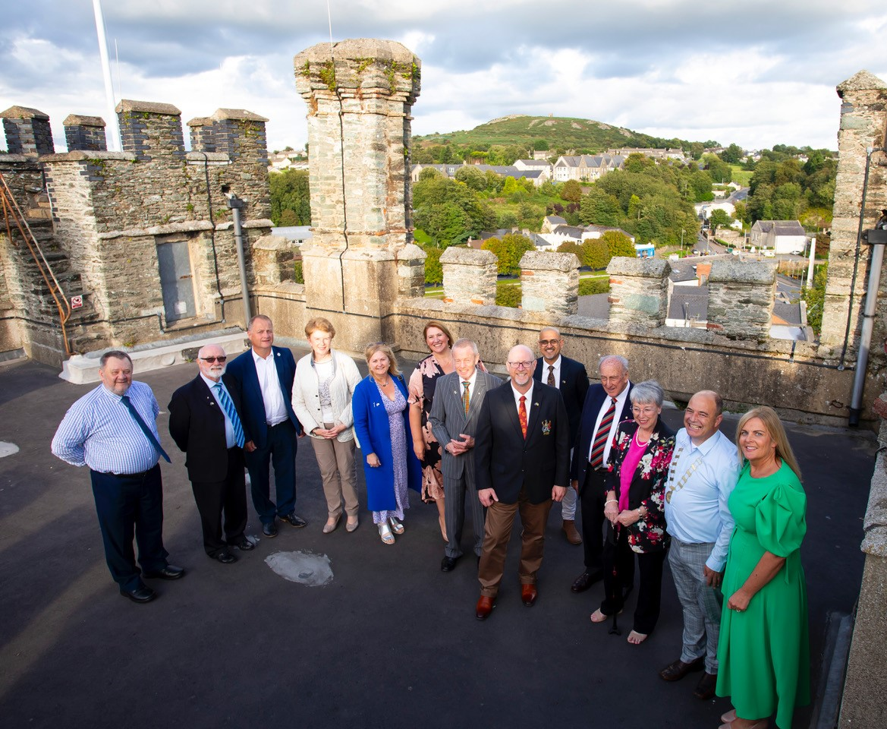
Our most recent
relationship
Enniscorthy,
Wexford
Ireland
August 2023

Slide 10
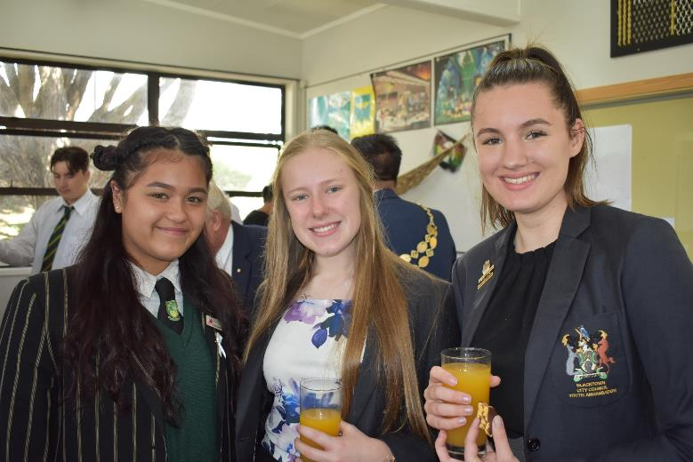
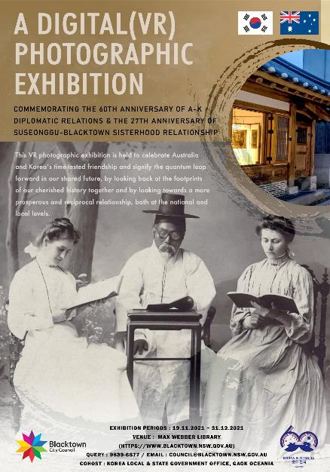
A short snapshot of our extensive International and Sister Cities Program
A TRUE COMMUNITY TO COMMUNITY FOCUSED ACTIVITY

