Slide 1
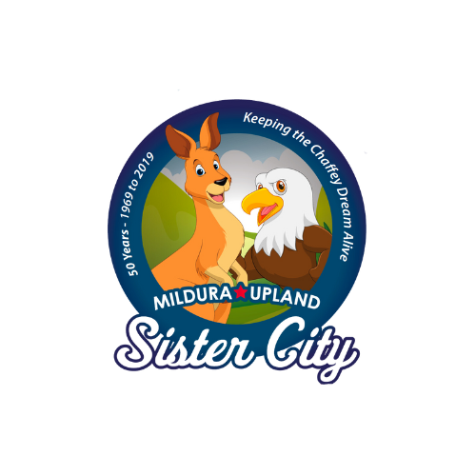
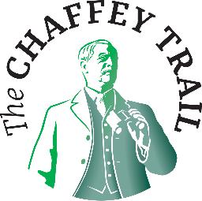
The Tale of Two Cities
Presented by Julie jewell

Slide 2
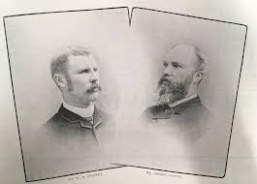
This is a story of:
Two generations of a high achieving family
Two visionary brothers
Two irrigation developments in two different continents
Two grand avenues in two sister cities
This is the Chaffey story
That became …..
Two Sister Cities

Slide 3
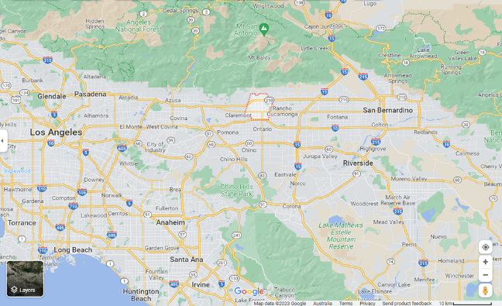
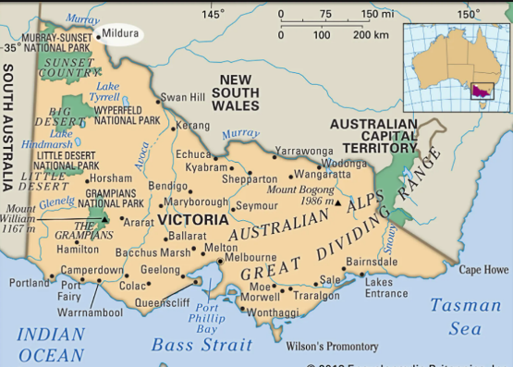
Where in the world...
Upland, 58kms east of Los Angeles
Approx 80,000 residents
Mildura, 540kms NW of Melbourne
Approx 65,000 residents
Upland

Slide 4
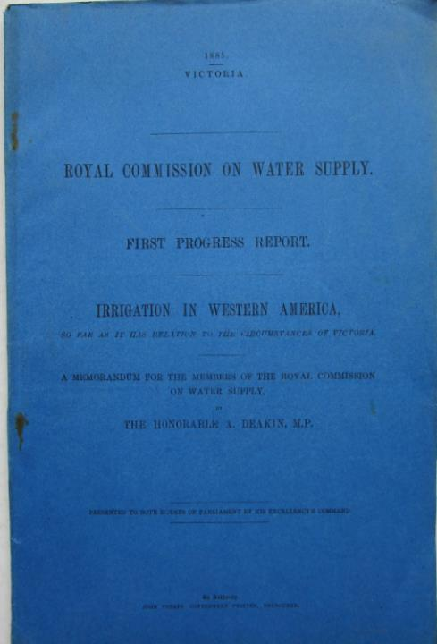
How it all began.... the link of Upland and Mildura
1884 Victoria held a Royal Commission posing the question as to ‘How do we open the Mallee (north-west Victoria)?
A deputation followed in 1885 resulted in Alfred Deakin, the then Victorian Water Minister, travelling to American to investigate how America opened the wild west
Alfred Deakin visited several places, including California and met with the Chaffey Brothers, separately, and left an open invitation to come to Victoria
In early 1886, George knocked on Alfred Deakin’s door at Parliament House, Spring Street , Melbourne
Ahead lay the extraordinary beginnings of Mildura, by the same people who founded Ontario, California.
Notes:
1884 Victoria held a Royal Commission posing the question as to ‘How do we open up the Mallee (north-west Victoria)?
A deputation followed in 1885 resulted in Alfred Deakin, the then Victorian Water Minister, travelling to American to investigate how America opened up the wild west
Alfred Deakin visited a number of places, including California and met with the Chaffey Brothers, separately, and left an open invitation to come to Victoria
In early 1886, George knocked on Alfred Deakin’s door at Parliament House, Spring Street , Melbourne
Deakin was impressed with the Chaffeys and their achievements , and the Chaffeys were sufficiently interested in Deakin's proposals to send their manager, Stephen Cureton , to Victoria in 1885. After a promising report from Cureton, George Chaffey visited Victoria in 1886 and having decided on the Mildura Run as a suitable location for an irrigation colony he sent word to his brother to sell their Californian interests (at a loss) in order to invest in this new venture.
The boldness and perspicacity of this decision can perhaps be appreciated from the following description of Chaffey's chosen location
Ahead lay the extraordinary beginnings of Mildura, by the same people who founded Ontario, California.
The Chaffey Brothers, were nether Australian or American, but from Ontario, Canada and proudly used the word ‘Ontario’ wherever they went and in 1906, North Ontario, California became a separate municipality and took the name ‘Upland’

Slide 5
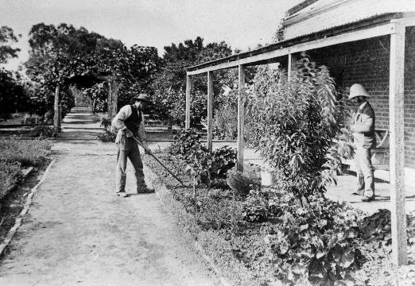
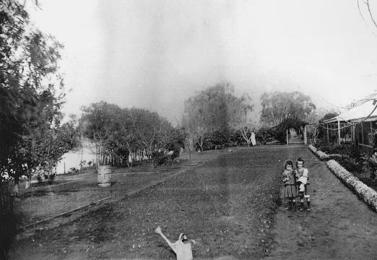
When George looked over the dry, barren, rabbit infested red sand at the Mildura Station Homestead, it is doubtful if even he could see the vision that was to unfold over the next century.
However, on seeing the homestead gardens, it is from this spot that he is believed to have uttered his prophetic words, “Someday, the whole area will look as this garden.”
Notes:
He certainly contacted “W.B” and instructed him to sell up all of their assets in California and come out.
While there is some conjecture as to whether Deakin actually officially invited the Chaffey brothers from California out to oversee its development, it is highly probable that his enthusiasm for the project caused them to come. George arrived in Melbourne on Tuesday February 26, 1886 and began negotiations which included the possibility of the land occupied by the Mildura Pastoral Lease.
The terrain at Mildura was very different to that in California. There they tunnelled into the mountain to tap into an aquafer and the water was then sent via a system of pipes to the landholders below. Mildura is a very flat place. The problem was how to raise the water high enough that it could flow downhill all to each ‘block’. And how could they store the water when the river was low?
The Chaffey Agreement was signed with the Victorian Government in October 1886 and the Indenture on May 31st 1887 establishing the first irrigation colony in Australia. A similar Act was signed in South Australia to develop the Riverland area and an irrigation colony also began to develop at Renmark under the supervision of a third brother, Charles Chaffey.

Slide 6
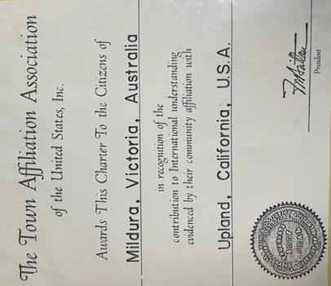
The connection: Upland instigated
Town Affiliation Agreement
In 1969, Upland’s Ian Richardson was visiting Adelaide with his work, and requested by Council to sound out a possible link with Mildura
Met with the enthusiastic Mildura Mayor, Ken Wright
Notes:
18 persons from Upland visited Mildura to celebrate Thanksgiving, the first of many groups
Mildura people, including Mayors and Councillors have enjoyed the tremendous friendship, hospitality and generosity of the Uplanders.

Slide 7
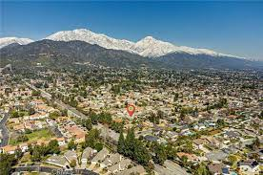
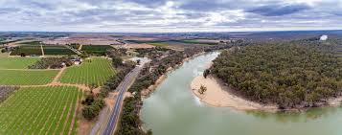
And there were differences…. …like water access
Upland
Mildura
At the Foothills of the San Antonio Mountains with wild and rugged terrain
Irrigation meant getting the water from the mountains
Situated on the Murray River with a flat terrain
Water was raised from the Murray River , constructing 3 functional power station and an elaborate of channels following the contours of the land to each ‘block’.
Notes:
Irrigation Systems – this provides the most fundamental difference between the two colonies. While the plan to provide water to each property was similar, the means of doing this was fundamentally different. In California, pipes were drilled nearly one kilometres into the mountains to tap into aquafers. The water was then sent by gravitational force in pipes to each property. In Mildura, the water was lifted by pumps from the river and then stored in a natural billabong. Two further lifts were conducted to raise the water to a high point in the district and then the water was sent through an elaborate system of channels following the contours of the land to each ‘block’. The differences in these schemes, based on the varied context of the locations, is a true testament to the genius of George Chaffey.
The engineering genius of George Chaffey helped to create a unique three-lift irrigation system. George Chaffey designed the Psyche Bend pump in 1889. It was based on the design for a paddle steamer engine. It was built by Tangye’s in England. It used four 1 metre diameter pipes which sent up to 670 tons a minute of water into Kings Billabong. A natural billabong, this was extended and a channel constructed at one end and a dam bank at the other. At the Billabong, the water was lifted by a similar pump, at 30,000 gallons a minute into the 50 foot (18 metre). This channel took the water several kilometres to Nichols Point. At Nichols Point Station, the water was further lifted to 70, 85, and 92 (30 metres) feet and sent by gravity throughout the district. When we look at the plan of the settlement we see that there were over 500 kms (a distance from Mildura to Melbourne) of earthen channels all running along the contours of the land to each ‘block’.

Slide 8
Chaffey homes
Garcia House, Upland
Rio Vista, Mildura
Notes:
click photo to enlargeThis house is about 6 or so miles from where we live and it has taken 12 years to finally get there. <grin> It is only open one Saturday a month and between volunteer work and other things we just never seem to get there. It was the first house built in Etiwanda in 1874 and was owned by a retired Sea Captain, Joseph Garcia. In 1883 the Chaffy brothers George and William went by horseback from Riverside to Etiwanda to purchase the house and the 560 acre sheep farm. Being on an alluvial fan meant there was fertile soil and water.
On the back of the property they have built a replica of the barn that used to be there. In this barn they have a lot of historical displays and in one room they have built a reproduction of what the Etiwanda General store looked like, complete with many replicas of items that would have been for sale. The Historical Society is presently working on the restoration of the Chaffey-Isle House, a sister house built by George Chaffey Jr. for his mother and sister in 1884. This is the picture directly below.

Slide 9
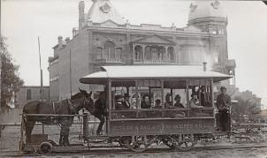
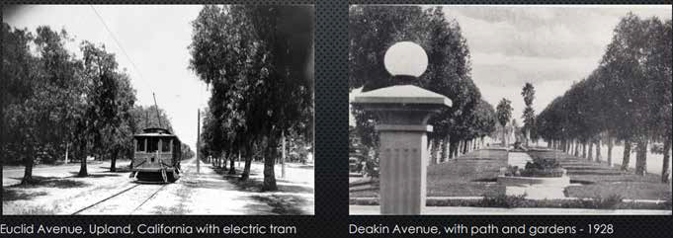
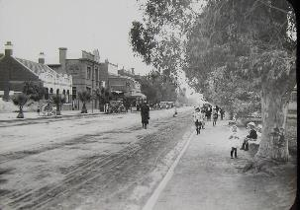
Euclid Avenue, Upland and Deakin Avenue, Mildura
The layout of the Mildura township, with its grid road system is modelled on Euclid Avenue with a prominent tree lined avenue comprising of two carriageways.
Notes:
Starting from bare ground, without a blade of grass in some area’s
The layout of the Mildura township, with its grid road system is modelled on Euclid Avenue in Upland, California with a prominent tree lined avenue comprising of two carriageways. The original proposal similar to Upland, was for an electric tramway to run up and down the centre median to the proposed township of Irymple 12km to the south. This tramway did not eventuate however, allowing the avenue to be fully planted within the City limits.
Upland's most distinctive feature is the 200-foot-wide Euclid Avenue, which runs the length of the city from north to south. Fascinated with geometry, George Chaffey designed Euclid with cross streets planned precisely one-quarter mile apart from each other. In the early days, Euclid was home to a trolley called the "gravity mule car." Mules hauled passengers uphill, then placed on
a trolley and rode downhill behind the car. An electric trolley replaced the mules in 1895. Euclid Avenue early plantings - Circa early 1900’s Conveyances were provided by the Messrs' Chaffey and by Mr Williams. The party proceeded down Deakin Avenue, a 3-chain street, forming the principal thoroughfare of the town. And which continues on through the rural district to a total distance of 5 miles and a half, and is intended to be continued right through the irrigation colony. So far as yet laid out, it has been grubbed and cleared it full width, rendered passable for traffic, and planted with four rows of trees – two of Moreton Bay fig, enclosing an avenue, and two of South Australian sugar gums, separating the sideways from the portion intended for vehicles.

Slide 10
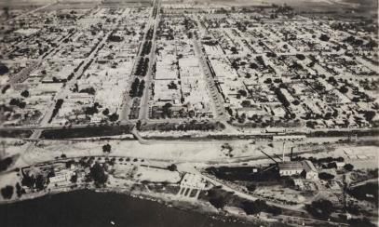
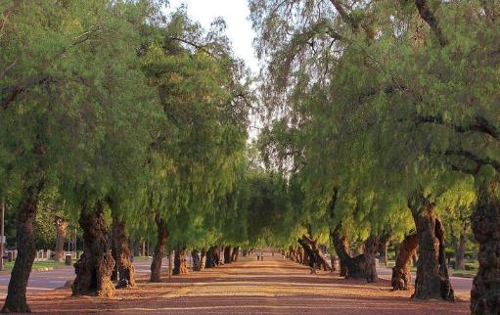
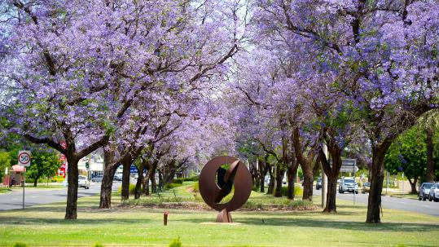
Euclid Avenue, Upland
Deakin Avenue, Mildura
1898
c1950
Notes:
No one could miss the similarities between Euclid Avenue and Deakin Avenue. All width measurements and virtually the same with a similar centre plantation in ach. The reason for this was obvious, WB Chaffey, usually known as WB ) was responsible for both .
The town also began to develop along a similar grid plan as that used in Ontario with named avenues and numbered streets intersecting at right angles. The main street design in exact dimensions was replicated as Deakin Avenue,
In Upland, a horse drawn tramcar rana the length of the Euclid Avenue plantation and WB ordinally intended something similar in Mildura, linking the river at lease as far as Crossroads (15th St) Although this was never build, it left us with an astonishing beautiful entranceway
Back in California, the town of Upland (previously known as Magnolia and Ontario North) was proclaimed in 1906. It was one of the cities located on the National Old Trails Road which was the first coast to coast highway. The westernmost of twelve statues of the ‘Madonna of the Trail’ is located at the intersection of Foothill Boulevard and Euclid Avenue. The trail is now known as Route 66 and is visited annually by millions of travelers from around the world.

Slide 11
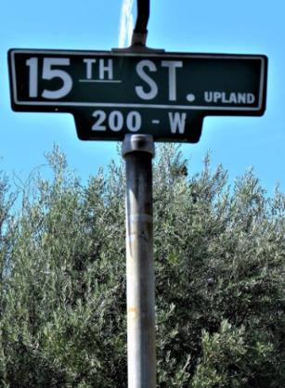
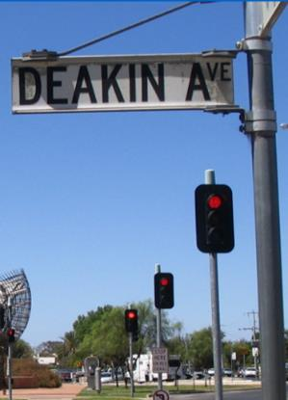
Avenues and Streets
The Avenues have names,
including Euclid in Upland and Deakin in Mildura
Upland Streets have numbers,
like Mildura
Notes:
He certainly contacted “W.B” and instructed him to sell up all of their assets in California and come out.
While there is some conjecture as to whether Deakin actually officially invited the Chaffey brothers from California out to oversee its development, it is highly probable that his enthusiasm for the project caused them to come. George arrived in Melbourne on Tuesday February 26, 1886 and began negotiations which included the possibility of the land occupied by the Mildura Pastoral Lease.
The terrain at Mildura was very different to that in California. There they tunnelled into the mountain to tap into an aquafer and the water was then sent via a system of pipes to the landholders below. Mildura is a very flat place. The problem was how to raise the water high enough that it could flow downhill all to each ‘block’. And how could they store the water when the river was low?
The Chaffey Agreement was signed with the Victorian Government in October 1886 and the Indenture on May 31st 1887 establishing the first irrigation colony in Australia. A similar Act was signed in South Australia to develop the Riverland area and an irrigation colony also began to develop at Renmark under the supervision of a third brother, Charles Chaffey.

Slide 12
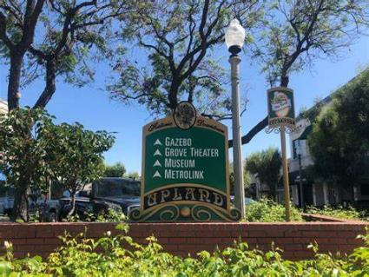
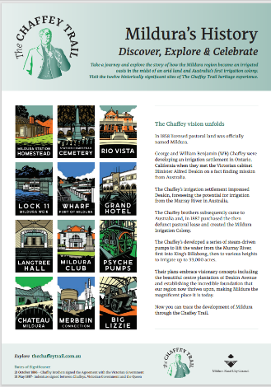
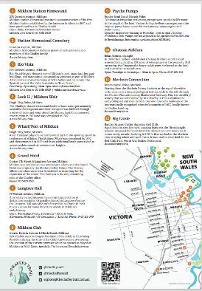
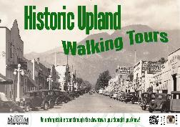
Preserving History
Upland, preservation in a historic district
Mildura has developed the Chaffey Trail connecting 12 historic sites

Slide 13
Historic Displays
Psyche Pumps ‘Chaffey Engine’ is still working at Psyche Bend, Mildura
Mule Tram display on Euclid Avenue - Upland

Slide 14
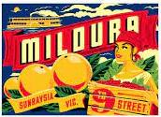
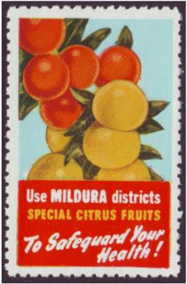
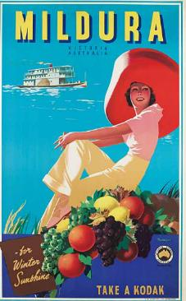
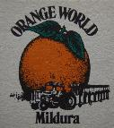
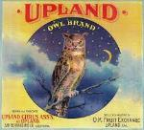
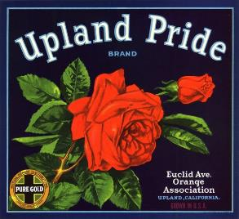
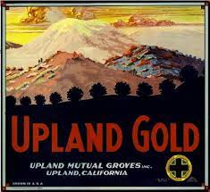
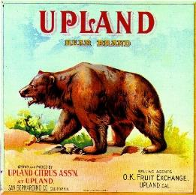
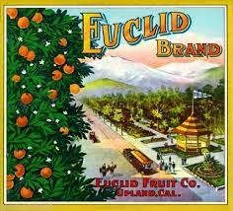
The citrus industry established by the Chaffey Brothers continued to thrive as the major industry well into the 1940’s.
Notes:
After World War 11 however, land prices began to skyrocket and growers began to sell their land to developers for residential development. In 1954 the San Bernardino Freeway to Los Angeles was completed, accelerating the transition of Upland from a rural, citrus growing to a residential and commercial community. In the National census of 2010 the population was calculated at 73, 732.
As indicated, the district is still associated with horticulture. Murray River tourism is also a major industry and the Chaffey Trail is a feature attraction.

Slide 15
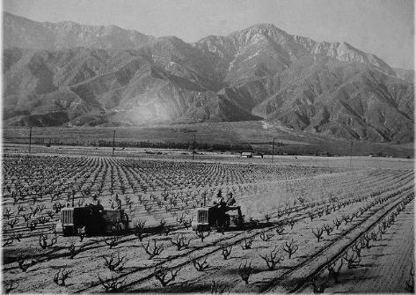
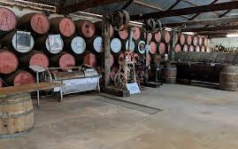
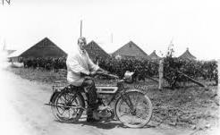
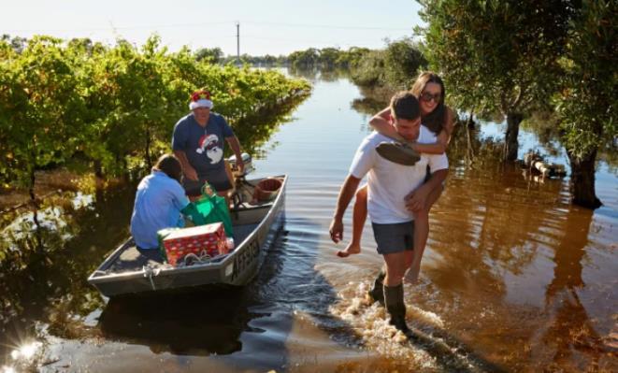
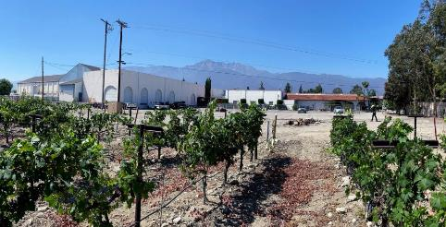
Vineyards
Upland
Mildura
Notes:
The citrus industry established by the Chaffey Brothers continued to thrive as the major industry well into the 1940’s. After World War 11 however, land prices began to skyrocket and growers began to sell their land to developers for residential development. In 1954 the San Bernardino Freeway to Los Angeles was completed, accelerating the transition of Upland from a rural, citrus growing to a residential and commercial community
The Chaffeys in California
In 1890 the Chaffey family vacationed in Riverside, California. When George saw the orange groves he was inspired: irrigation appealed to him so strongly that he rapidly absorbed its basic principles and thought of more.
George was ahead of his time in many fields and had a creative faculty that few men in world history can claim. He was a pathfinder in hydro-electricity engineering. As a promoter and president of an electricity company, he gave Los Angeles the original light and power plant, making it the first city in America to be electrically lit throughout. He was also a visionary who, as he stood on a ridge in a howling wilderness he could clearly envisage the city he was to himself build, complete to the fountain in the square.
William Benjamin (W.B.) had devoted himself to the study of horticulture and land selection. He also demonstrated a keen business instinct. They formed a partnership that became known as “The Chaffey Brothers” or simply “The Chaffeys”. Together they conceived a simple scheme of colonisation: to buy land, provide water for irrigation, prepare and sell ‘blocks’ on time payment and use the profit gained in further development then realize it on real estate.
Their first venture was Etiwanda named after a beloved old Indian Chief and family friend from their Canadian homeland. On Thanksgiving Day 1881, they bought 1500 acres of land, the house and water rights of the old Garcia Ranch out on the Santa Fe Trail. While George was busy directing two or three rivers in the nearby ranges through concrete pipes four miles to the orchards, W.B. laid out the land, supervised the sales on time-payment and oversaw the cultivation process. Within a year 1400 of the 1500 acres were occupied.

Slide 16
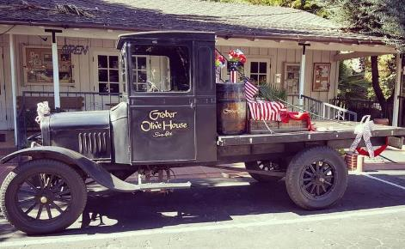
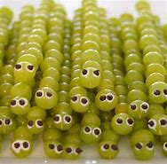
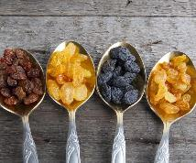
Other produce of the colonies
Dried fruit to wine and olives and so much more

Slide 17
Similarities ….
Upland – George Chaffey
Mildura – WB Chaffey
Notes:
George Chaffey out the front of Upland Council – Euclid Avenue
WB Chaffey in Deakin Avenue, front of CouncilOffices

Slide 18
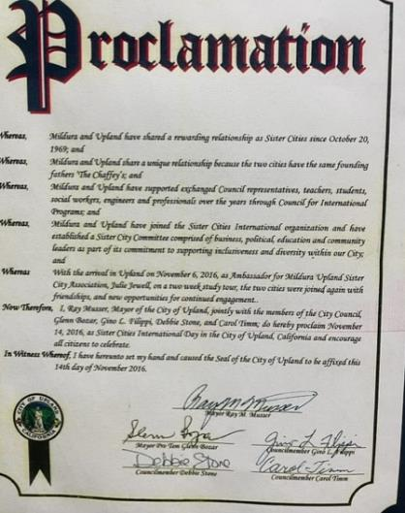
Both were founded as model irrigation colonies and shares their history in the horticultural industry.
The sister city relationship goes back to the 1960’s with reciprocal visits by citizens of both settlements.
In 1969 a charter of friendship was signed to foster mutual friendship and exchange between the two cities
14 November 2016, Upland City Council made a declaration for an international Sister Cities day in honour of our visit
Notes:
The Chaffey Brothers, were nether Australian or American, but from Ontario, Canada and proudly used the word ‘Ontario’ wherever they went and in 1906, North Ontario, California became a separate municipality and took the name ‘Upland’

Slide 19
Proudly embracing our Upland Sister City relationships
Active organisation
Conducts regular meetings
Hosts a range of events including support for Mildura Day
continues to celebrate the shared heritage with Upland
In 2019 celebrated the fiftieth anniversary of the relationship and a weeklong series of events including a reciprocal visit
Plans to approach the City of Brockville with a view to establishing a sister city relationship
Notes:
Today, the Mildura/Upland Sister City is a vibrant organization and conducts regular meetings, a range of activities including support for Mildura Day and continues to celebrate the shared heritage with Upland.
In 2019 the sister cities celebrated the fiftieth anniversary of the relationship and a series of events including reciprocal visits being planned.
There are also plans to approach the City of Brockville with a view to establishing a sister city relationship

Slide 20
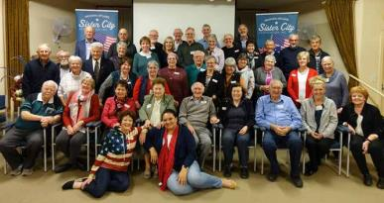

Slide 21
50 years to celebratory visits…
Mildura Day 31 May
Upland Sister City Agreement 20 Oct ‘69
So much to celebrate, we produced a 100 page book on our history, our celebrations, our exchanges and shared a few recipes. We launched time book simultaneously using Zoom – with books being shipped to Upland and unveiled at the launch. It was self-funded.

Slide 22
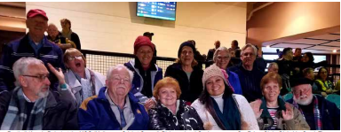
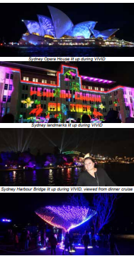
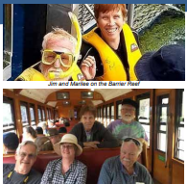
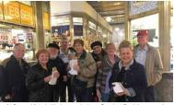
Extended tour of Australia
14 guests on a 6 day tour inclusive package
2 days Sydney during Vivid
- Bridge climb
- Dinner harbor cruise
2 days in Cairns/Port Douglas
- Reef cruise,
- Kuranda scenic sky rail
2 days in Melbourne
- MCG Football game
- Queen Victoria Market
Coordinated by Mildura Sister City members and accompanied by the President and his wife joined by other members at times

Slide 23
The Tale of Two Cities
Thank you for keeping the Chaffey Trail alive
Presented by Julie jewell

