Slide 1
Alphington Grammar School
Sister City Relationships
Queens Hall,
Parliament House
Wednesday 18 July, 2018
Dr Vivianne Nikou

Slide 2
“Step into the classroom you know and discover the world you don’t”.

Slide 3
Alphington Grammar School Motto
“Aspiring to Excellence”
Non denominational
Academic excellence
Respecting cultural diversity

Slide 4

Decades of fostering
A wonderful sense of openness, cultural awareness;
Strong sense of self belief;
Responsible citizenship;
Community;
Contributing to a globally sustainable future

Slide 5

Aim
Build vital lifelong skills and attributes which allow for deeper cross cultural understanding both in Australia and overseas;
Embed opportunities into our curriculum offerings to encourage our students to build knowledge, skills, understanding and behaviours which will help them develop into active informed global citizens.

Slide 6

The Global Gateways Program designed along major interconnected themes for Years 9 and 10 is part of a two year cycle of approaching international education.
Enabling young people to participate in shaping a better shared future is at the heart of global education.
Students learn to take responsibility for their actions, respect and value diversity and see themselves as global citizens who can contribute to a more peaceful, just and sustainable world.
Experiential program that is a progression of skills from middle primary years to upper secondary.

Slide 7
Developing Global Citizens
(Stages of Learning)
Throughout their learning, students progressively develop knowledge, skills and behaviours that support them to develop into active and informed global citizens.
From Foundation to Year 4 students connect with others through their family, school and local community. They come to understand cultural similarities and differences.
During Years 5-8 students become increasingly aware of national events, environmental, social and political issues, and international events and crises.
Through these, they evaluate their role as a global citizen.
In Years 9-10 they have greater awareness of political, legal, national and international issues and consider their roles and responsibilities as global citizens.

Slide 8
Sister School Projects
Kormilda College – Darwin
First High School of Voula – Athens
Music School of Larissa
The Hellenic American Educational Foundation (Psychico College) Athens
Dinghuili Primary School – Bejing
Yangpu Private Primary School - Shanghai

Slide 9
1. Start up / Set up
Mou’s between Principals, Local Governments, School Council, Greek Community
Willing staff – failure not an option!!
Parent information evenings
Project based initial introductions
  Self
  Hobbies
  Family
  City and lifestyle
Skype sessions and video exchanges
Use of Dropbox, Messenger and WhatsApp
Diaries and topics to share
Cross age peer and buddy system

Slide 10
2. Face to Face contact
Willing staff – failure is not an option!!
Preparing for contact and logistics
Duty of care
Robust procedures and processes
Travel arrangements, insurance, risk management
Medical and Legal
Hotel v’s Homestay
Budgets
Funding / financial support / sponsors

Slide 11
3. Challenges
Program (academic vs leisure and tourism)
Culture shock
Homesickness
Language barriers
Lifestyle cost differential

Slide 12
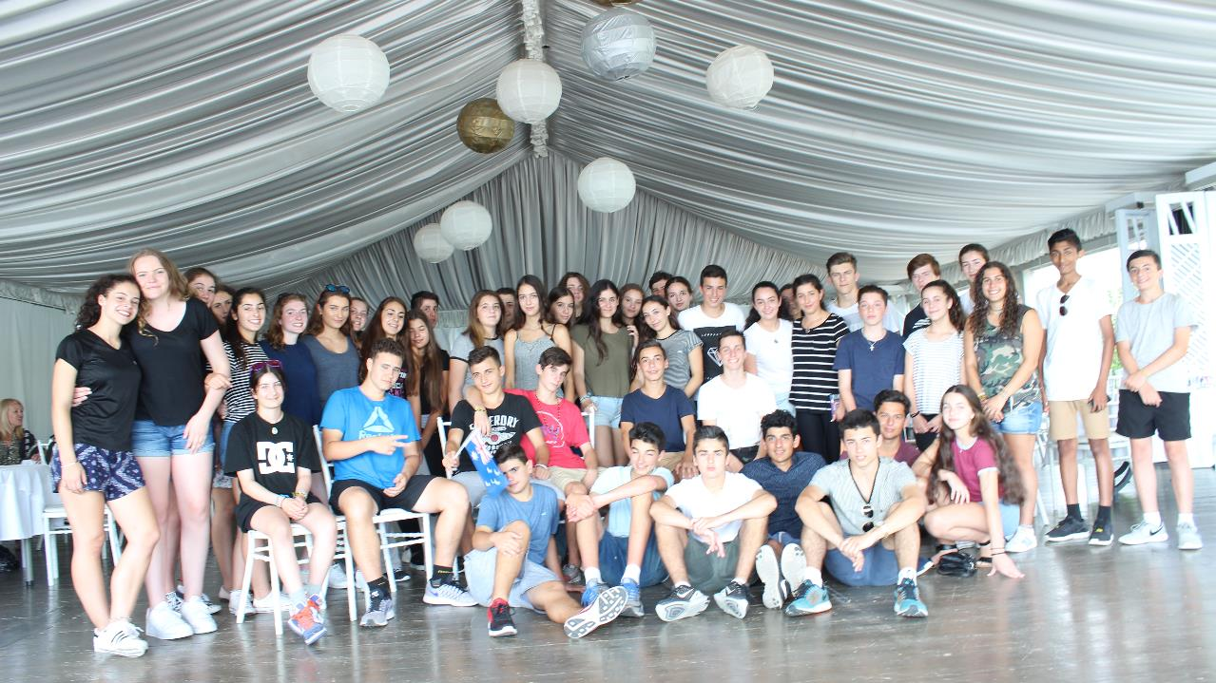
Benefits
Develops independence
Resilience
Creativity
Personal Growth
Maturity
Identity
Self awareness
Social competencies
Ambassadorship
Cultural understanding
Further travel / study
Employment opportunities
Community service opportunities

Slide 13
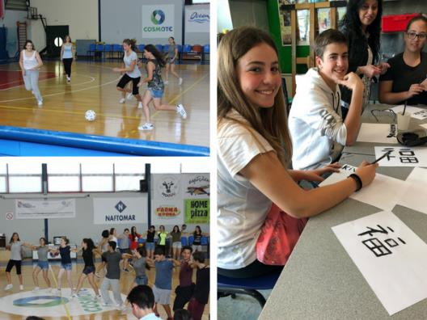
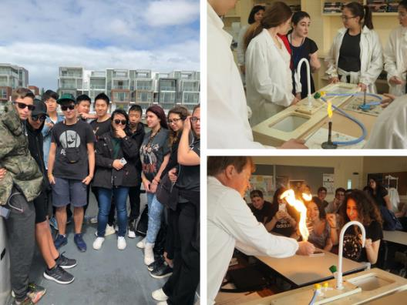
Bringing youth together
Cross cultural understanding

