Slide 1
Creating Value
Sister City Engagement and Activation
NingNing Zhang
Chair of Bendigo Sister City Committee
Managing Co-Director of Global City Connect

Slide 2
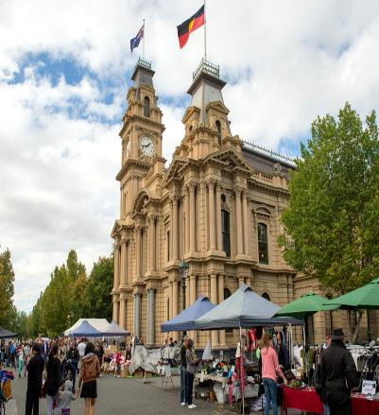
Bendigo Sister Cities Committee
VISION: Linking Bendigo to the cities of the world.
VALUES:
Cultural Awareness and Understanding
Cooperation
Mutual Benefit
Los Altos, established in 1987, California, USA.
St Just, established in 2006, United Kingdom
Haimen, established in 2014, Jiangsu Province, China.

Slide 3
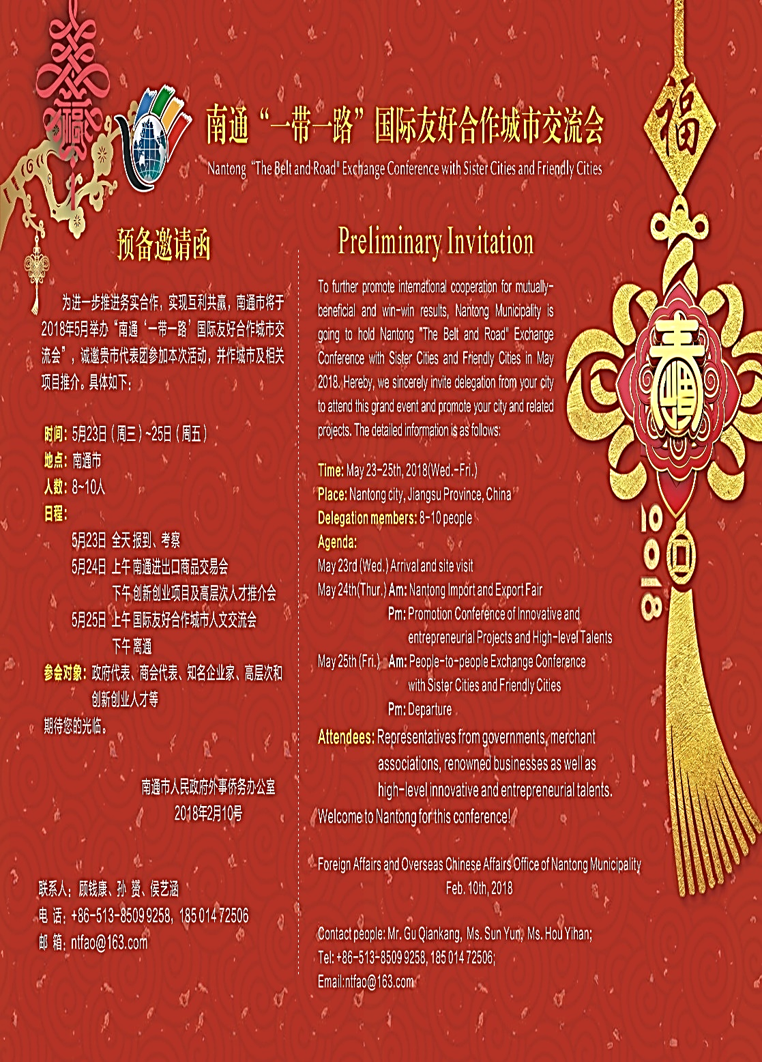
Major Achievements
Jun 2016 Strategic Plan 16-19
Jan 2017 New Branding and Communication Plan
Feb 2017 Bendigo delegation to China
Jul 2017 Inbound provincial infrastructure delegation – Ravenswood Intersection
Oct 2017 Outbound delegation to Selangor Malaysia
Dec 2017 Inbound delegation from City of Ningbo
Jan 2018 Conference Keynote speaker about Business Diversity by Hebei Provincial Chamber of Commerce
May 2018 One-belt-one-road International Sister City Conference

Slide 4
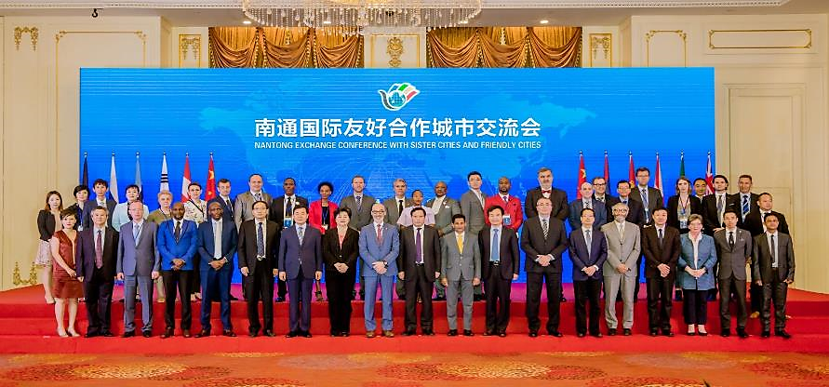
May 2018 One-Belt-One-Road International Sister City Conference
Nantong- China

Slide 5
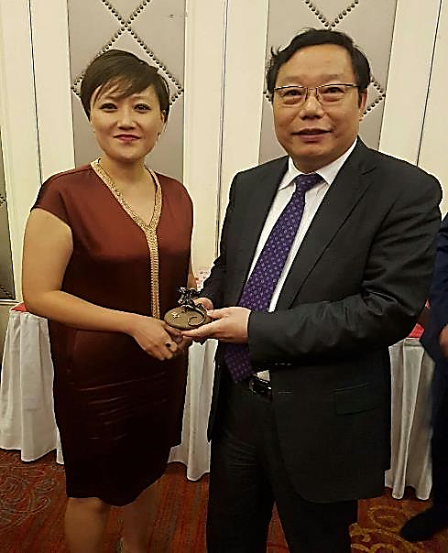
Overview of the Conference
Nantong Vocational Education College of Science & Technology
Nantong No. 2 Middle School
Nantong Alphay Bio Technology
Haohe Scenic Area
Nantong Economic Technological
Development Area
Nantong Museum
People-to-people exchange conference

Slide 6
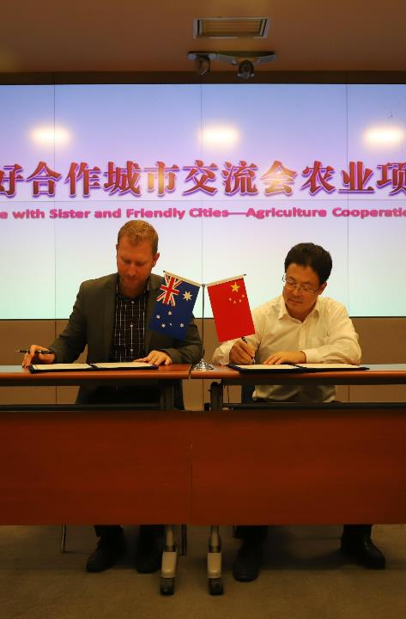
MOU’s Signed
Global City Connect Australia and Agriculture Commission of Nantong City, China on the development of Modern Agriculture.
St. Peters No. 376 Middle School and No 02 Middle School Nantong, China on the Education Exchange
Vacoas -Phoenix, Mauritius And Jiangsu Alphay Bio Technology Co., Ltd. on Paratheatrical Product Development
Siena Foreign Language University and Jiangsu Arts and Technology Vocational College on Student and Teacher Exchange and Cooperation in College Establishment
Gimei City, South Korea and City of Nantong Sports Bureau on Physical Education Development and Applications for Communities
Swansea City AFC, Swansea, Wales, the United Kingdom and Nantong Zhiyun Football Club, Nantong, Jiangsu Province, China
Business Promotion Co., Ltd., Duchy of Lauenburg, Federal Republic of Germany And Haimen Industrial Park, People's Republic of China

Slide 7
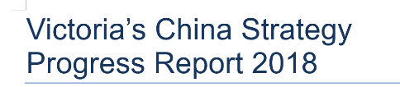
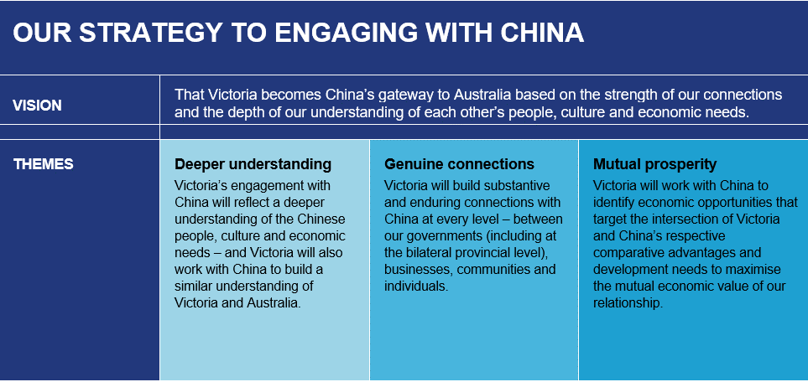

Slide 8
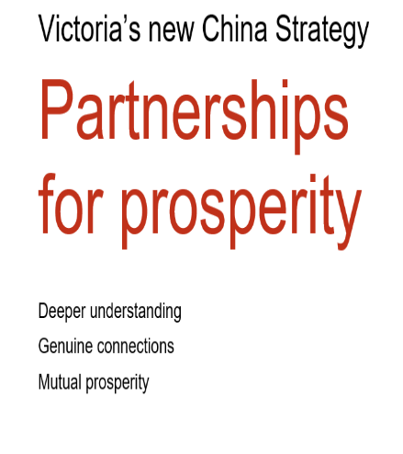
Key Outcomes
More Investment and Jobs
More Trade
More Visitors
More Students

Slide 9
1. Relationships
City to City Relationships
Strategic Research
- Based on our Industry Capacity and their Market Alignment
- NOT Size of Population

Slide 10
2. Engagement
Inbound/Outbound Delegation visits
Clearly define the purpose, goals and outcomes of each visit
International Events
  Introduce industry, businesses and stakeholders
    Sister City Conference
    Agriculture Congress
    Sporting event

Slide 11
3. Activation
Industry / Business specific MOUs
Innovation
Education
Agribusiness
Tourism
Who activates your opportunities?
Consultant
Internal Team
Advisory Committee

Slide 12
Connect. Engage. Activate
Thank You
NingNing Zhang
Managing Co-Director
Global City Connect
0447743809
www.globalcityconnect.org
md@globalcityconnect.org

