Slide 1
Frankston - Susono
Our
Community Based
Sister City Relationship
Mayor Cr Colin Hampton
Chairperson Peter Patterson

Slide 2
Background
Proclamation between cities signed 22 February 1982.
Instigated by Yazaki (Australian Arrow) in Susono and Frankston
Managed by community volunteers in both cities:
Frankston Susono Friendship Association (FSFA)
Susono Overseas Friendship Association (SOFA)
Activities supported and funded by respective Councils
36 years of active and sustained effort by many in both cities and beyond.

Slide 4
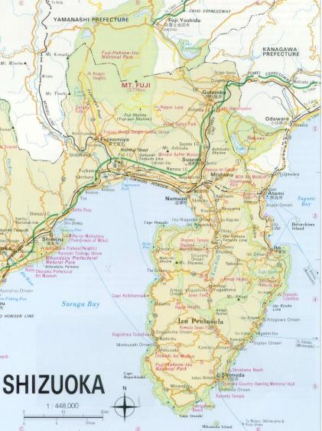
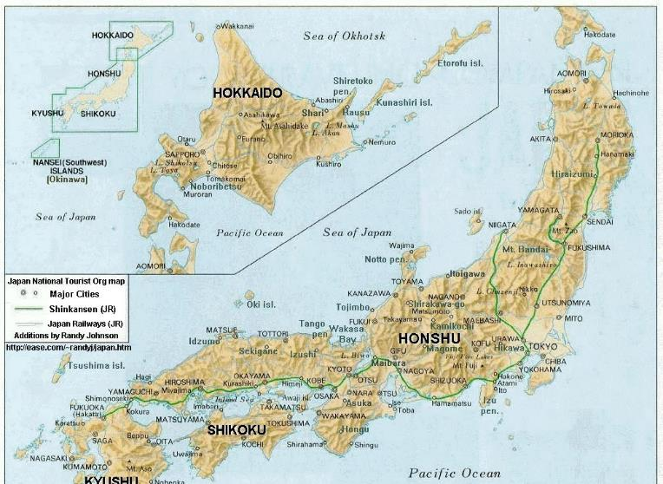
Susono

Slide 5
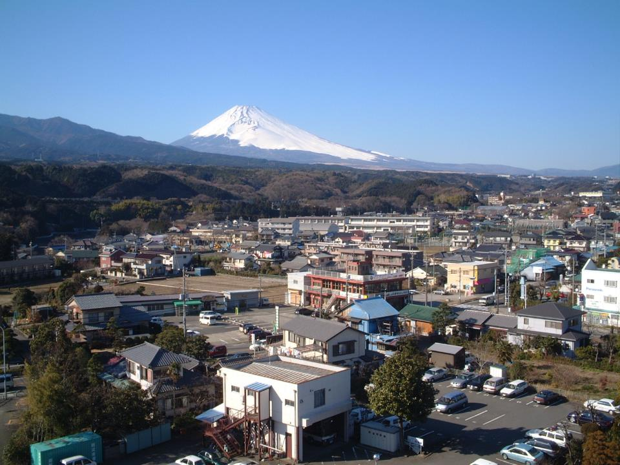

Slide 6
Our Role (FSFA)
Enable people in the Frankston region to experience another culture;
Promote and celebrate Japanese culture through performances, displays and exhibitions
Create opportunities to promote Frankston and give our citizens life changing experiences
Develop local students through cultural exchanges and support of Japanese learning programs in local schools
Develop and foster relationships with Japanese related organisations and businesses.
Promote travel to and from Japan;
Maintain a deep and sustainable relationship with Susono.

Slide 7
The Recipe -The ingredients
Long-serving volunteers who are Passionate and Committed.
We want to do it rather than have to.
Most of us have a connection to and/or an understanding of Japan
Think outside the boundaries both physically and mentally
Operate on the “Onion” principle. ie Small group to manage day to day and helpers when needed
Centre of Excellence for “Japanese matters” in the region
Strong relationship with local schools – more than 26 schools in the greater Frankston Region are teaching Japanese.

Slide 8
The long haul –
36 years and still going strong
Activities that motivate and encourage our volunteers;
Visible and engaging eg active social media presence
Run regular Community awareness activities. Eg cultural Fair held in one city. Each sends a delegation to the host city;
Sustained relationships in the broader community
Have regular contact with our Sister city
Find inventive ways of promoting sister city relationship
Jointly acknowledge and Celebrate our Successes
Always look to the future but not forget the past.

Slide 9
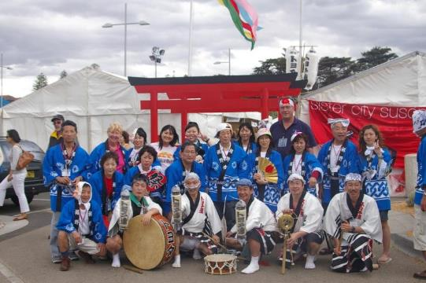
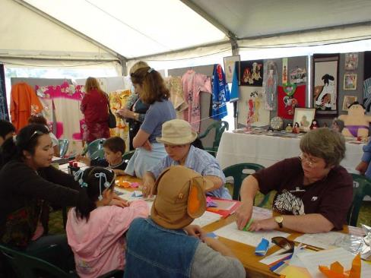
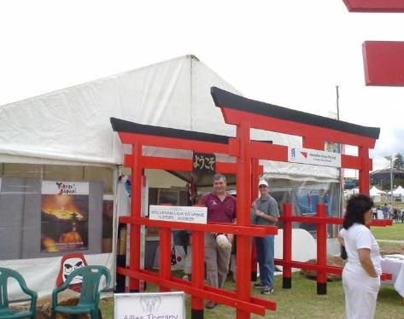
Waterfront Festival

Slide 10
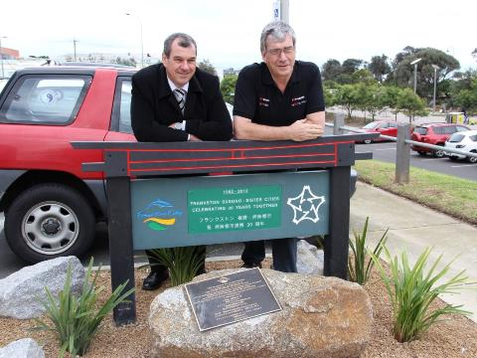
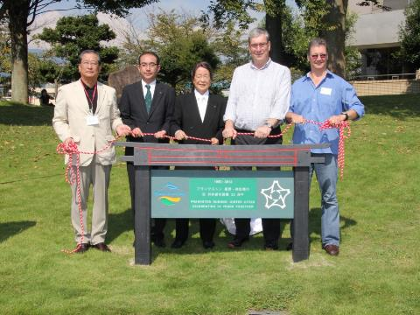
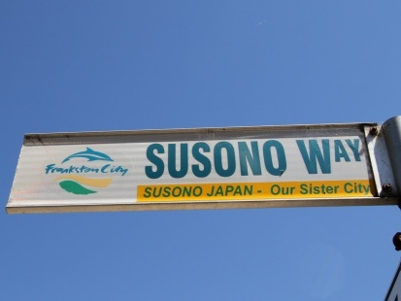
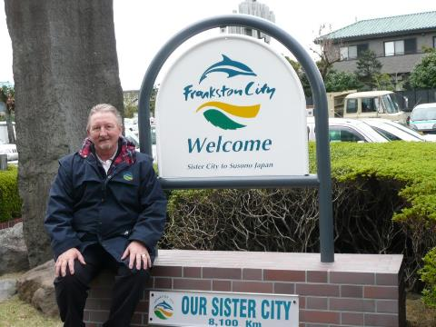

Slide 11
What we do
Annual Japanese Speech Contest – 80 Plus Primary and Secondary school students Language participate. We use local Japanese native speakers as judges.
Bi annual Japanese Festival with emphasis on youth activities.
4 yearly delegation visits to Japan
Hosting short term visits from Susono – giving students an insight into our culture
Loaning resources to local schools to support cultural activities

Slide 12
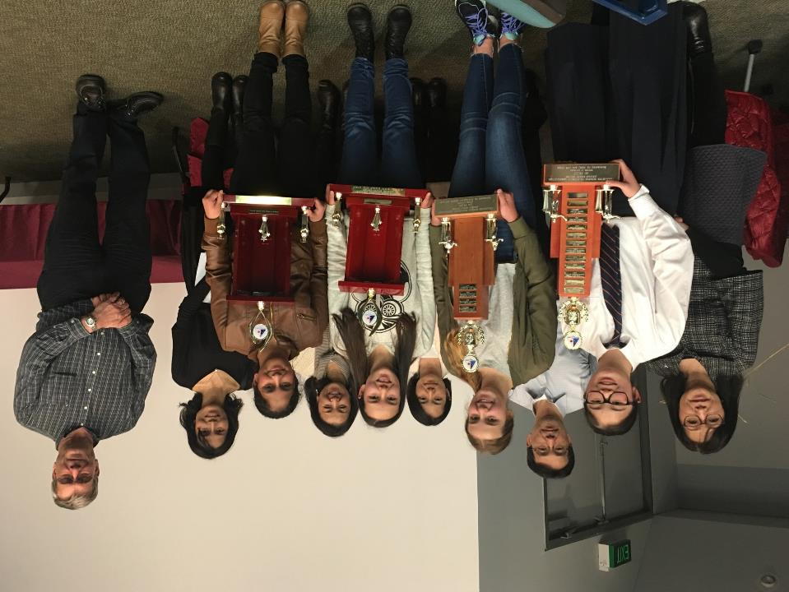

Slide 13
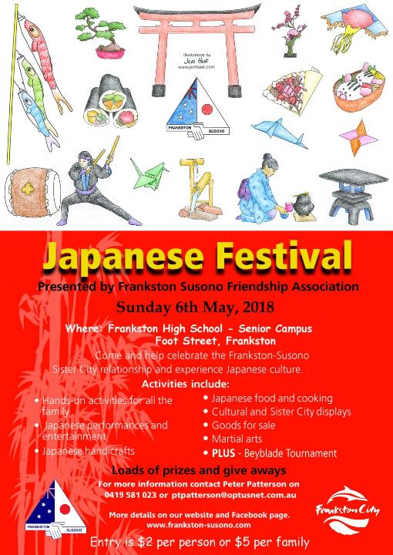

Slide 14
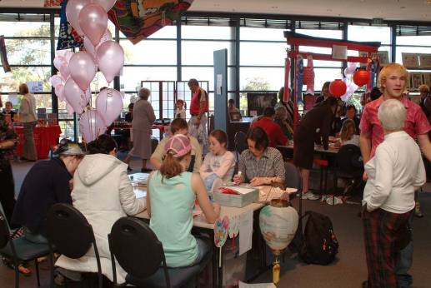
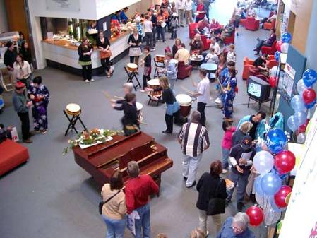
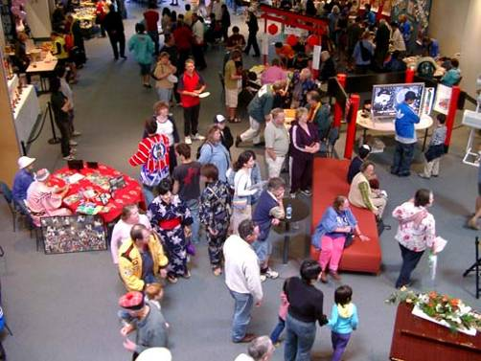
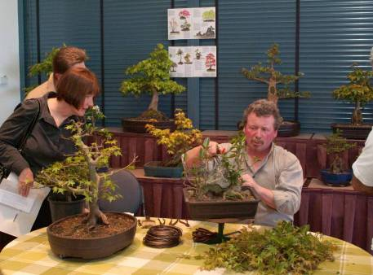
Japanese Cultural Fairs

Slide 15
What we also do
Maintain the Frankston Susono Japanese Garden at Frankston High School – Now Japanese style gardens in a number of local primary and secondary schools.
Recruit for a Susono Community Teaching Position
Built sound relationship with Japanese Organisations – eg Consul General, Japanese businesses, local Japanese Community.

Slide 16
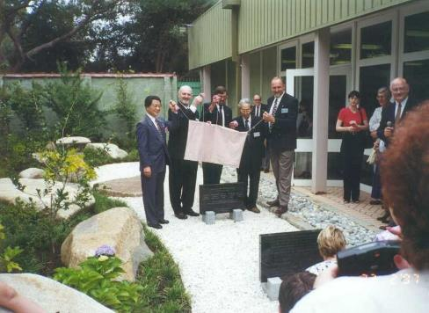
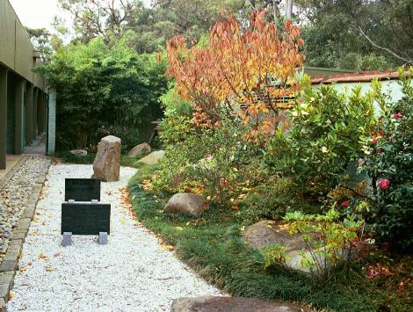
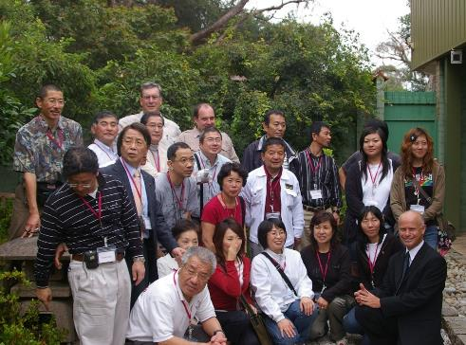
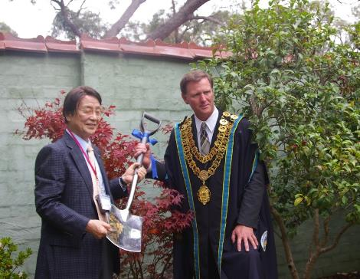

Slide 17
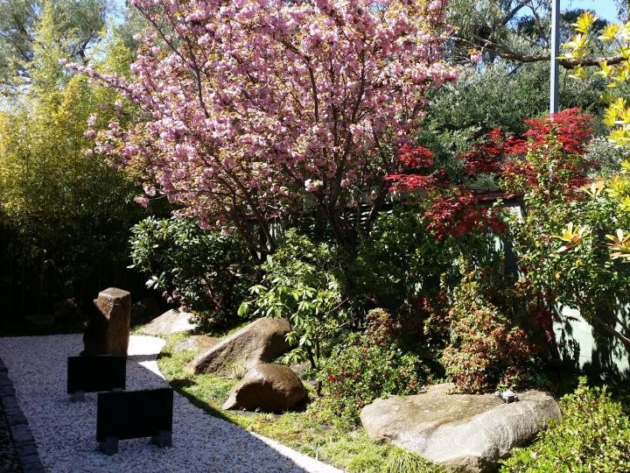

Slide 18
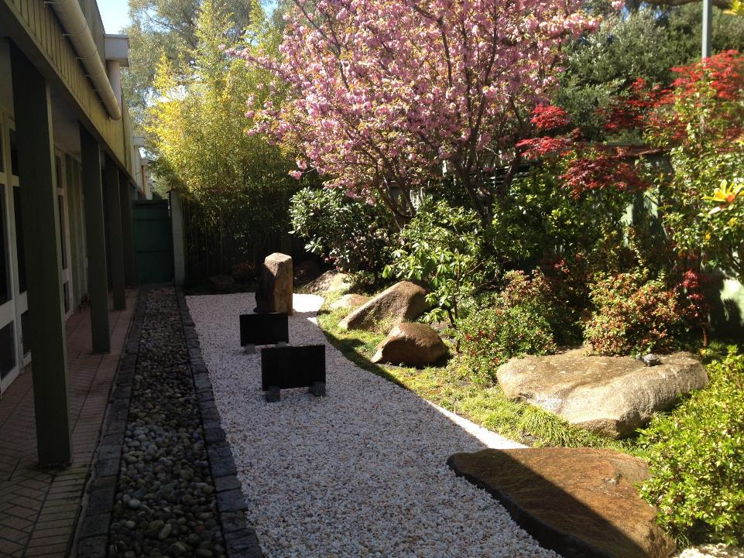

Slide 19
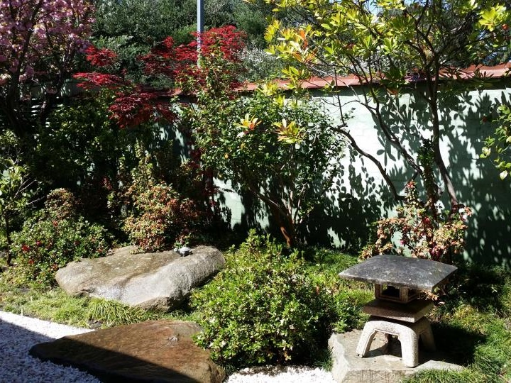

Slide 20
Our Success
Student Exchange Program – 75 students on long term exchange and over 500 short term stays;
Given the youth of Frankston life changing experiences – eg band performance at World Expo 2005;
Facilitated creation of Japanese Language Book about school life in Susono – used in schools all over Australia.
International recognition for “building bridges” in the community. – Yazaki Global Forum 2006
Awards from the Sister Cities Australia for our activities: eg
2007 Best overall sister city program in Australia.
2017 Community Involvement

Slide 21
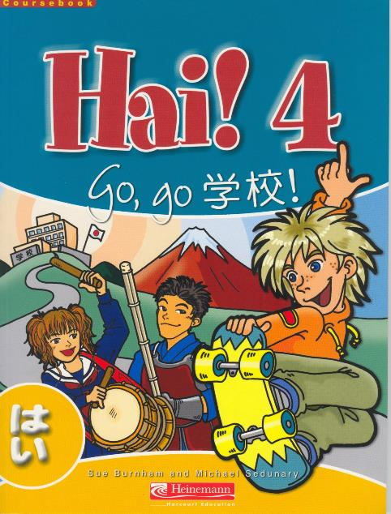
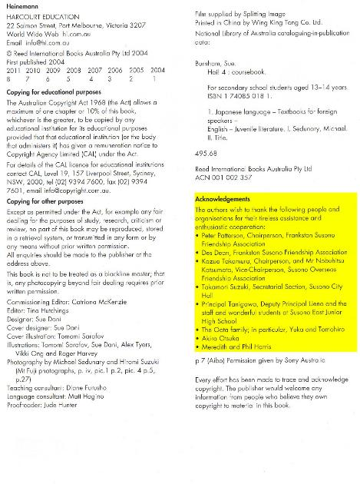

Slide 22
2006 Yazaki Global Stakeholder Forum

Slide 24
Council Support
Unwavering support for the sister city relationship throughout the past 36 years
Admin support and annual operational grant
Commitment to have Mayor/Councillors lead delegations
Renaming of a local street – Susono Way
Establishment of Japanese style Tribute Garden

Slide 25
This year
Started by winning SCA award for Community Involvement
Held initial Japanese network function
Japanese Festival in May – Over 1500 people attended
Active Social media presence to spread the word.
Ongoing Maintenance of Japanese Garden
Susono school visit in August
Supported Frankston representative in Susono Half Marathon

Slide 26
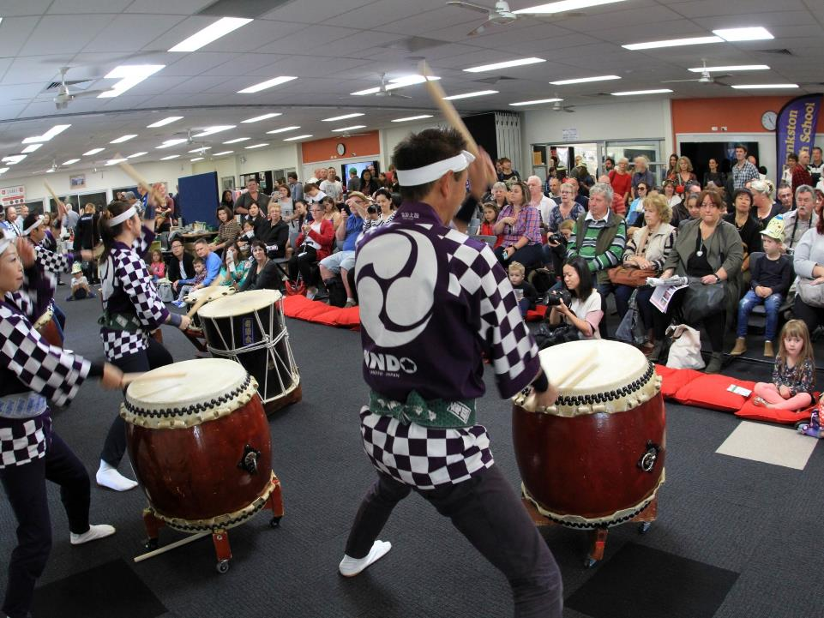

Slide 27
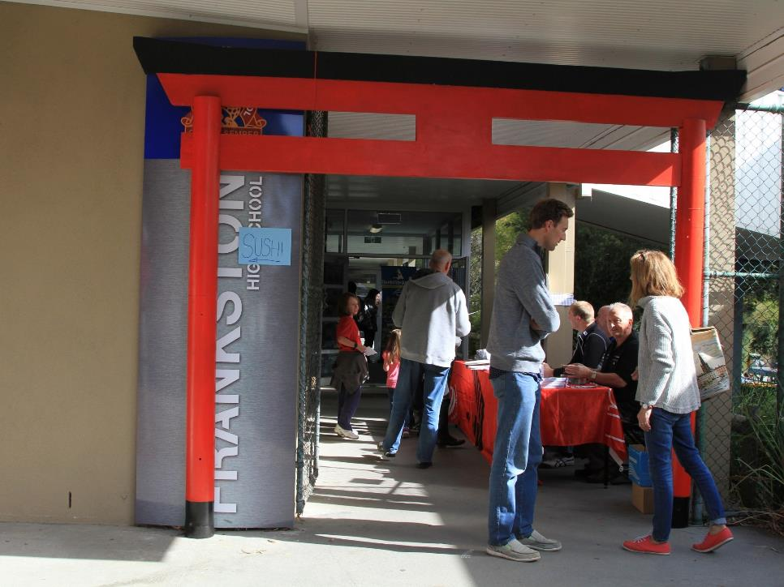

Slide 28
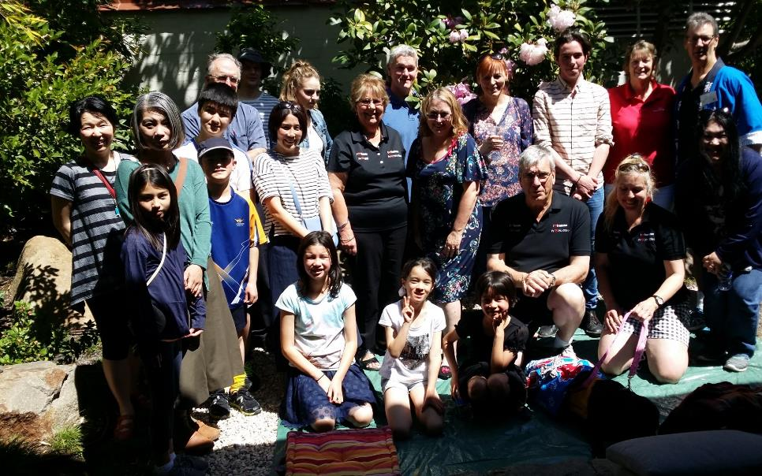

Slide 29
Later this year
Japanese Speech Contest – expect over 80 participants. Updated Rules and Code of Conduct with help of JLTAV
Delegation to Susono in September for Australian Fair – led by Mayor Hampton with up 25 others. Features:
Using Virtual Reality and Drone photography to give a modern view of Frankston. The theme will be “Frankston – You are standing in it”
Skype Link for those who cannot go to Japan
High School musicians
Lots of food and activities to engage with the folk in Susono.

Slide 30
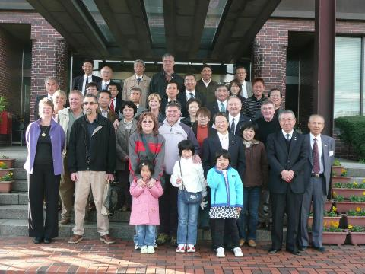
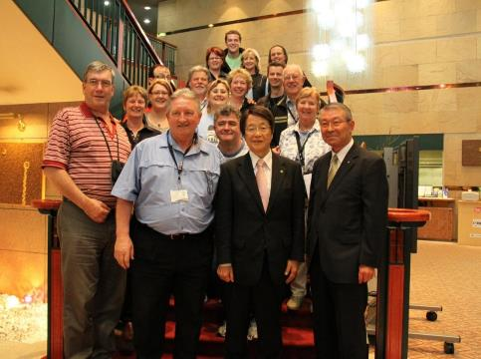
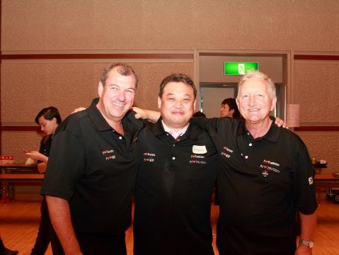
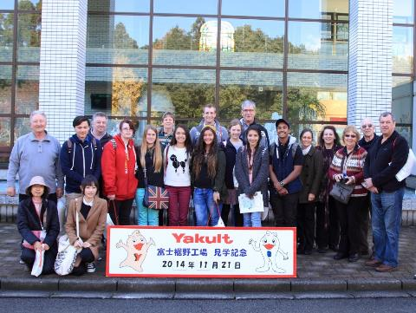

Slide 31
Recent Delegations

Slide 32
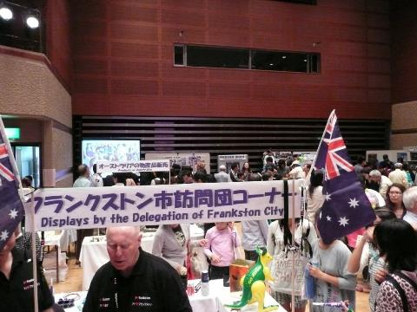
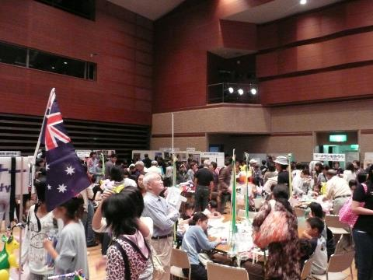
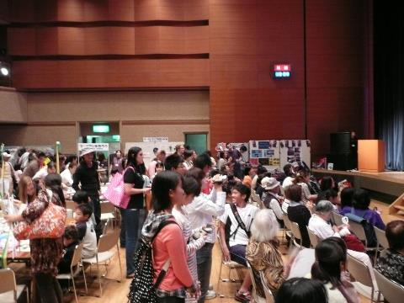
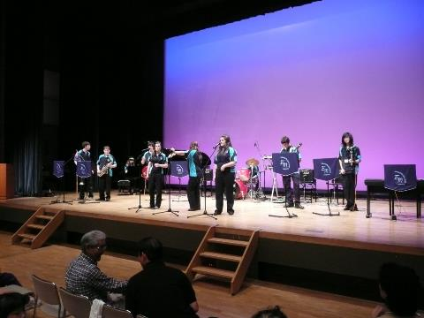

Slide 33
The Future
We are all getting older, handing the baton to the next generation
Volunteer organisations are not popular anymore
We lost part of our heritage when Yazaki closed in Australia 6 months ago. For many years we partnered with Yazaki in the Annual Frankston Waterfront Festival.
Will the increased gap between visits (2 year/4 year cycle) dilute the commitment.
Continuing to be relevant and appealing
Have a lasting tribute to our history and to the future

Slide 34
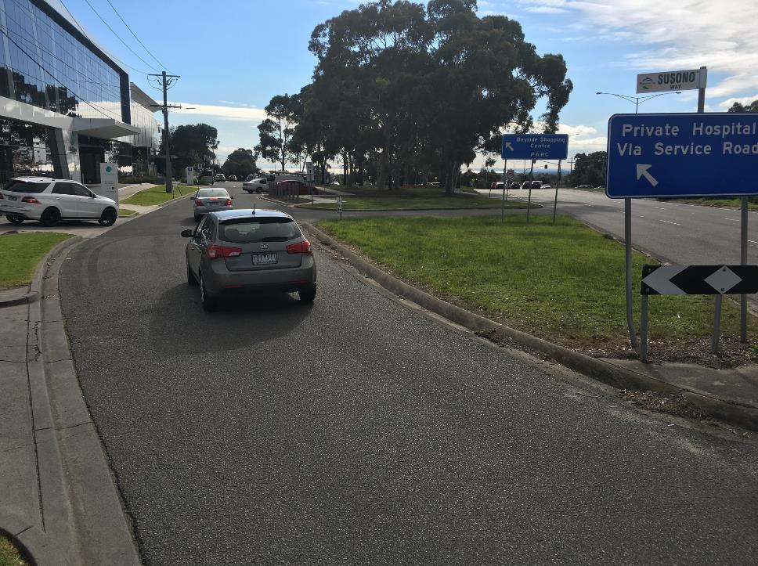

Slide 35
Susono Tribute/Recognition Site – being developed in coming months

Slide 36
Thank You

