Slide 1
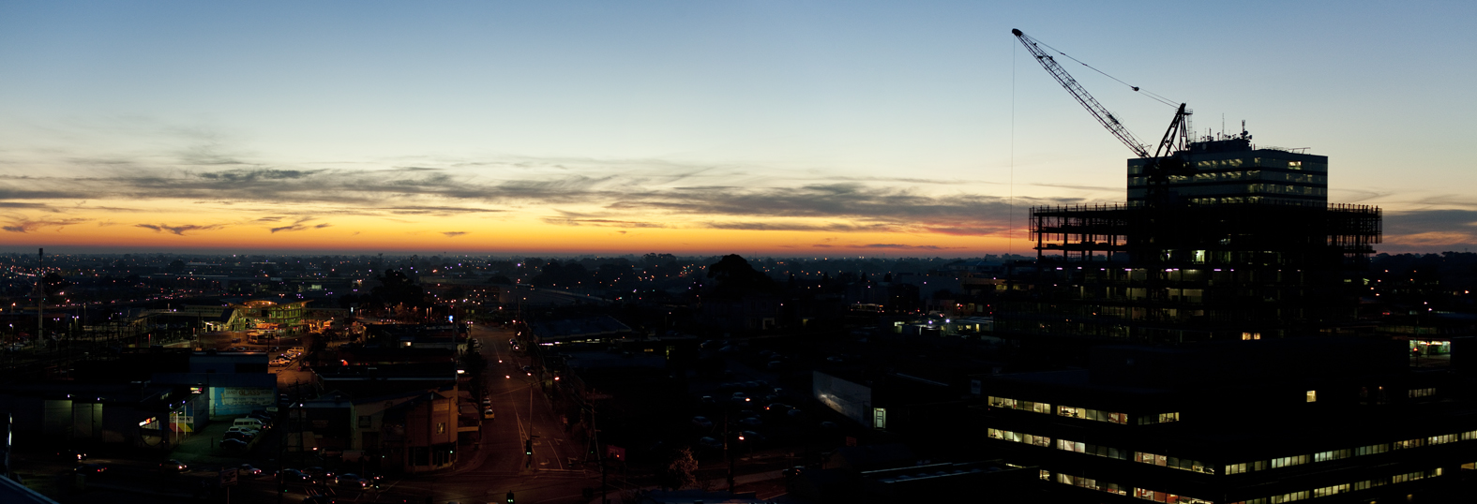
Victoria Sister Cities Forum
Queens Hall, Parliament House
City of Greater Dandenong
Local Opportunities for Economic Relationships, How and Why?

Slide 2
City of Greater Dandenong Sister City with Xuzhou, Jiangsu Province since 1996
Objectives:
Fostering international understanding and goodwill
Promoting the understanding of diverse cultures through exchange and education
Encouraging international communication to promote peace and tolerance
To break down cultural differences through providing experimental opportunities

Slide 3
To encourage the exchange of ideas relating to good government
To promote and exchange ideas which break down cultural barriers
To encourage community education about other cultures
Predominately involved in cultural, education and health
Involved delegations from Xuzhou and City of Greater Dandenong every second year
Delegations led by Mayor

Slide 4
Creation of Greater Dandenong Business (GDB) group in 2013
Group comprises of Economic Development, Activity Centres Revitalisation unit and South East Business Networks unit
Created to facilitate investment opportunities, support business and initiate economic links overseas
Economic relationship established with Xuzhou through visits to Xuzhou Trade and Investment Fairs
Business leader groups and business delegation to Xuzhou have taken place for the last four years

Slide 5
Delegations to Xuzhou include factory/business visits, meetings with Xuzhou government officials and Mayor/Deputy Mayors
Xuzhou relationship (20 plus years) has assisted in creating opportunities in Nanjing
Jiangsu Federation of Industry and Commerce (JFIC) and City of Greater Dandenong participate in business to business visits
JFIC are the largest Chamber of Commerce in Jiangsu Province

Slide 6
Has broadened opportunity for business to business opportunities
No government to government role with JFIC
Sister City Policy replaced with International Relations Policy which was adopted by Council in July 2016

