Slide 1
Melbourne’s Successes with our International Partners

Slide 2
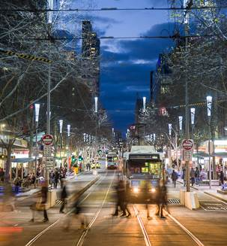
Section 1.8
Melbourne’s Relationships
Boston (1985)
Milan (2004)
Osaka (1978)
Tianjin (1980)
Thessaloniki (1984)
St Petersburg (1989)

Slide 3
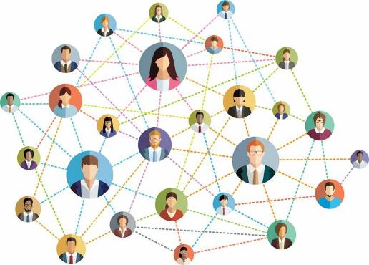
Section 1.9
Other Relationships
Strategic Relationships
Business Partner Cities Network

Slide 4
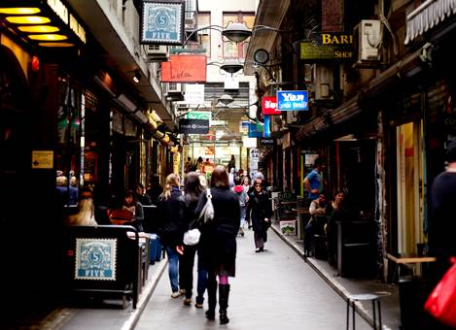
Section 1.10
From Market Approach to Sector Approach
Health – Life Sciences, Biotechnology, Regenerative Medicine.
Liveability – City Design, Public Transport
Startups & Innovation
Education – Cultural integration

Slide 5
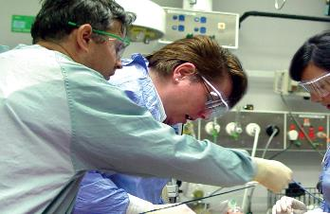
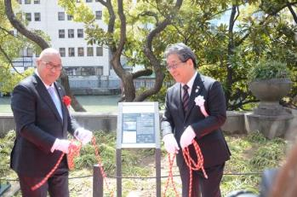
Section 1.12
Business Missions
2018 to Japan and China
- Osaka, Beijing, Tianjin, Wuxi, Suzhou
2017 to India
- Mumbai, New Delhi
Incoming missions
International Projects
Jiangsu-Victoria Research and Innovation Centre
Melbourne Osaka Health Innovation Exchange

Slide 6
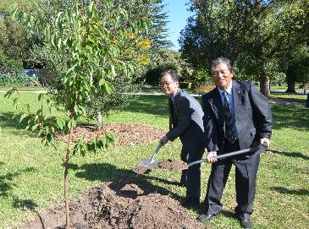
Section 1.12
Ongoing Projects
Leaders exchange programs
Support of festivals and community organisations
Civic exchange

Slide 7
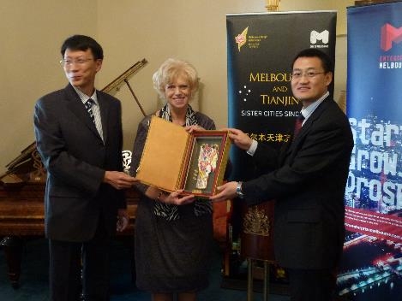
Section 1.13
Ongoing Projects
Leaders exchange programs
Support of festivals and community organisations
Civic exchange

Slide 8
Questions

