Slide 1
Buloke’s OVERVIEW

Slide 2
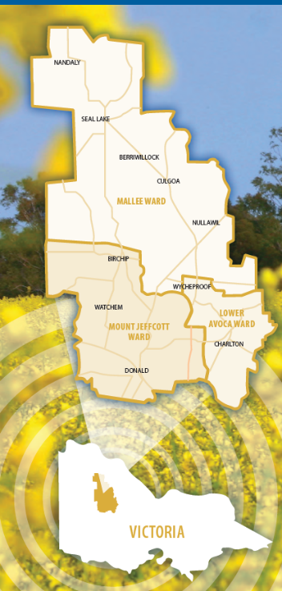
Buloke Shire
Land Mass: 8000 sq/km
Population: 6,240
Roads: 5,300km
Every person has 1.3 sq/ km to live in and 840m of road to look after

Slide 3
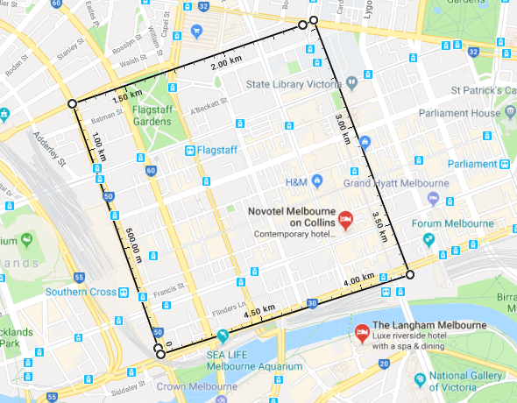

Slide 4
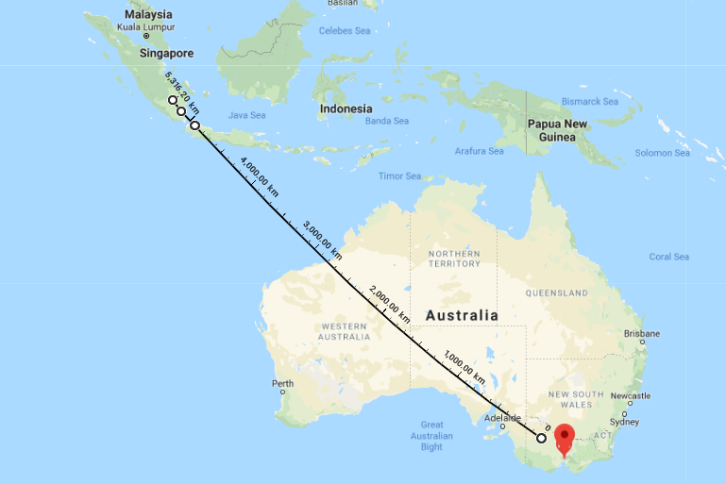

Slide 5
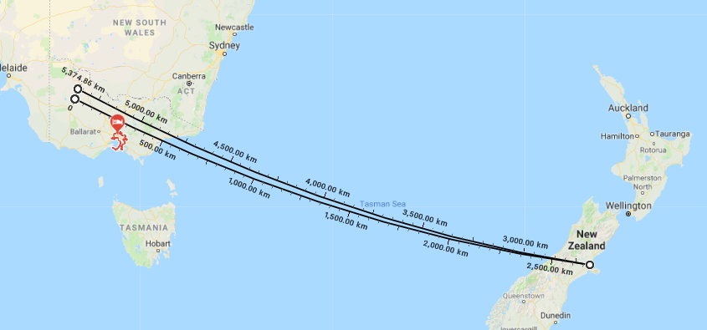

Slide 6
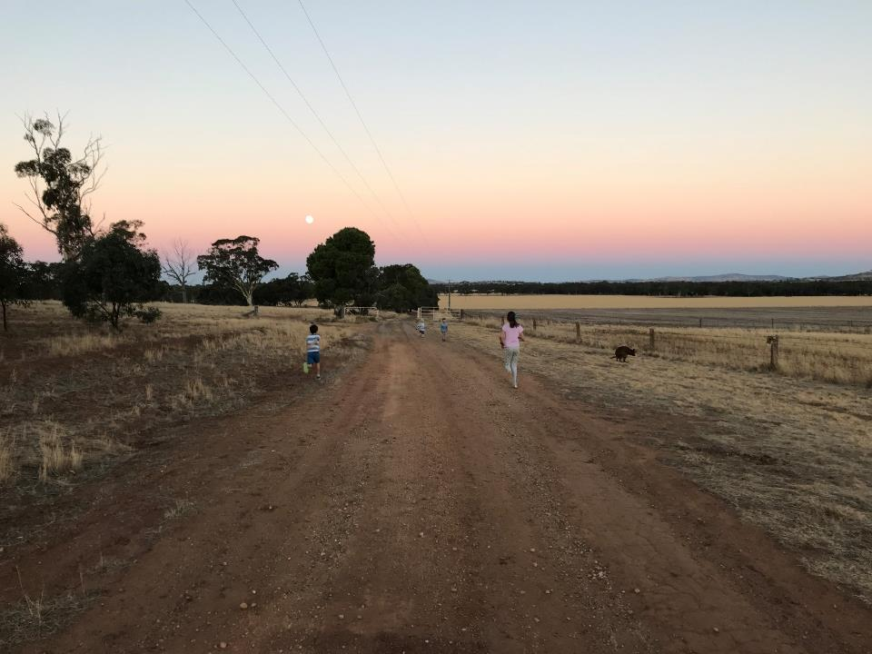
Buloke’s Big Builds

