Slide 2
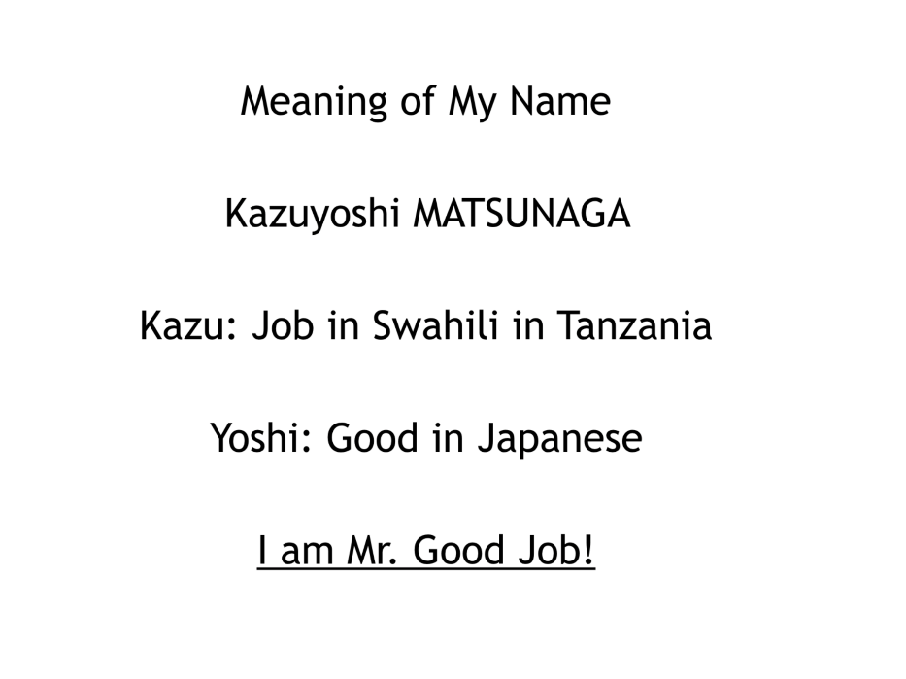

Slide 3
Origins of Sister City Relationships Photo of Nagasaki

Slide 4
1,732 states, cities and towns
67 countries
108 in Australia
19 in Victoria

Slide 5
International Conflicts and Sister City Relationships

Slide 6
Different Aims for Sister City Relationships

Slide 7
Economic Exchanges

Slide 8
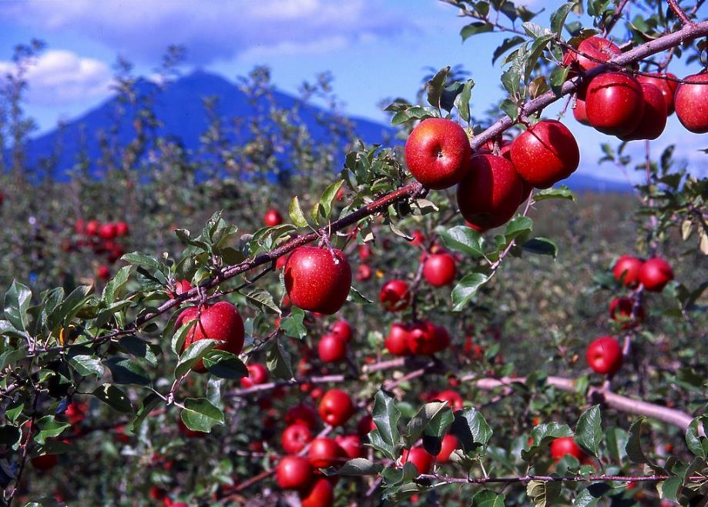

Slide 9
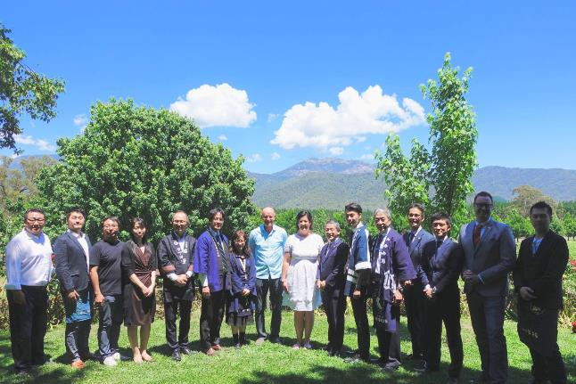
Feathertop Winery in Porepunkah in Victoria

Slide 10
Sister city relationships are a starting point of interaction with a particular country, which leads to further innovative relationships across the country, not just within the sister cities.

Slide 11
Different Types of Exchange:
Social Issues

Slide 12
Different Types of Exchange:
Garbage Problem

Slide 13
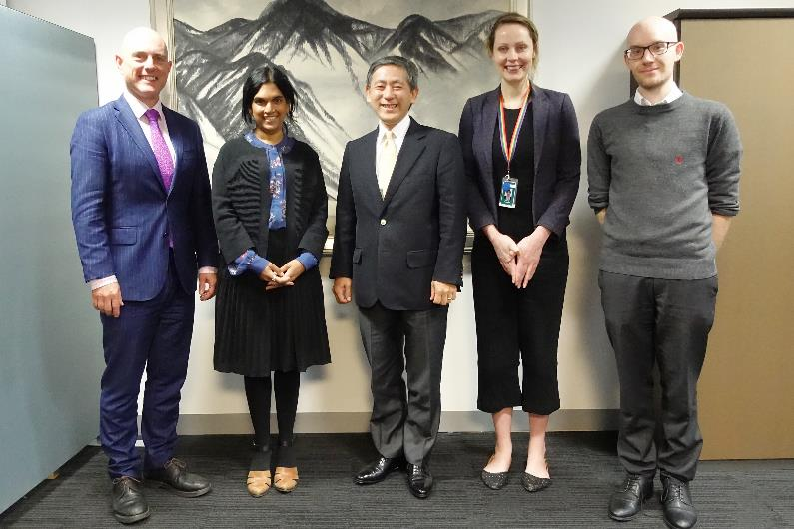
Different Types of Exchange:
Gender Equality

Slide 14
MCG (Melbourne Cricket Ground)

Slide 15
M: Multiculturalism
C: Convenience
G: Generosity

Slide 16
The Role of CLAIR: Promoting Intercultural Communication for Japanese Local Government

Slide 17
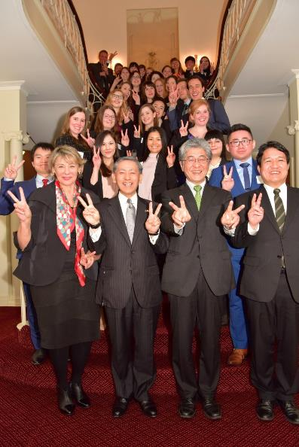
JET Programme Japan Exchange and Teaching Programme

Slide 18
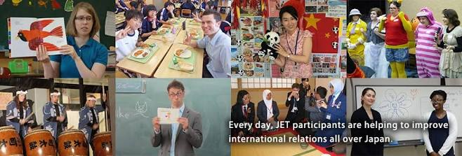
Assistant language teachers
Sports exchange advisors
Coordinators for international relations

Slide 19
351 JET participants from Australia

Slide 20
Photo: Broome Visitor Centre
http://www.broomevisitorcentre.com.au/

