Slide 1
Sister City Bridge Project

Slide 2
Objectives
What sister-city relationships are there?
How active is each relationship?
How does each Council utilise their relationship. Delegations. Exchanges. Cultural Activities.
Provide Case Studies that can inspire Councils to better leverage their sister-city relationship

Slide 3
Victorian Local Council | Chinese Sister City Partner | Active | Victorian Local Council | Chinese Sister City Partner | Active
Ararat | Taishan, Guangdong | Was More Active in the Past | Glenelg | Zhangjiagang, Jiangsu | Partially Active
Ballarat | Kunshan, Jiangsu | Inactive | Horsham | Nuijiang, Yunnan | Partially Active
Baw Baw | Jiujiang, Jiangxi | N/A | Latrobe | Taizhou, Zhejiang | Fully Active
Bendigo | Haimen, Jiangsu | N/A | Melbourne | Tianjin | Fully Active
Campaspe | Shangri-La, Yunnan | Partially Active | Mildura | Dali, Yunnan | Fully Active
Casey | Dujiangyan, Sichuan | Fully Active | Moreland | Xianyang, Shaanxi | N/A
Dandenong | Xuzhou, Jiangsu | Fully Active | Shepparton | Jintan District, Jiangsu | Fully Active
Darebin | Hefei, Anhui | Was More Active in the Past | Southern Grampians | Gaoyou, Jiangsu | Was More Active in the Past
East Gippsland | Weifang, Shandong | Inactive | Wangaratta | Suzhou, Jiangsu | N/A
Frankston City Council | Wuxi, Jiangsu | Partially Active | Warrnambool | Changchun, Jilin | Fully Active
Geelong | Lianyungang, Jiangsu | Partially Active

Slide 4
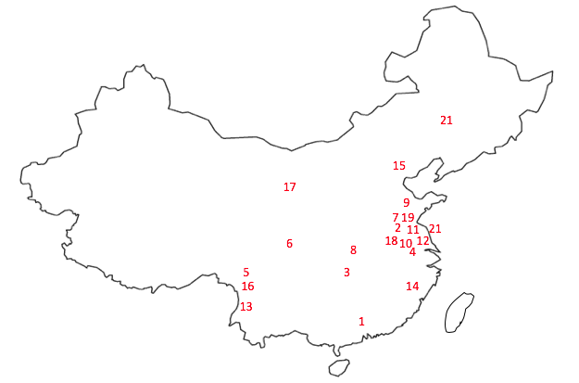
Victoria’s Sister-City Network

Slide 5
Survey Results - Relationship
Status: Fully Active 42%, Partially active 29%, More active in past 18%, Inactive 12%
Activities: Outbound delegations 76%, Inbound delegations 71%, Cultural Activities 47%, Educational Exchange 41%
Sectors: Education 86%, Tourism 71%, Agribusiness 57%, Manufacturing 36%
Challenges: Limited Personnel 57%, Differences in Business Culture 50%, Communication 36%
External Support: State Gov (4), Confucius Institute (3), ACBC / Local Unis (2)

Slide 6
Survey Results - Activities
Outbound Missions: Site Visits (88%), Formal Entertaining (88%), Business Matching (56%), Meet with State, Federal Gov (50%)
Inbound Missions: Site Visits (81%), Cultural Activities (75%)
Inbound Challenges: Logistic challenges (78%), Time Constraints (43%)
Exchanges: Councils (12%), Educational – Primary (50%), Educational – Tertiary and Secondary (42%)

Slide 7
Survey Results – Appraisal

Slide 8
Survey Results – Appraisal

Slide 9
The View from China
Chinese perspectives on sister-city relationships are very clearly more strategic and positive
China usually takes a two-step approach. Sister-city relationships often start from a position of ‘getting to know each other’ which can then be transitioned into a more formal ‘sister-city’ agreement.
Many Chinese cities have 50+ municipal level links.
On the Chinese side of sister-city relationships, resourcing is vastly different

Slide 10
Recommendations
Go West: Victoria’s Sister State Relationship with Sichuan
Bridge the knowledge gap: External support is available – Vic Gov, ACBC, Asialink, Austrade, Confucius Institute
Scheduled activities
Align with similar Councils
Harnessing local Chinese students to fill personnel gaps
Keeping the relationship alive

Slide 11
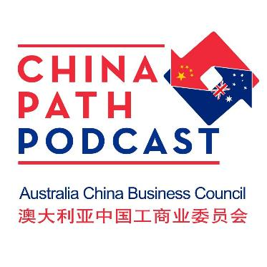
More information
Find the Report at: http://acbc.com.au/Publications
ACBC Victoria Branch: virginia.birrell@acbc.com.au
Report contact: james.scullin@acbc.com.au

