Slide 1
Sister City Relationships in Japan
Makio Yamada
Deputy Executive Director, CLAIR Sydney
1
Notes:
1

Slide 2
Today’s topics
1. Introduction of CLAIR
2. Japan’s Sister City Relationships
3. CLAIR’s Support for Sister City Relationships
2
Notes:
2

Slide 3
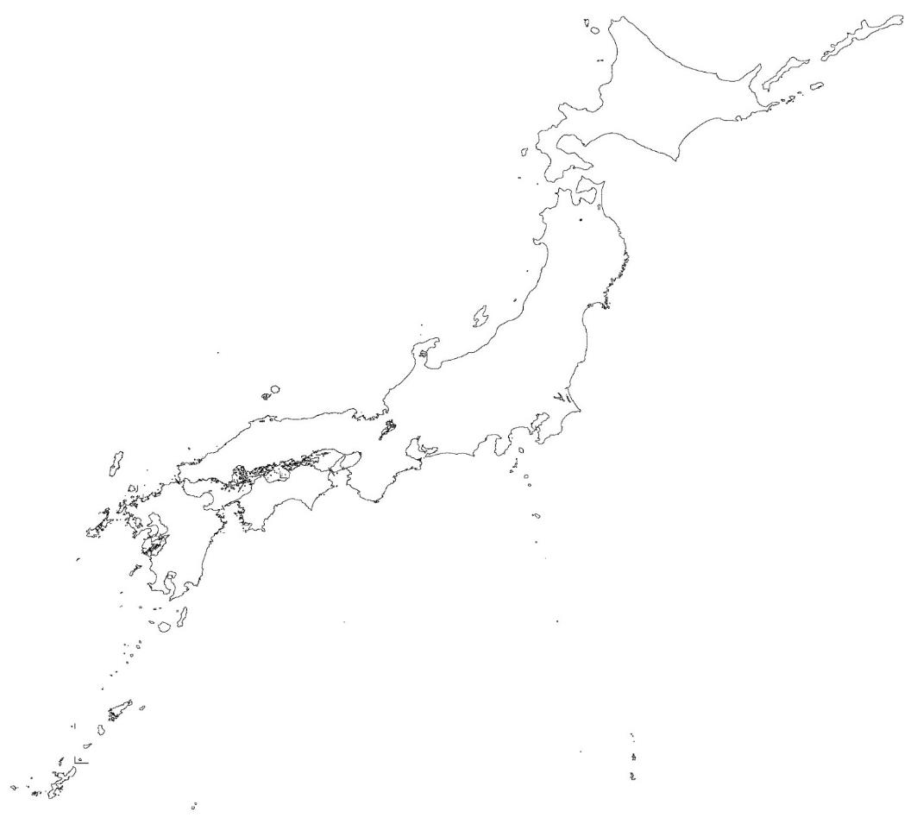
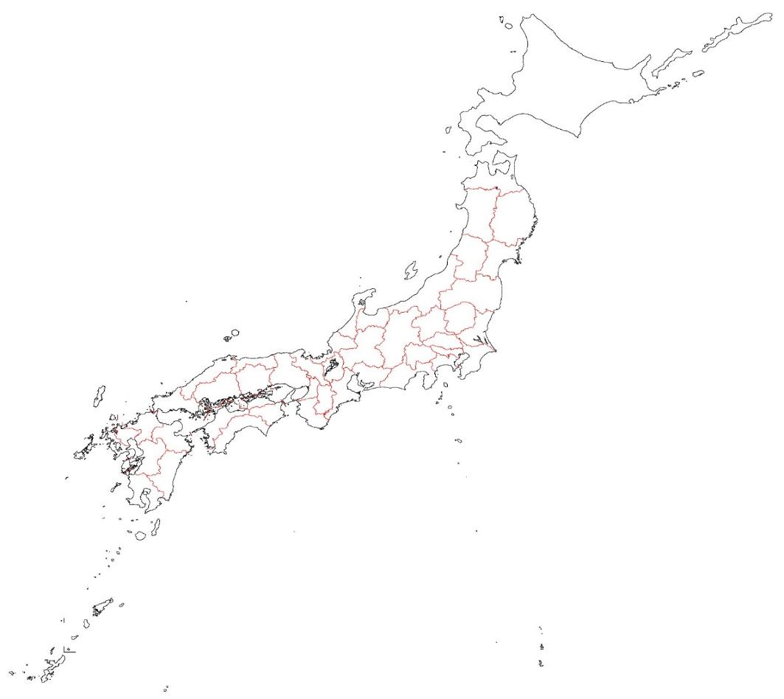
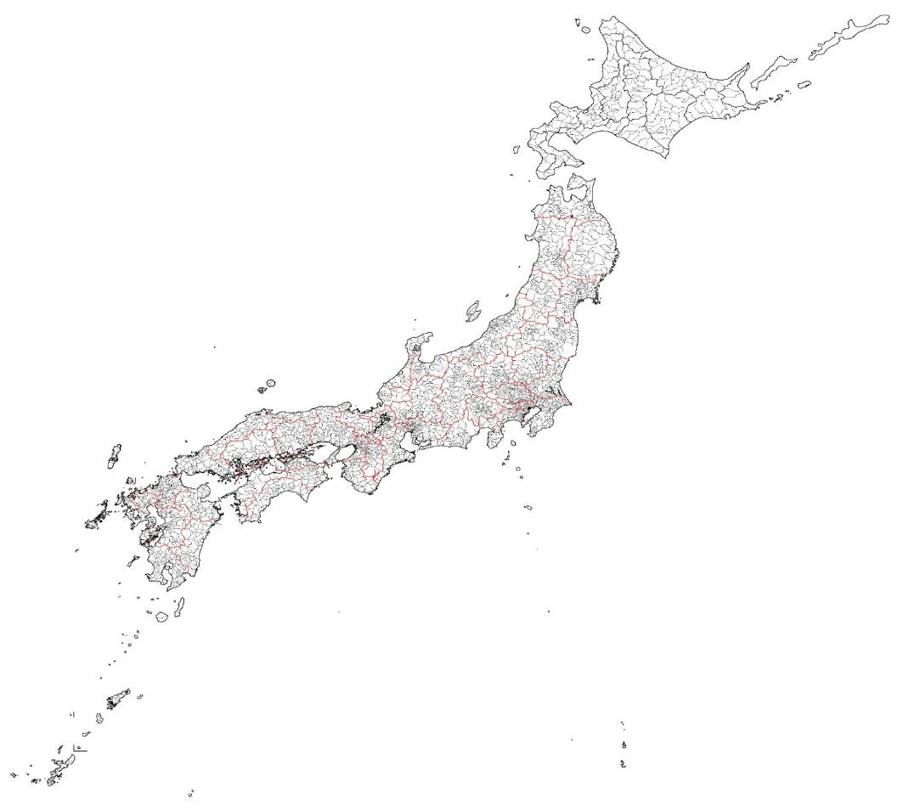
(Japan Local Government Centre)
1. Introduction of CLAIR
CLAIR
Council of Local Authorities
for International Relations
Joint Organisation of Local Governments
in promoting International Relations
established in 1988
3
Notes:
3

Slide 4
1. Introduction of CLAIR
Council of Local Authorities for International Relations
（Japan Local Government Centre）
EST 1988
Central Government
collaboration
Ministry of Internal Affairs and Communications (MIC)
Ministry of Foreign Affairs (MOFA)
Ministry of Education, Culture, Sports, Science and Technology (MEXT)
4
Notes:
4

Slide 5
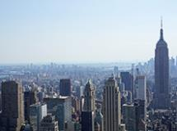
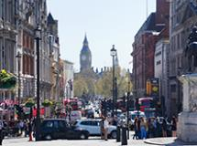
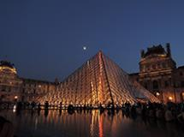
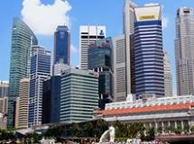
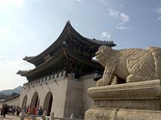
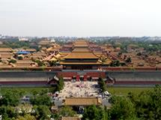
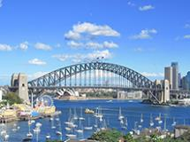
1. Introduction of CLAIR
Overseas Offices
7 locations
Branch Offices
47 Prefectures and
20 Ordinance-designated Cities
Sapporo
New York
London
Niigata
Sendai
Paris
Singapore
Kobe
Sakai
Kyoto
Okayama
Saitama
Hiroshima
Chiba
Kitakyushu
Fukuoka
Sagamihara
Kawasaki
Yokohama
Seoul
Beijing
Nagoya
Shizuoka
Kumamoto
Osaka
Hamamatsu
Sydney
5
Notes:
5

Slide 6
Japan’s Sister City Relationships
2. Japan’s Sister City Relationships
The Total Number of Japan’s International Sister City Relationships
*Including Sister State/Prefecture Relationships
As of Sep 2022
NOW!
↑
CLAIR established in 1988
6
Notes:
6

Slide 7
Japan’s Sister City Relationships
2. Japan’s Sister City Relationships
The Number of Japan’s Sister City Relationships by Country
*Including Sister State/Prefecture Relationships
Total Number: 1,788
As of Sep 2022
7
Notes:
※３条件のくだりには触れない
N.B.
Incidentally, as shown below, CLAIR deems a ‘sister city relationship’ valid if it fulfils all of three conditions.
The first condition is that there is a partnership agreement signed by the heads of both local governments.
The second condition is that the area of exchange is not limited to a specific field.
The third condition is that some budgetary measures are required as a prerequisite, so it is necessary to obtain approval from the Assembly.
7

Slide 8
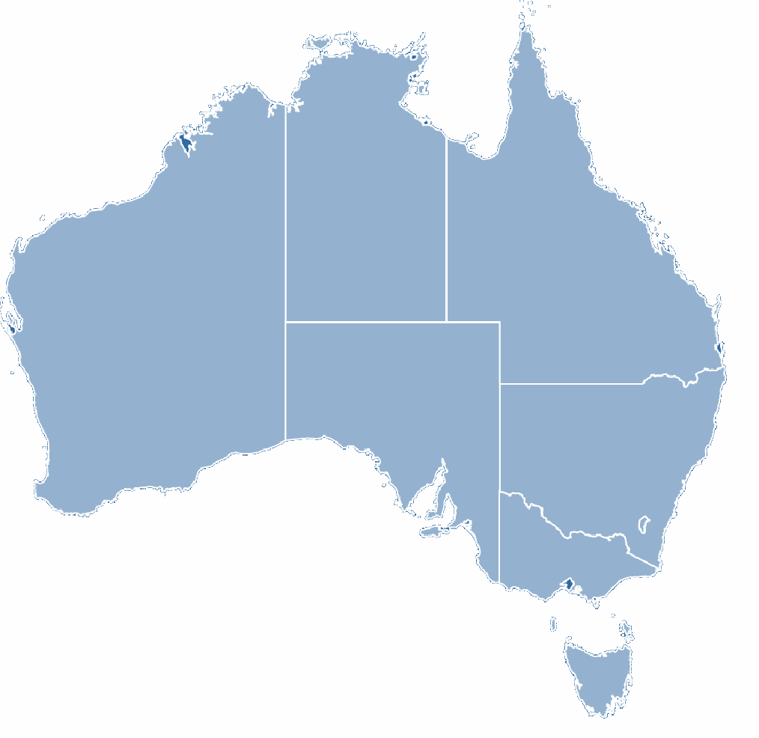
Australia-Japan’s Sister City Relationships
2. Japan’s Sister City Relationships
6 Prefectures
101 Cities
NT
2 Cities
QLD
2 Prefectures
21 Cites
WA
1 Prefecture
10 Cities
SA
1 Prefecture
8 Cities
NSW
1 Prefecture
38 Cities
ACT
1 City
VIC
1 Prefecture
17 Cities
TAS
4 Cities
8

Slide 9
Australia’s Sister City Relationships
2. Japan’s Sister City Relationships
The Number of Australia’s Sister City Relationships
*Excluding Sister State/Prefecture Relationships
Total Number: 607
Source: Sister Cities Australia (May 2021)
*
*There is a discrepancy between CLAIR and SCA’s sister city numbers due to the two organisations’ differences in specifications on sister city relationships.
9
Notes:
9

Slide 10
2. Japan’s Sister City Relationships
Japan’s Sister City Activities
The number of planned activities for 2020
*including cancelled activities due to COVID-19
As of Dec 2021
Education (Student Exchange) 39%
All Countries
Education (Student Exchange) 55%
Australia
10
Notes:
10

Slide 11
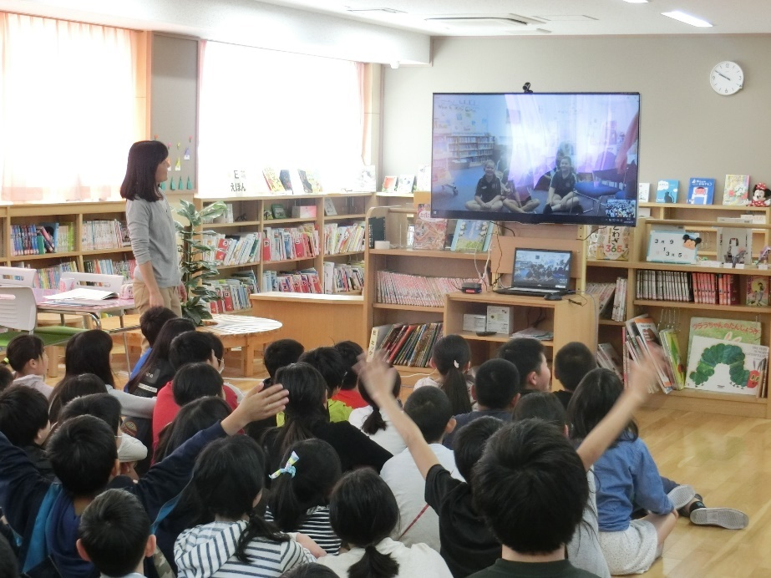
2. Japan’s Sister City Relationships
Online School Exchange
11
Notes:
11

Slide 12
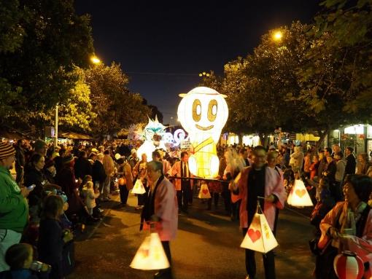
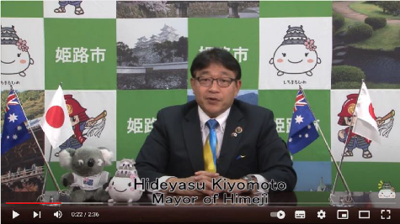
CLAIR’s Support for Existing Sister City Relationships
3. CLAIR’s Support for Sister City Relationships
Reconnect Australia-Japan sister cities
Support sister city events
Attend sister city events as representatives of Japanese sister cities
Delegates joining the Lismore Lantern Parade with Yamato Takada’s mascot character
Commemorative video message celebrating the 40th anniversary of the sister city relationship between Adelaide and Himeji
12
Notes:
12

Slide 13
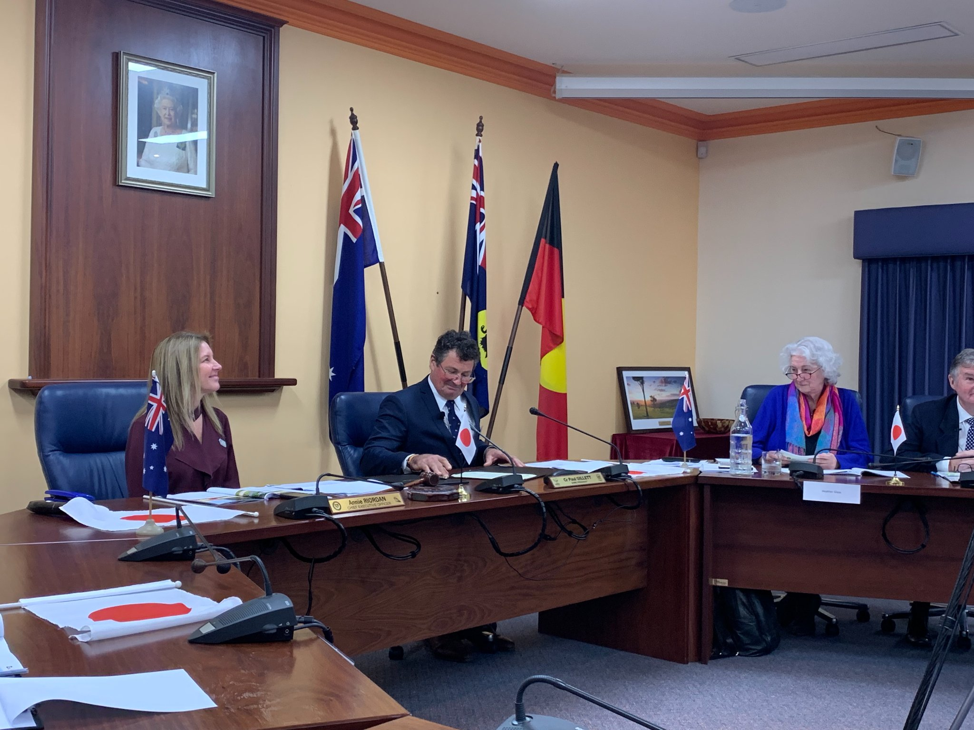
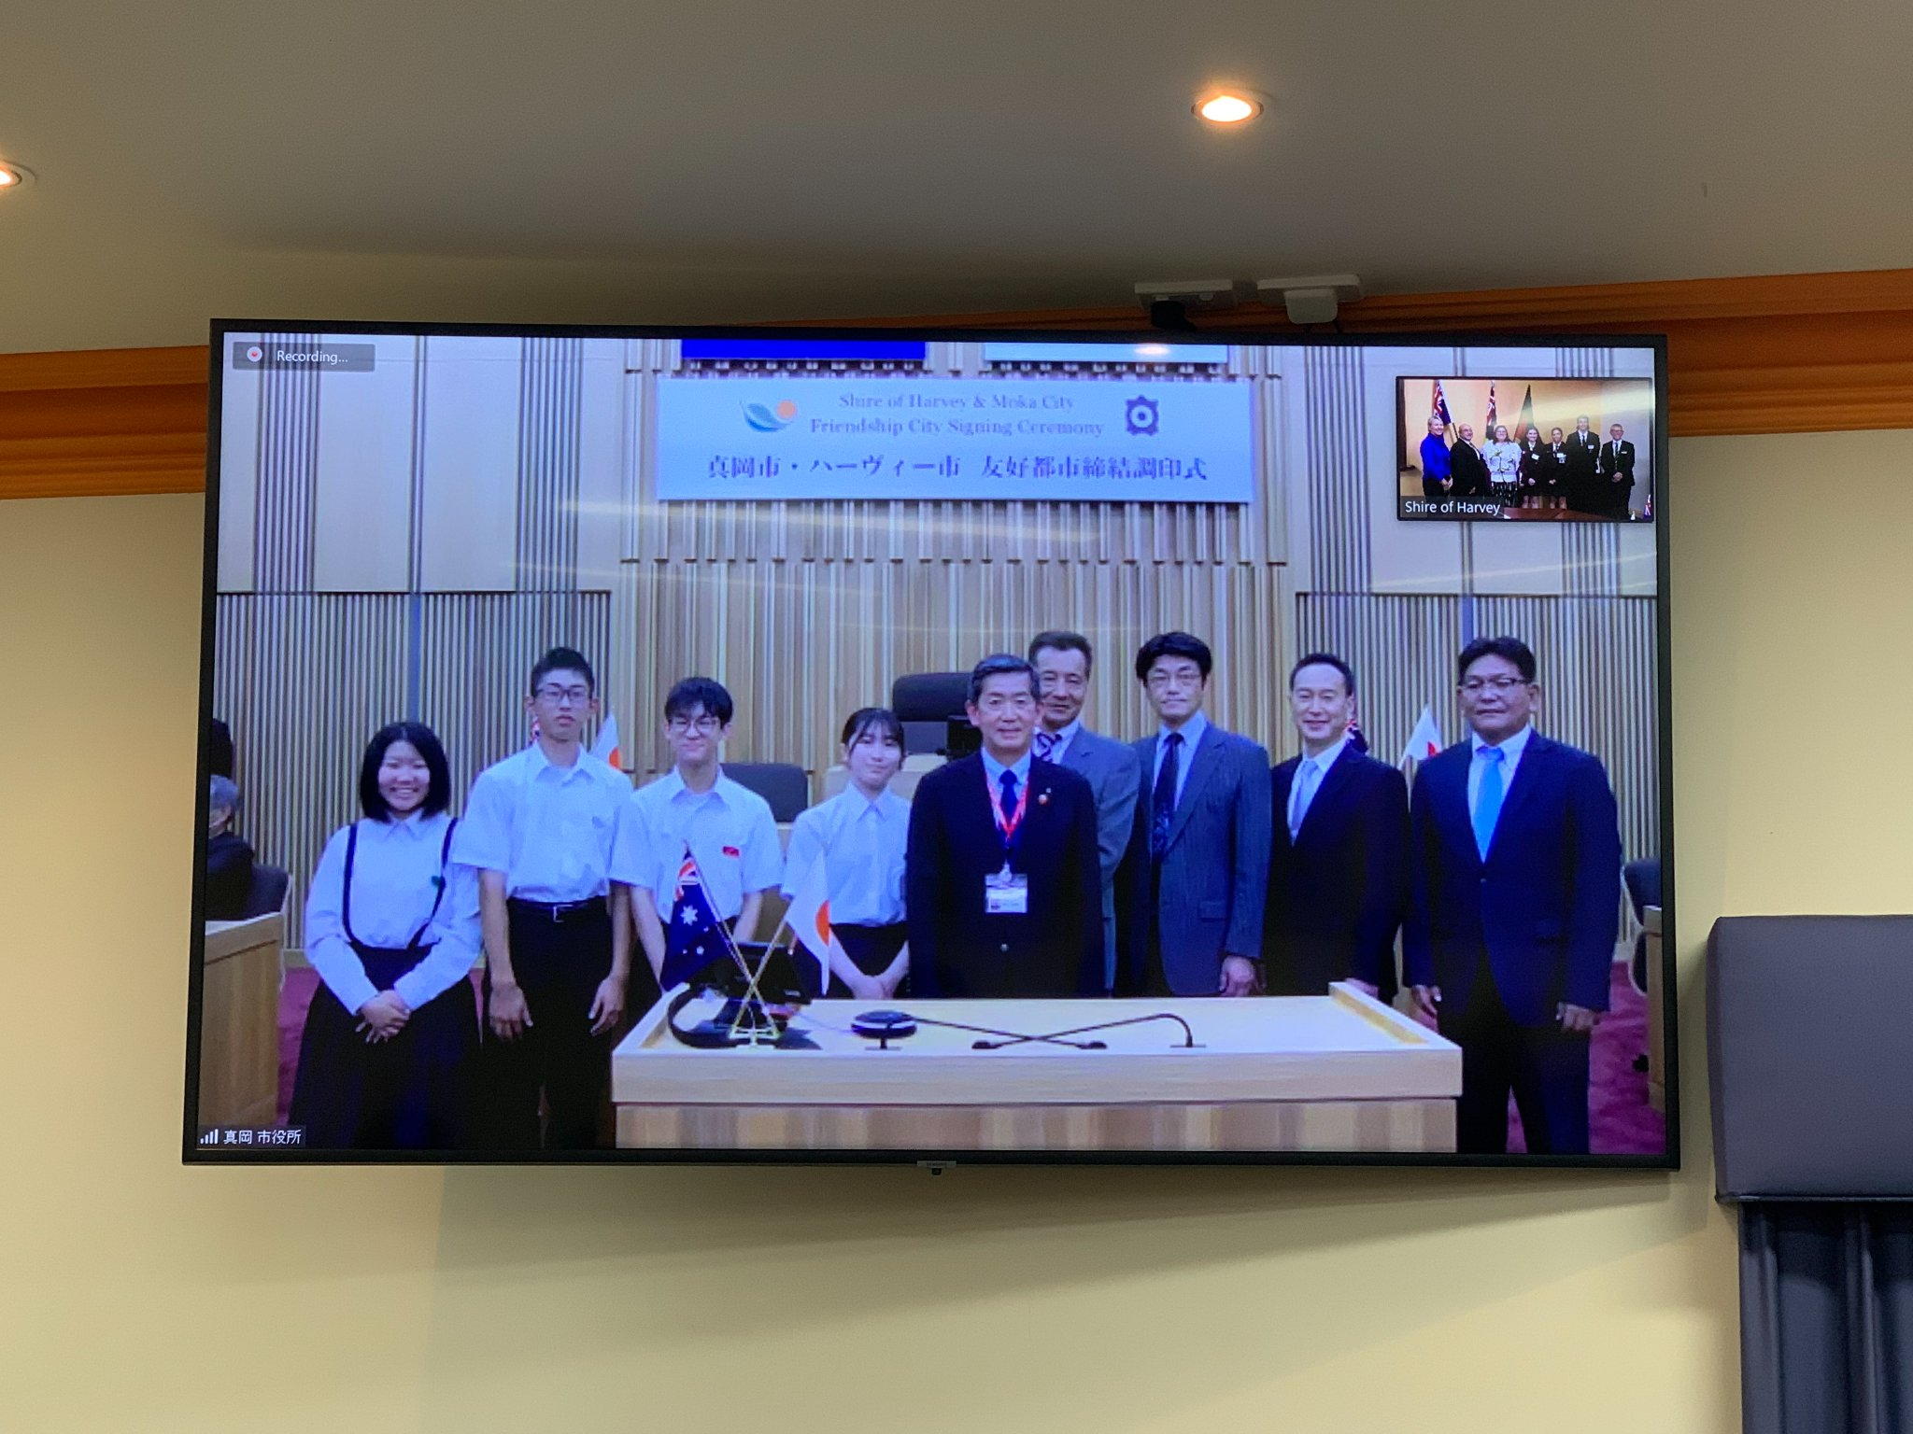
CLAIR’s Support for New Sister City Relationships ①
3. CLAIR’s Support for Sister City Relationships
Provide information about potential Japanese sister cities
Match Australian cities with Japanese cities
The Online Friendship City Signing Ceremony between Moka City and the Shire of Harvey
13
Notes:
13

Slide 14
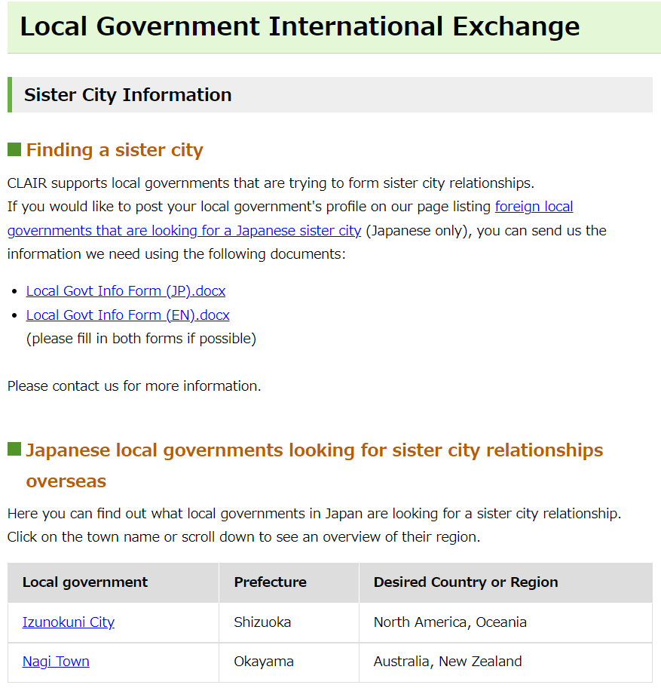
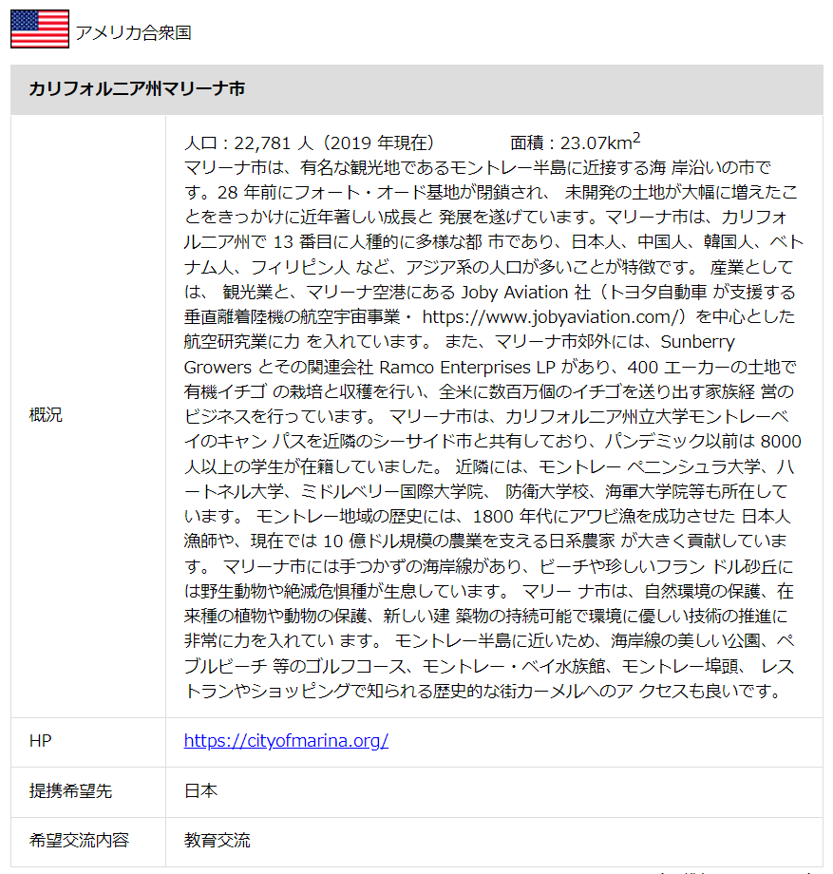
CLAIR’s Support for New Sister City Relationships ②
3. CLAIR’s Support for Sister City Relationships
Post information on our website to facilitate the establishment of new sister cities
Connect potential sister cities
14
Notes:
14

Slide 15
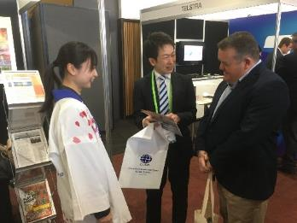
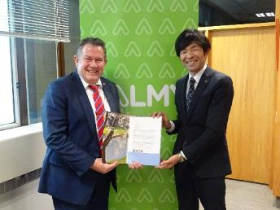
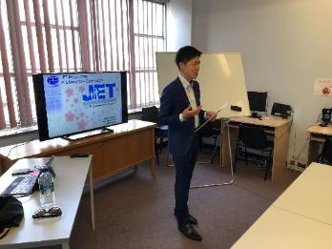
If you have any questions, please don't hesitate to contact us!
CLAIR, Sydney (Japan Local Government Centre)
Email: mailbox@jlgc.org.au
Web: http://www.jlgc.org.au
Facebook: https://www.facebook.com/clair.syd
Tel: +61-2-9241-5033
15
Notes:
15

