Slide 1
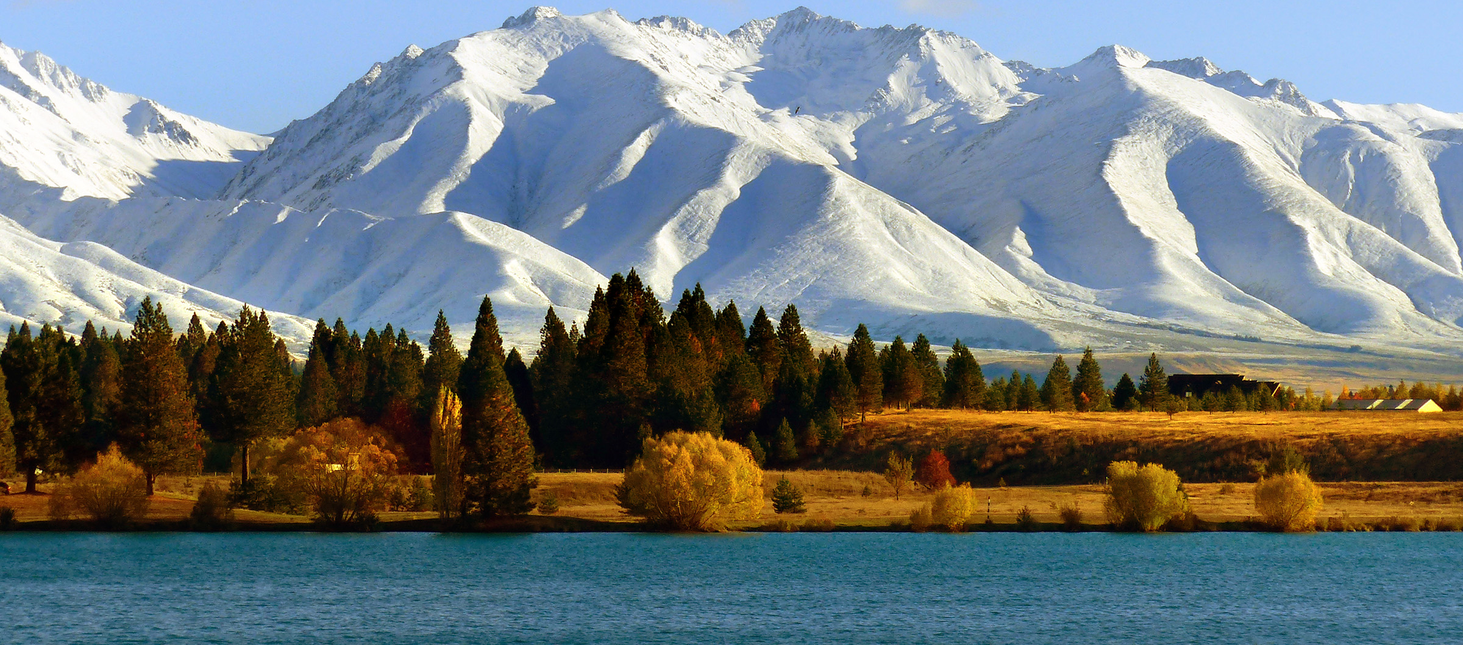

Slide 2
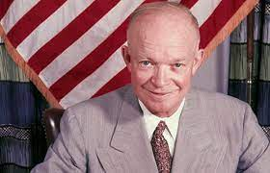
The Global Cities (Sister Cities) Movement
The Sister City programme was
established to promote peace by people to people links between
cities in different countries by
Dwight D. Eisenhower in 1956

Slide 3
GCNZ Objectives
National organisation founded in 1981 to bring together sister city associations throughout New Zealand, including: - Kindred organisations - Voluntary, local-body and governmental groups, - Individuals, cultural, sporting, educational and business groups
People-to-people contact between countries and cultures
Facilitate and assist members locally
Promote cultural understanding
Stimulate economic development
Foster a citizen’s network of organisations and individuals
Devoted to creating and strengthening partnerships between New Zealand and international communities
Notes:
In 2021 Sister Cities New Zealand changed its operating name to ‘Global Cities New Zealand’. However, for legal purposes we remain as Sister Cities New Zealand Incorporated operating as Global Cities NZ.

Slide 4
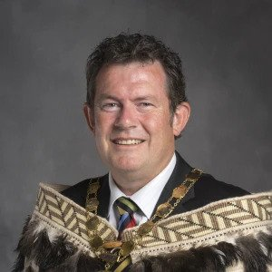
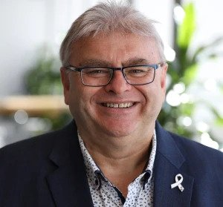
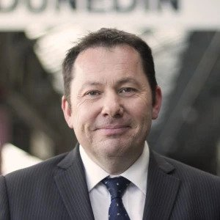
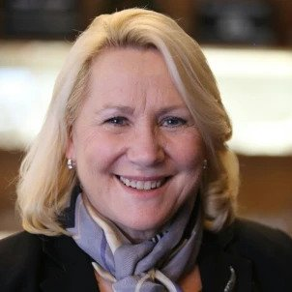
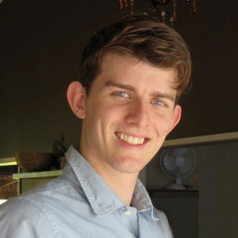
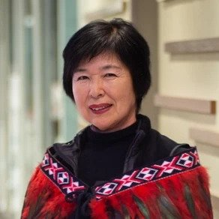
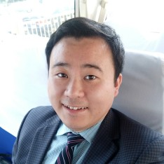
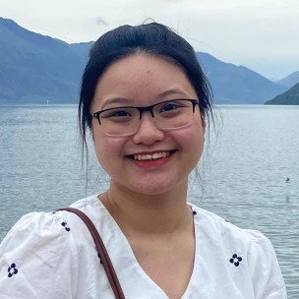
GCNZ Board & Advisors
Grant Smith
Palmerston North
Ray Wallace
Lower Hutt
John Christie
Dunedin
Beth Knowles
Christchurch
Taylor Marston
Auckland
Hiromi Morris
Wellington
Emeritus President
Elisha Hsiao
Wellington
Advisor
Luke Qin
Auckland
Advisor
Sarah Ma
Palmerston North
National Administration

Slide 5
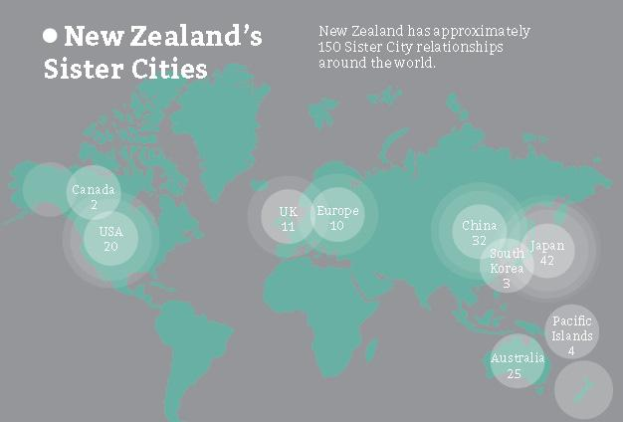
Country Relationships

Slide 6
GCNZ Members

Slide 7
GCNZ Partners

Slide 8
Connections with Diplomatic Corps

Slide 9
GCNZ Youth Sub-committee
Re-invigorating this group – Our Future!

Slide 10
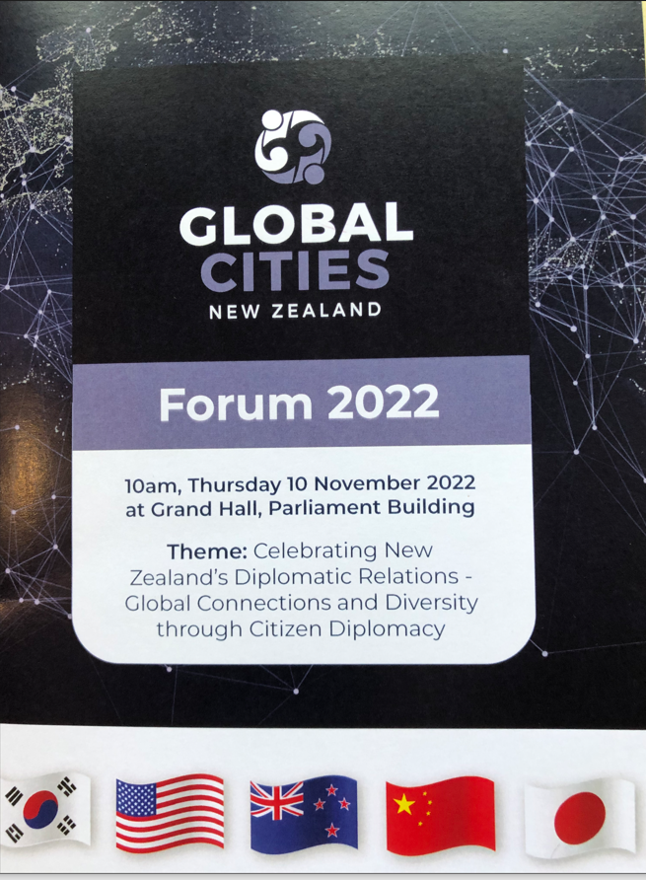
2022 Activity GCNZ Parliamentary Forum

Slide 11
International Bilateral Celebrations
80 years with the USA
70 years with Japan
60 years with South Korea
50 years with China

Slide 12
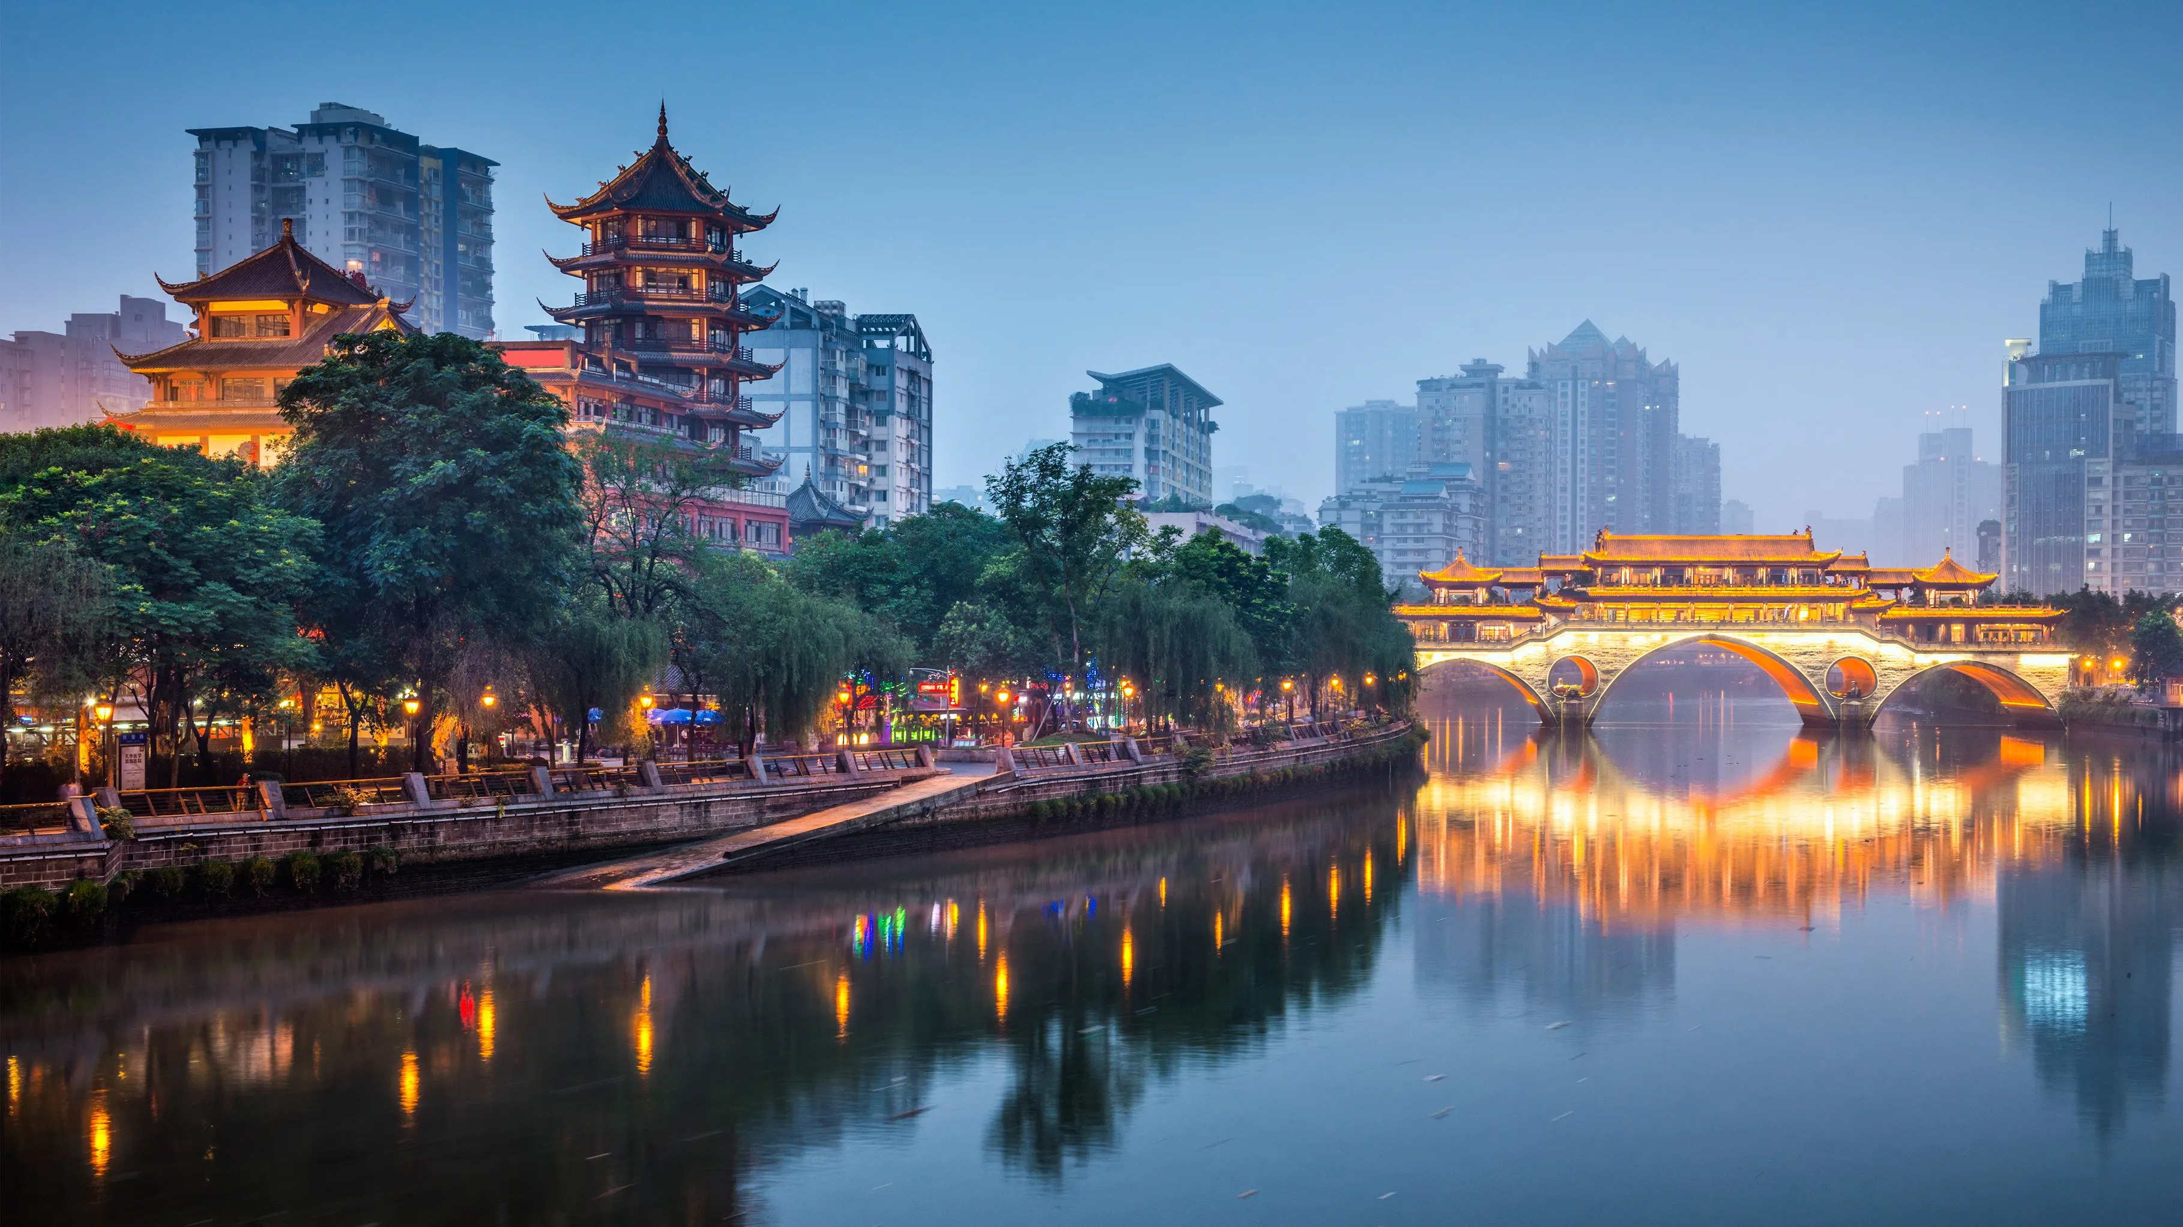
2023 Activities
Regional Forums in early 2023
Sister Schools Projects
Sister City delegations resume
New Zealand – China Mayoral Forum
Connections with Sister Cities Australia

Slide 13
2023 Annual Conference Marlborough
Date: 7 – 8 November 2023
Location: Blenheim

