Slide 5
Global Cities New Zealand
Notes:
Introduce the purpose of the presentation.
Wanted to gain an insight into what youth knew about the organization
Youth subcommittee worked together to generate questions
Survey was published on Facebook, LinkedIn, personal accounts and was shared with regional coordinators.

Slide 6
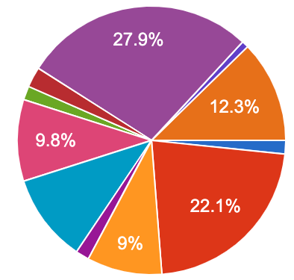
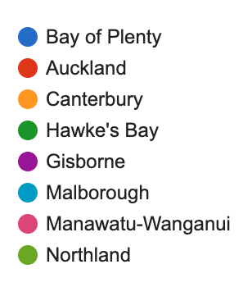
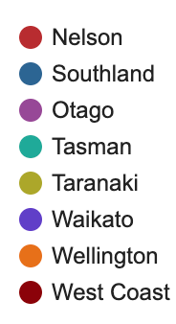
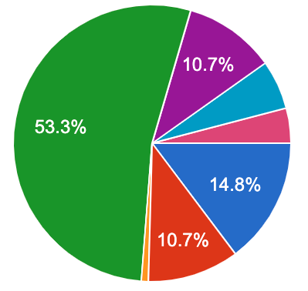
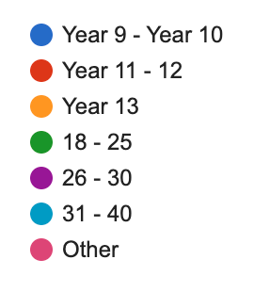
Survey Respondents
The survey was distributed through numerous social media platforms. We received a total of 122 respondents across Aotearoa New Zealand.
Age of respondents
Regions where respondents live
Notes:
We received a fair representation of youth from around Aotearoa as displayed in this diagram.
The majority of respondents were from Otago with Auckland being a close second.
The purpose of the survey was to target youth, hence why we asked for their age.
This graph shows that we were successful in reaching our target audience

Slide 7
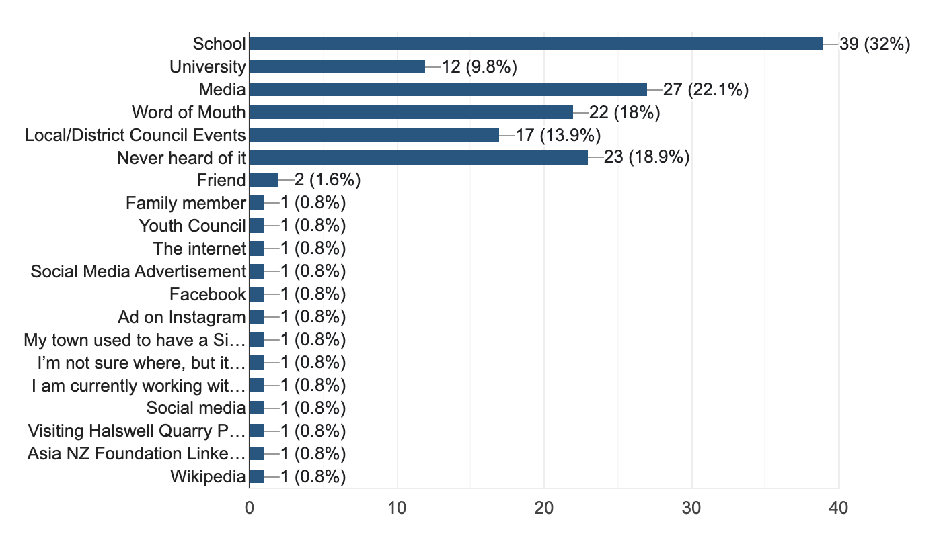
Youth Awareness levels
We asked respondents if they had heard about sister cities before, and if so where from.
Notes:
This graph shows the channels in which youth had heard of Sister Cities and it was very alarming to see that 18.9% of respondents had never heard of the organization before
The majority of respondents had heard of sister cities through school, media, or word of mouth.
A noticeable portion had never heard of sister cities before.

Slide 8
Youth Awareness levels
Further questions asked respondents how many Sister City relationships they think Aotearoa New Zealand has globally, and within which country the majority of these relationships reside.
Country of origin
Number of relationships globally
Notes:
Over 60% of respondents answered that they there are either 20 or 50 relationships globally. It is estimated that are around 132 relationships
It was also interesting to see that youth think we have the most relationships with Japan, but far less thought this way about other countries.

Slide 9
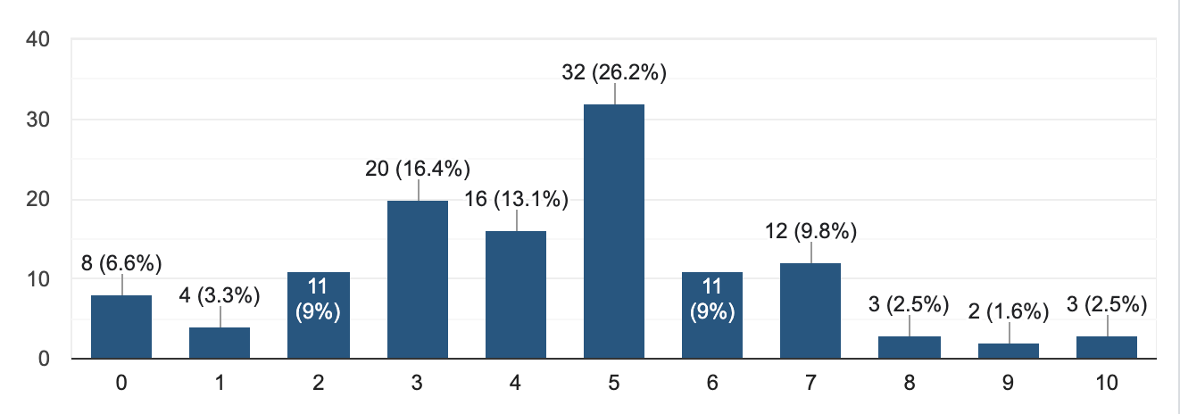
Youth Perceptions
We then asked respondents how active they believe Sister Cities are within Aotearoa New Zealand with 10 being the highest.
Notes:
This graph shows that our youth believe that Sister Cities is not very active, hence why, there needs to be an increased focus here.
Over 50% of respondents thought selected between 3 and 5, reflecting that Sister Cities are not believed to be very active.

Slide 10
Youth Perceptions
A follow up question asked respondents to give a reason for their response to the previous question. The following are some of these answers.
“Because I know that our city has three sister cities but it feels low key and not everybody knows about it”
“Only heard of it at school”
“Have heard some stuff but I haven’t seen it promoted as much by nz councils”
“Never heard of them”
“No clue what it is”
“We don’t hear much about sister cities relationships – but I am assuming that those involved are more active than we think. That they are driven by groups rather than by local governments”
“Have not heard otherwise”
“From what I observed in the news and media”
“It’s not something I’ve heard of talked about in school, areas of work or sport”
“I don’t really know so 4-5 is about average”
“Because I’ve heard about it within New Zealand. But still not sure!”
Notes:
A lot of respondents had responded to this question with "IDK, unsure, pure guess" highlighting that our youth aren't confident or educated enough in what this organisation does.
While some respondents noted hearing about Sister Cities through school, the majority expressed that they seldom hear about sister cities and are therefore unsure.

Slide 11
Youth Perceptions
The final question asked respondents to write a small blurb highlighting what they think a Sister City relationships is:
“A city with a partnership with others around the world that are similar or resolving similar issues”
“City’s that have some kind of a relationship in terms of sharing culture?”
“Like a partnership of something”
“Potentially pairing up cities that have similar size ratios or issues that they collectively face so that we can brainstorm solutions as a wider collective?”
“No idea”
“It’s a mutual partnership between two cities in order to promote one another while also encouraging cultural awareness and helpfully city planning or infrastructure ideas.”
“Not sure”
“A city in another country which is same as one here”
“Cities financially connected”
“No idea”
Notes:
As stated in the previous slide, some had basic understanding, however, others had no idea about the purpose of the organisation
The responses were overall quite positive and showed that many youth have a basic understanding of the concept. However, there were also numerous answers that were again unsure.

Slide 12
Personal Perceptions From Youth
"A sister city is a long-term relationship between two cities/towns/regions in different countries. The benefits of sister cities are local-to-global connections allowing for an array of potential opportunities."
"I think a sister city is an established connection to honour and acknowledge each other’s goodwill between nations. They should have exchanges, events and learning about the other city and consistent updates on why their relationship is important ESPECIALLY amongst the youth. There should opportunities for people to travel to their sister city as well."
"I think a sister city is a city that has a relationship with other schools in different cities to learn about other cultures from different countries. We learn about different cultures and languages to be able to communicate with each other, and so we can make new friends in different countries."
Notes:
A lot of respondents had responded to this question with "IDK, unsure, pure guess" highlighting that our youth aren't confident or educated enough in what this organisation does.
While some respondents noted hearing about Sister Cities through school, some expressed that they seldom hear about sister cities and are therefore unsure.

Slide 13
Conclusions
Key Findings:
There is an evident need to raise youth awareness for Sister Cities within Aotearoa New Zealand.
Results show that a large portion of youth have never heard of sister cities before.
Youth appear to have little confidence in their knowledge of what a Sister City does
Some youth do appear to have a strong understanding which could be developed further
What can we do to increase youth participation in sister cities within Aotearoa New Zealand?
Notes:
Thank you for listening to this presentation. We believe this will be very beneficial in increasing youth participation in sister cities.

