Slide 1
SISTER CITIES AUSTRALIA ZOOM CONFERENCE WEDNESDAY 4TH MAY 2022

Slide 3
Simon Hast
Vice-Chairperson
Frankston Susono Friendship Association

Slide 4
"Strengthening Ties in Challenging Times"
How the Frankston Susono Friendship Association (FSFA) has delivered a range of initiatives to further strengthen our 40+ year friendship with Susono, our sister city in Japan.

Slide 5
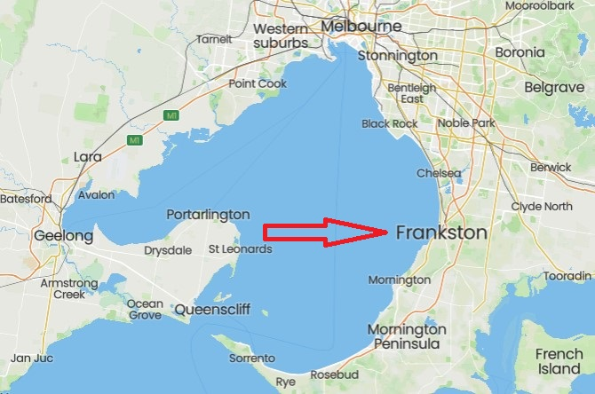
Frankston, Victoria – 41 kms south-east of Melbourne

Slide 6
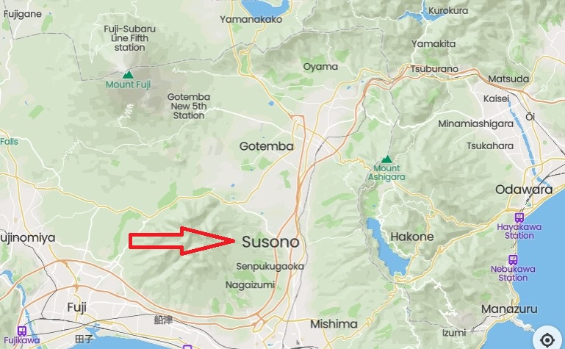
Susono, Shizuoka, Japan – 96 km south-west of Tokyo

Slide 7
Background
Yazaki manufactured electrical components for cars with world HQ in Susono, Oceania HQ in the City of Frankston
Delegation visits to/from both cities in 1981
Sister City Proclamation signed at simultaneous ceremonies in Frankston and Susono on 22nd February 1982
Relationship developed and strengthened via frequent delegation visits and homestay program, student exchange program, Fairs and Festivals, Speech Contests, Friendship Gardens in both cities, school group visits, Language Assistants program, and providing business networking opportunities for over 40 years.

Slide 8
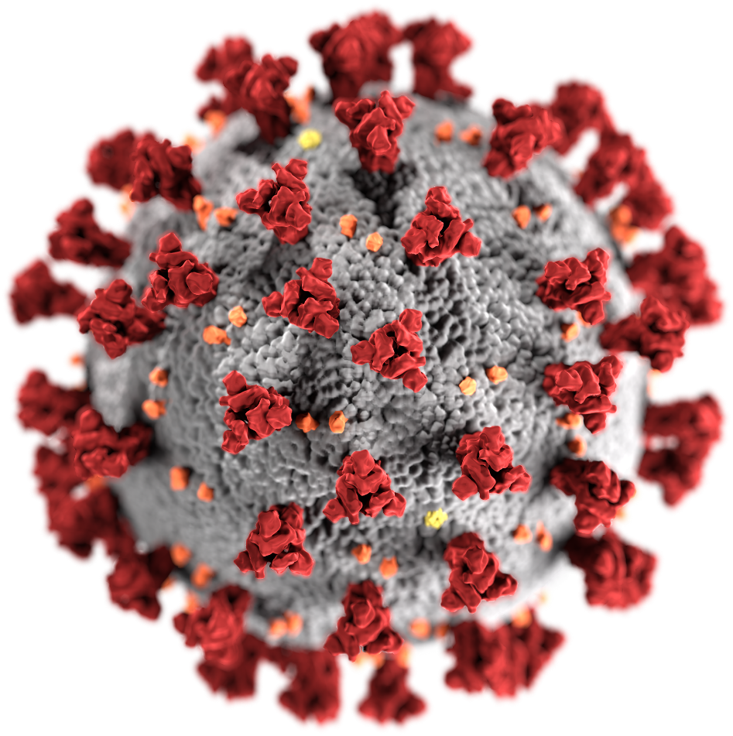
And then …

Slide 9
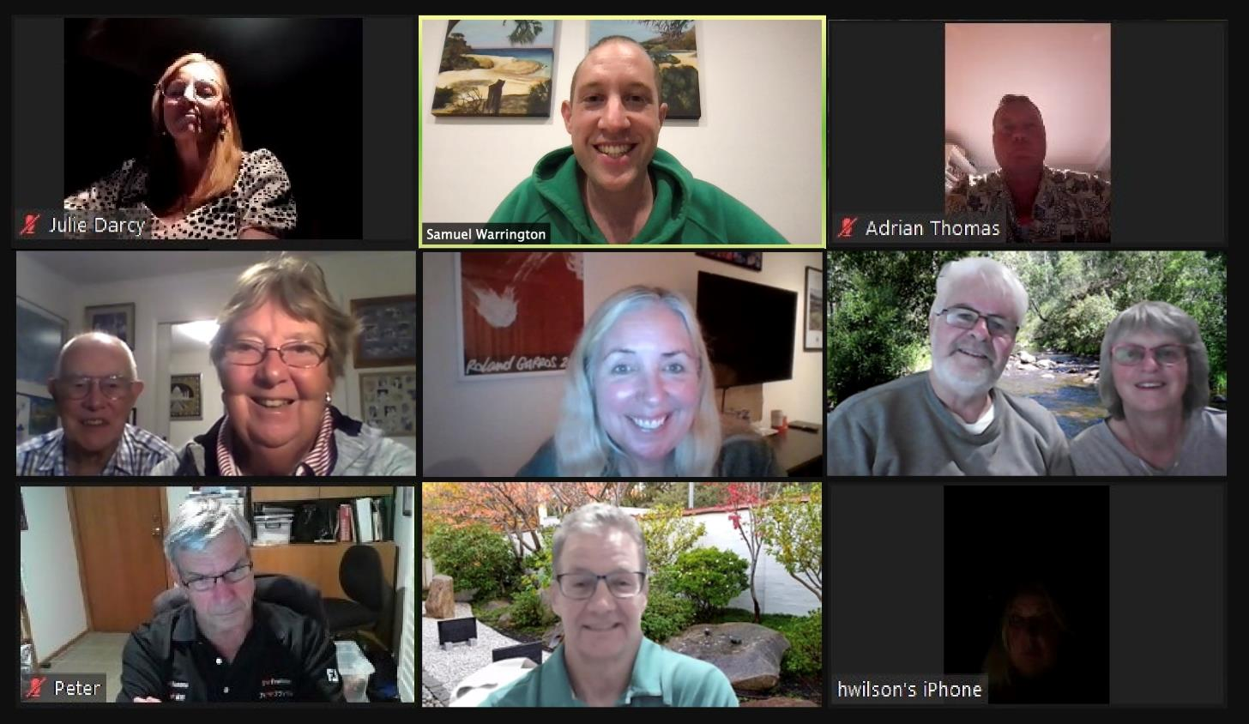
Initiatives FSFA has undertaken in response to COVID-19:
Monthly committee meetings held via Zoom since April 2020

Slide 10
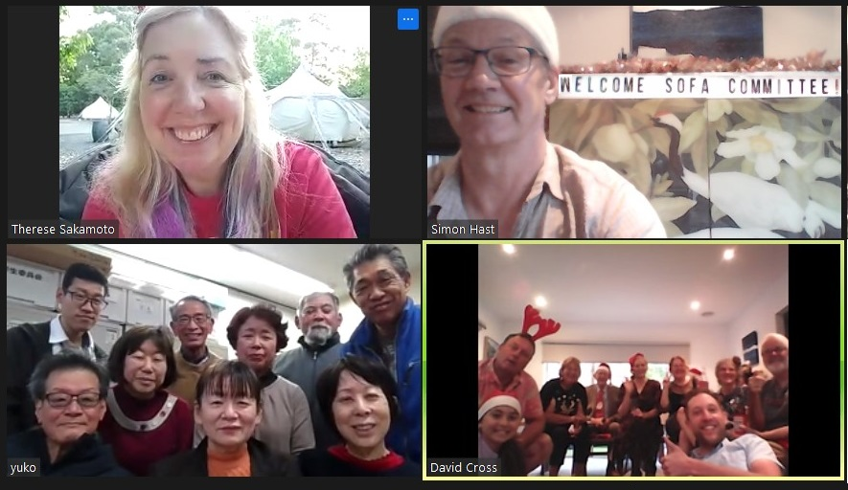
Quarterly meetings with the SOFA (Susono Overseas Friendship Association) Committee held via Zoom

Slide 11
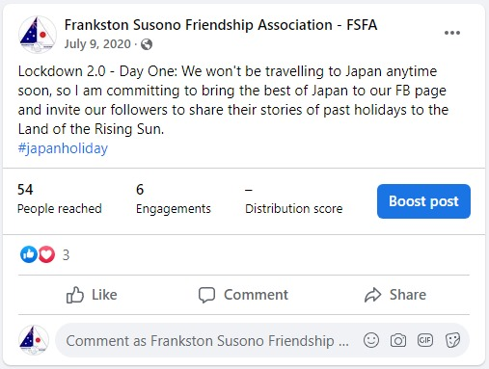
Daily Facebook posts were created during Victoria’s Lockdown 2.0 – 9th July – 28th October (112 days!)

Slide 12
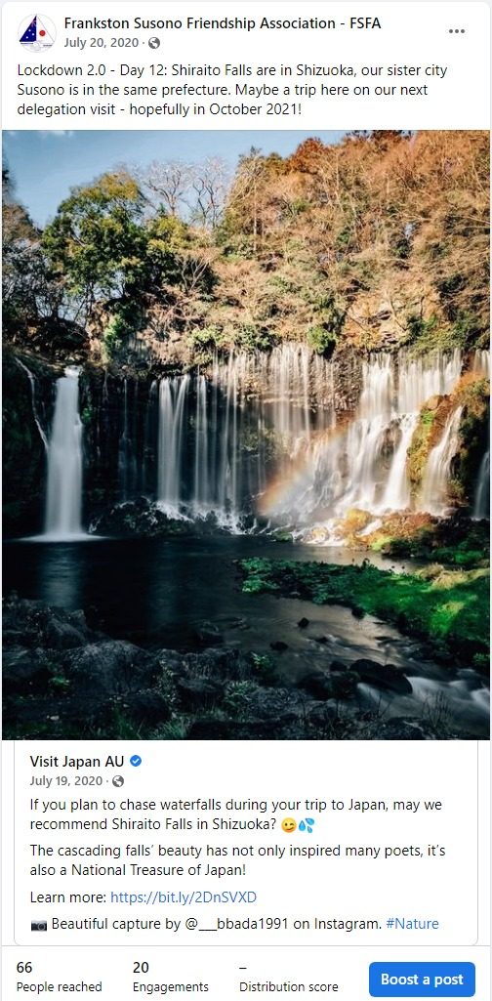
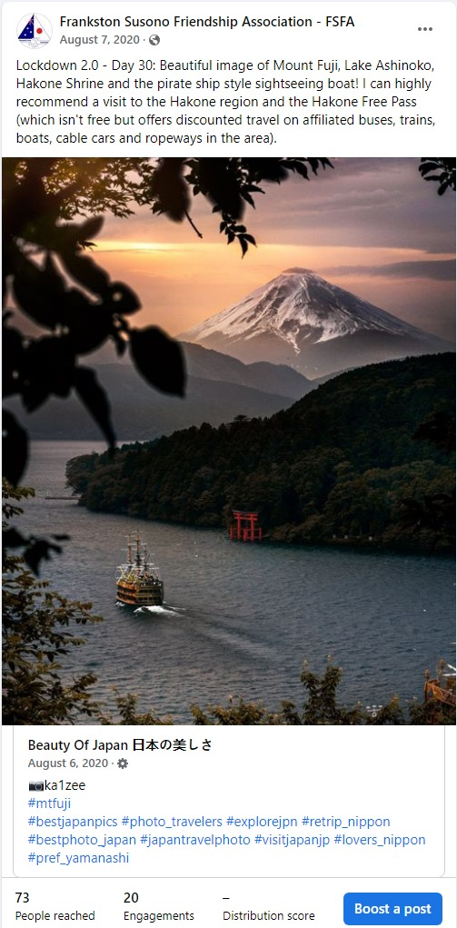
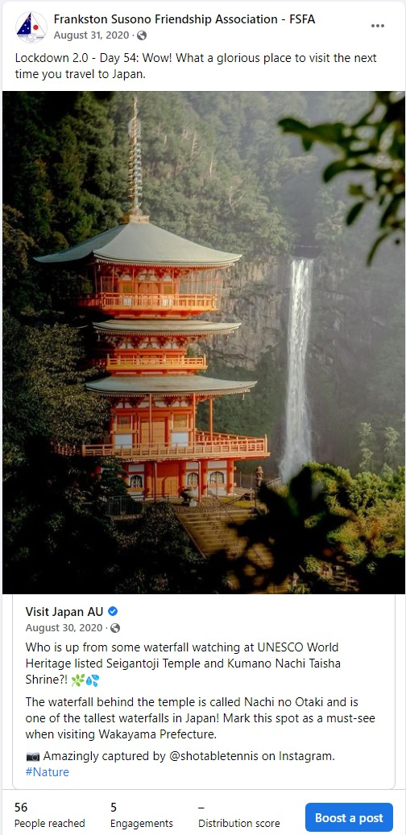

Slide 13
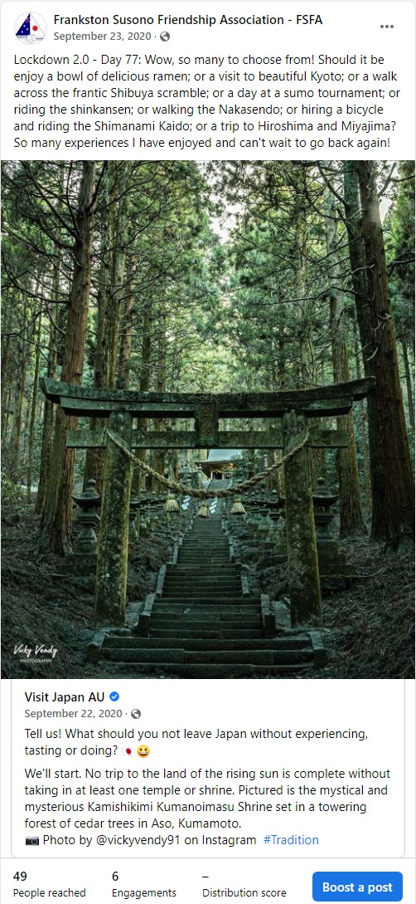
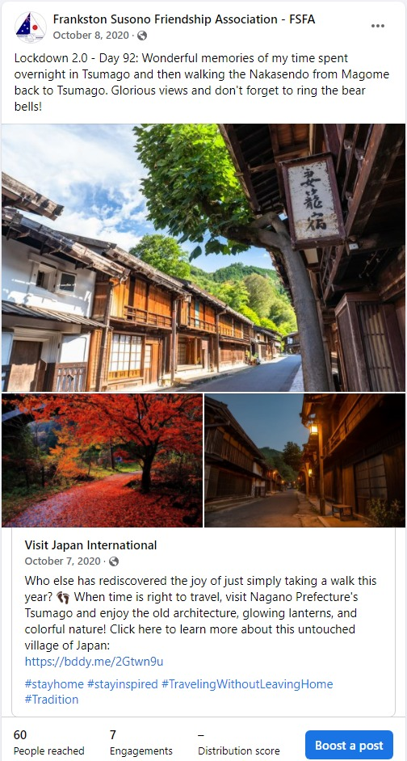
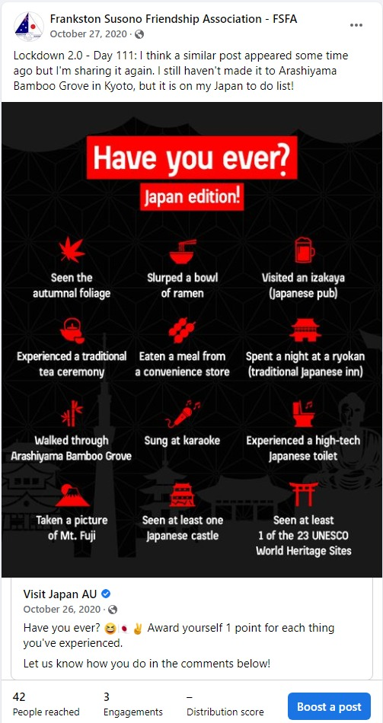

Slide 14
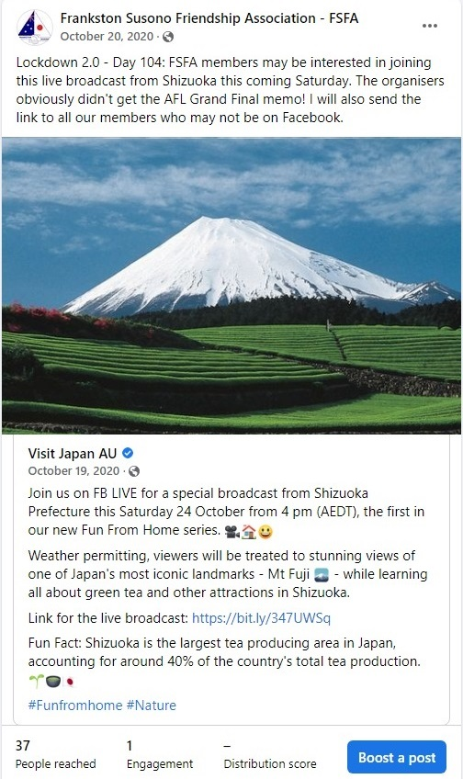
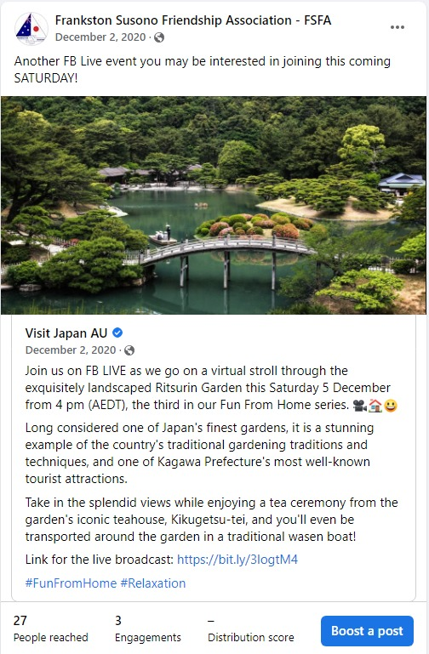
Promoting Facebook LIVE events

Slide 15
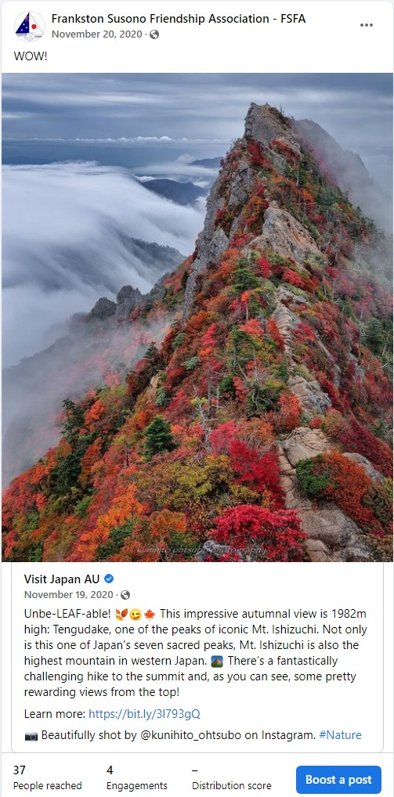
Recommended Facebook pages for Japanese content:
Visit Japan AU
Visit Japan International
Nature of Japan
Our Japan
Japan Live
Images of Japan
Beauty of Japan
(I can post these FB sites in the chat if you wish)

Slide 16
Susono City’s 50th Anniversary Ceremony – 10th October 2021

Slide 17
FSFA contributed the following items for SOFA’s 40th anniversary events:
Frankston Showcase Video – 15 minutes
“Messages From Frankston”
Frankston Map Project
Frankston Information Booklet & “I LOVE FRANKSTON” stickers (posted to Susono)
These items were part of the SOFA display celebrating the anniversary and was held at the Susono Lifelong Learning Centre from 1st – 13th February.

Slide 18
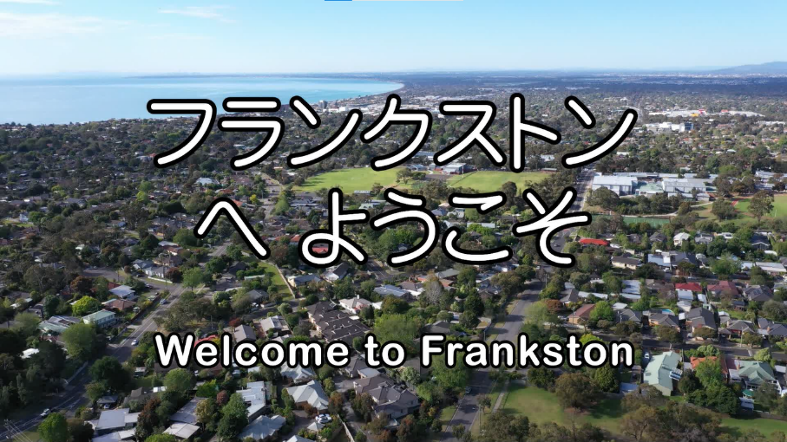
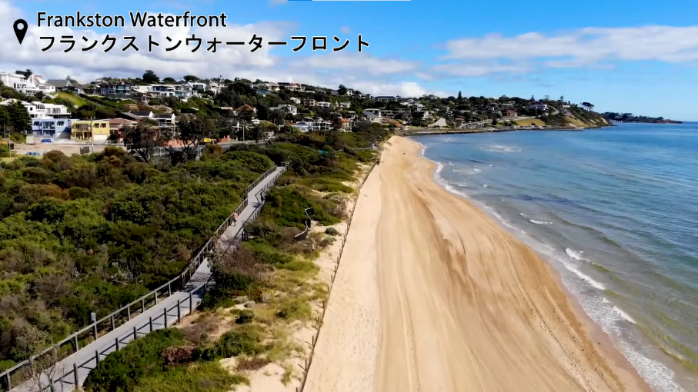
Frankston Showcase Video – 15 minutes
Featuring prominent and recognisable Frankston landmarks and locations
Key FSFA members introduced each segment
Each location identified in Japanese and English
English and Japanese subtitles throughout

Slide 19
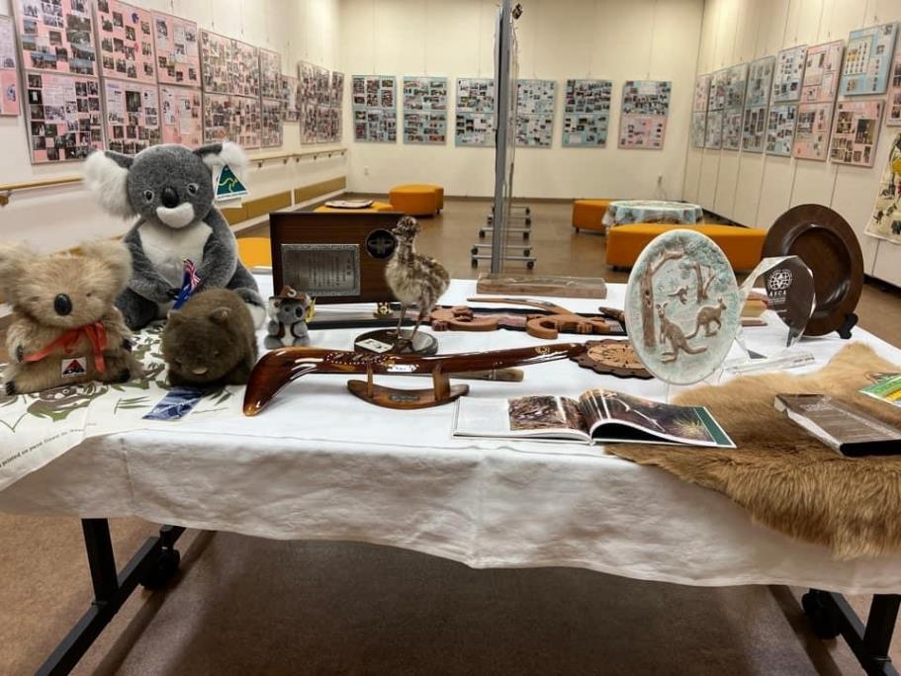
“Messages From Frankston”
Current and former FSFA committee members, FSFA Life Members, former exchange students, school principals & teachers, and past delegation members contributed messages of congratulations and goodwill
Messages combined into a word document
Document emailed to SOFA and printed
Featured at SOFA’s 40th anniversary display

Slide 20
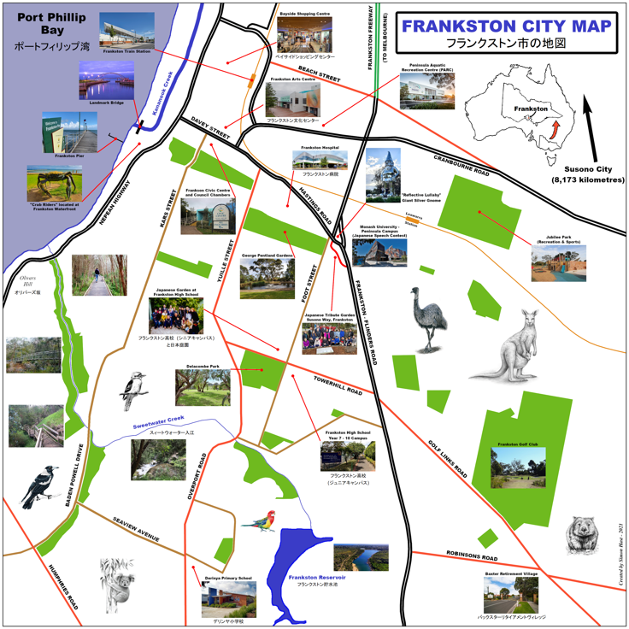
Frankston Map Project
Map (90 x 90 cm) created from scratch to include city centre, major roads and key landmarks
Features many images, green spaces and Australian animals
Japanese translations included
FSFA’s gift to SOFA will be printed, framed and displayed in Susono schools

Slide 21
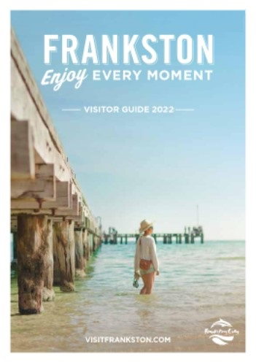
Frankston Information Booklet and “I LOVE FRANKSTON” Stickers
Sourced from the Frankston Information Centre
Posted to Susono and given to citizens at the 40th anniversary display

Slide 22
Student Exchange Activities During Lockdown and COVID
Derinya Primary School and Susono Nishi Elementary School
Regular Cultural Visits and Exchanges (August & October) cancelled
Both schools worked in conjunction with the Susono Board of Education
October 2021:
Students prepared handwritten pen-pal letters which also included origami, handmade bracelets, pictures and photos to surprise their pen-pals!
Webex live chats between classes with students preparing and presenting information about each other’s city
Self-introductions; interesting facts about each city; visual aids such as maps, photos and sketches aided the exchange of information

Slide 23
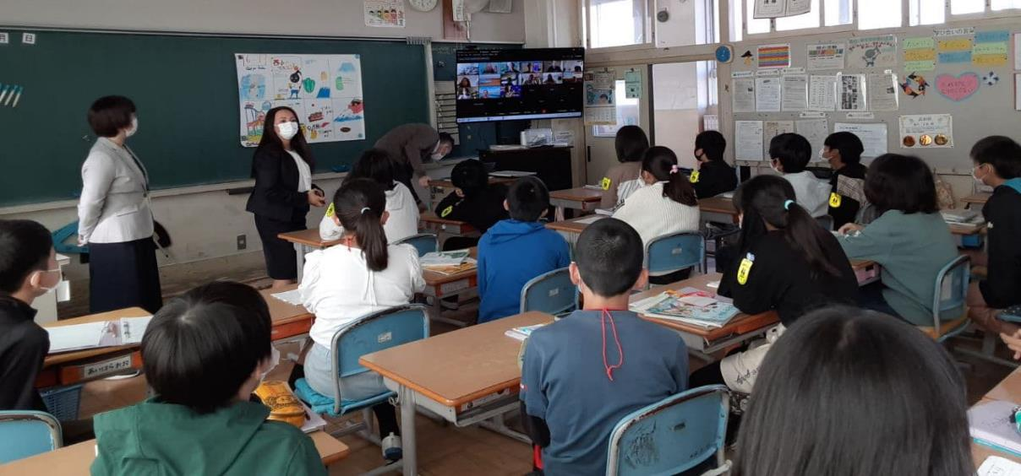
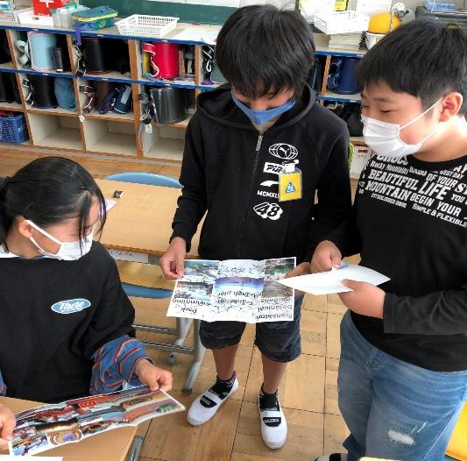
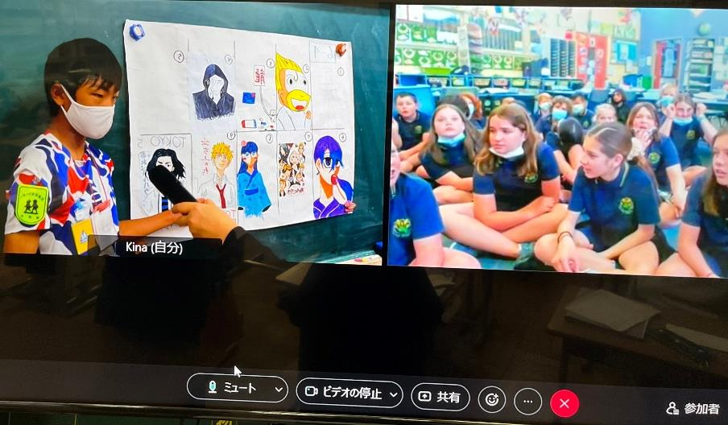
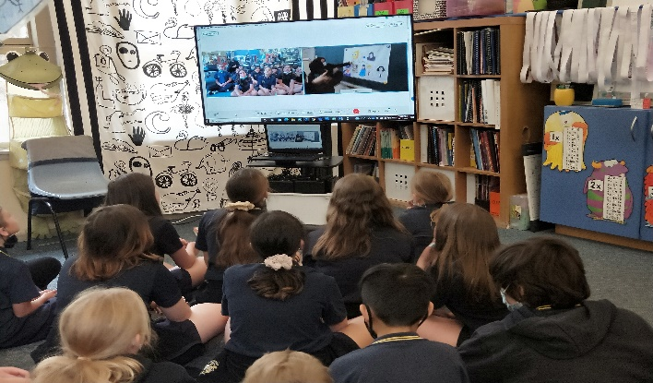

Slide 24
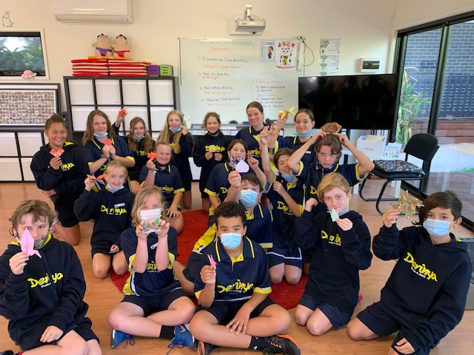
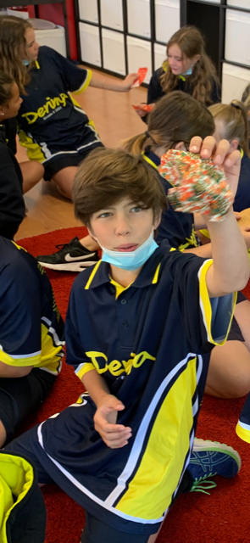
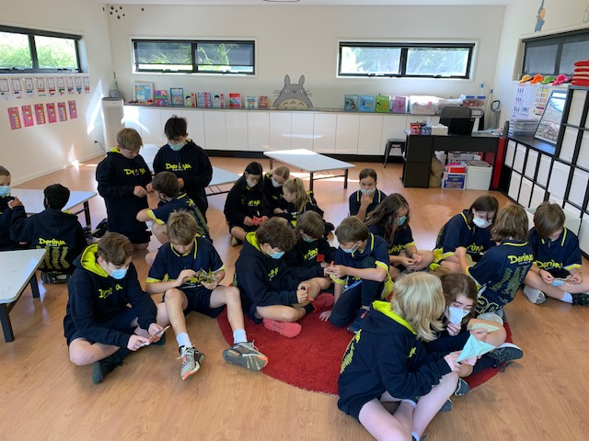
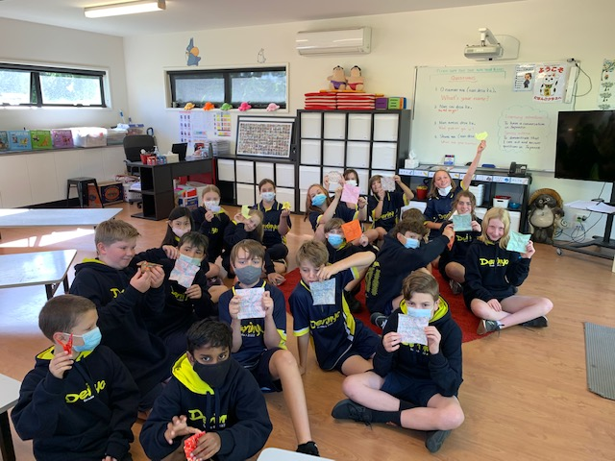
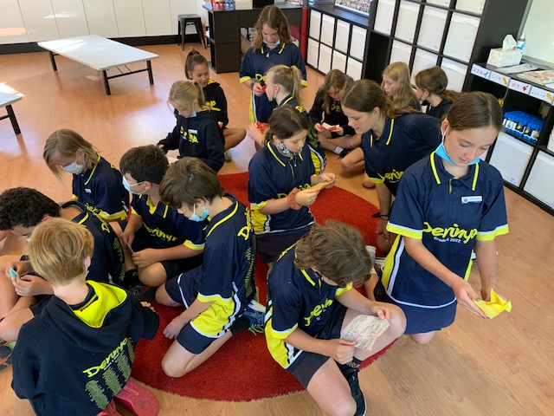

Slide 25
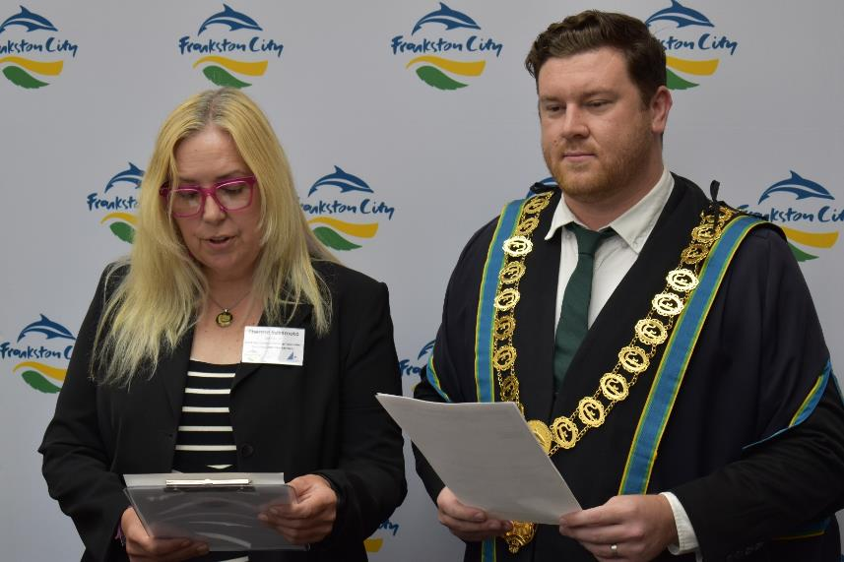
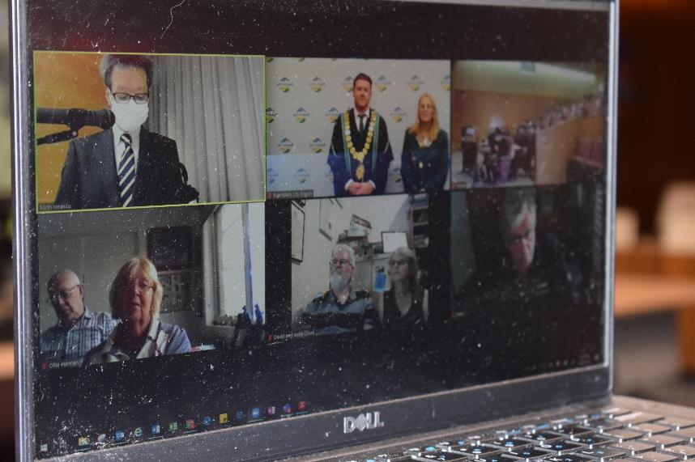
Susono’s Sister City 40th Anniversary Ceremony – 12th February 2022
Very formal ceremony
Frankston Showcase Video opened the ceremony
Speeches by Frankston Mayor and FSFA Chairperson via Zoom with Japanese translations provided by FSFA committee members (former exchange students)

Slide 26
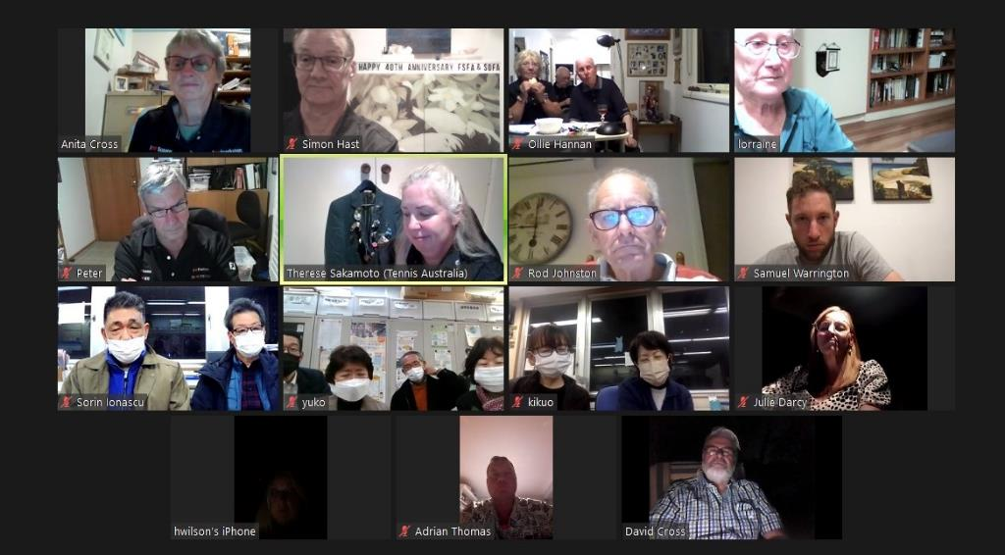
Frankston’s Sister City 40th Anniversary Ceremony – 22nd February 2022
Informal with FSFA/SOFA committees + Life Members & former Chairpersons
Speeches and introductions by current FSFA & SOFA Chairpersons
40th Anniversary Slideshow followed by a toast to our 40th anniversary!
3 FSFA Committee Members sharing their favourite memories

Slide 27
COVID has presented us with enormous challenges!
We have missed the delegation visits, Festivals & Fairs, speech contests, student exchanges/visits, face-to-face contact and friendship built over 40 years
Responded by thinking outside the box, adaptability, use of technology
Ironically, online meetings have allowed us more frequent contact with SOFA!
We are planning our Japanese Speech Contest, Susono Delegation, Homestay Visits, Japanese Festival, Hanami (Cherry Blossom Viewing) Party for 2022!
Life is returning to a new normal . . . Thankfully!

Slide 28
Thank you for your interest and attention!

