Slide 1
Mildura Sister City Association
Our link is with Upland, California, United States

Slide 2


Slide 3
The Mildura – Upland link is unique because our two cities were founded by the same two brothers, George and William Chaffey
Where is Upland ?
45 minutes drive east of Los Angles, on Route 66
Fly into LA International Airport
Similarities:
Both started as irrigation settlements
Structure and lay out of properties
Main Streets ,Deakin Avenue and Euclid Avenue, lay out the same
Town Planning
Community ideals
How our Sister City Came about - 51 years ago…
Brief history

Slide 4
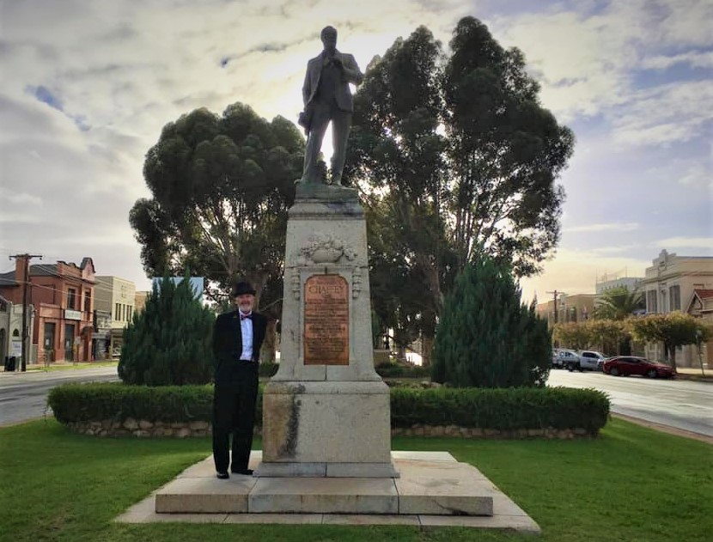
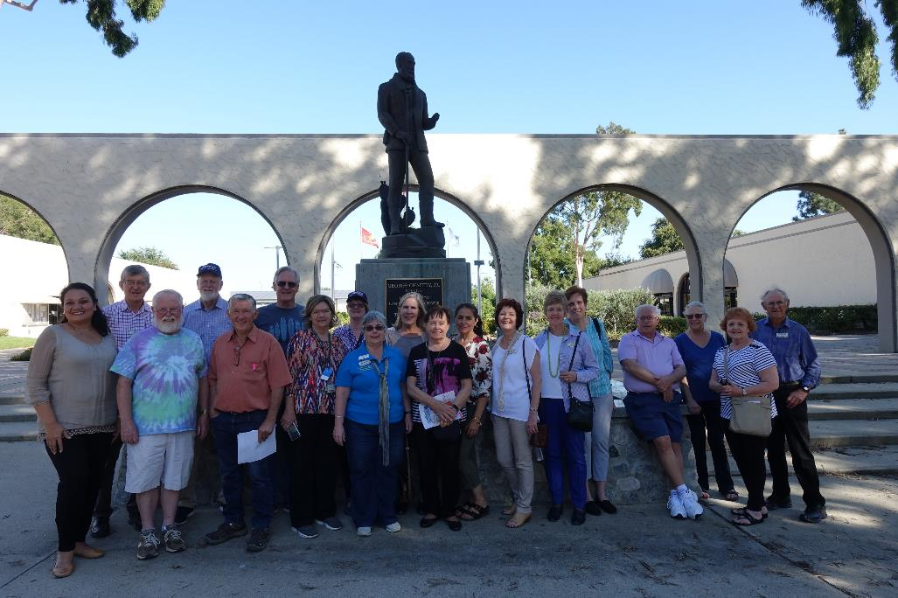
Statue’s
WB Chaffey (Mildura) George Chaffey(Upland)

Slide 5
…. In 1969, the City of Upland invited the City of Mildura to become “Sister Cities”……
53 years later our “family of friends” has grown and collected many happy memories.
We have enjoyed many visits to and from Upland over the years: members visits, school trips, job exchange

Slide 6
2019
Our Covid story starts in
Feb: Klopp competition with shared meal (outdoors)
April : Fort Courage Weekend
May: Upland Sister City visit
June: Uplanders Extended 7 day tour of Australia, arranged and hosted by Mildura Sister City
July 1: Canada/Brockville Flag Raising
July 4: American /Upland Flag Raising
October: Mildura visits Upland
November: Thanksgiving

Slide 7
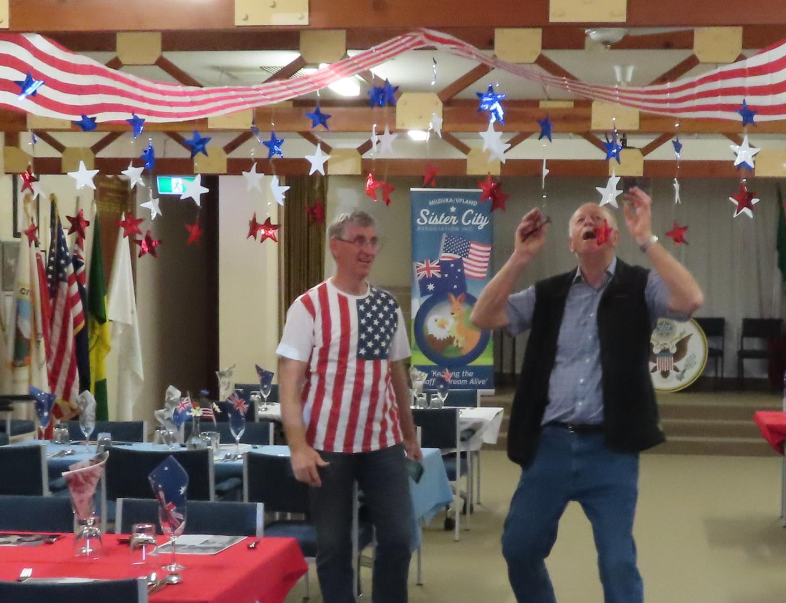
Decorations for a welcome to our Upland guests in May 2019

Slide 8
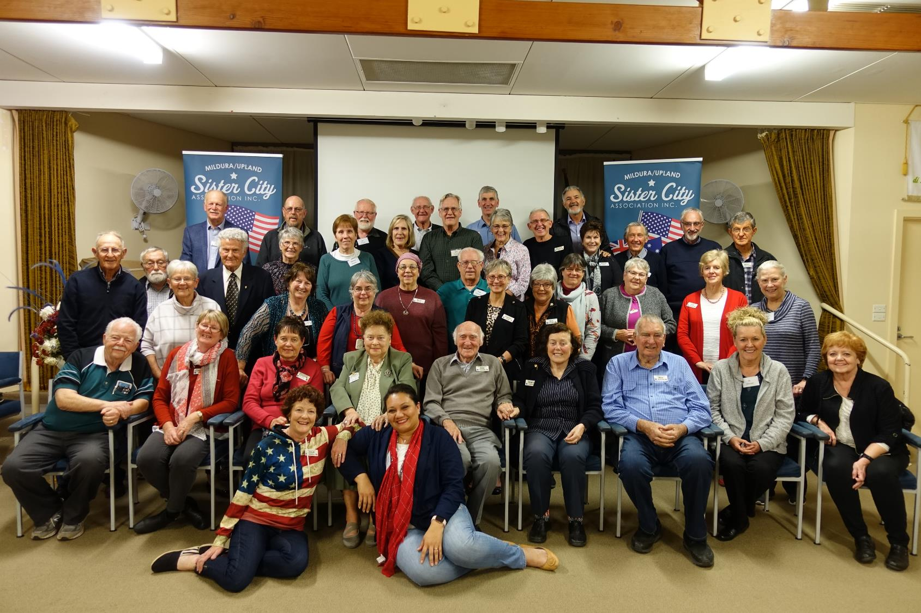
2019 Celebration of 50 years of Friendship

Slide 9
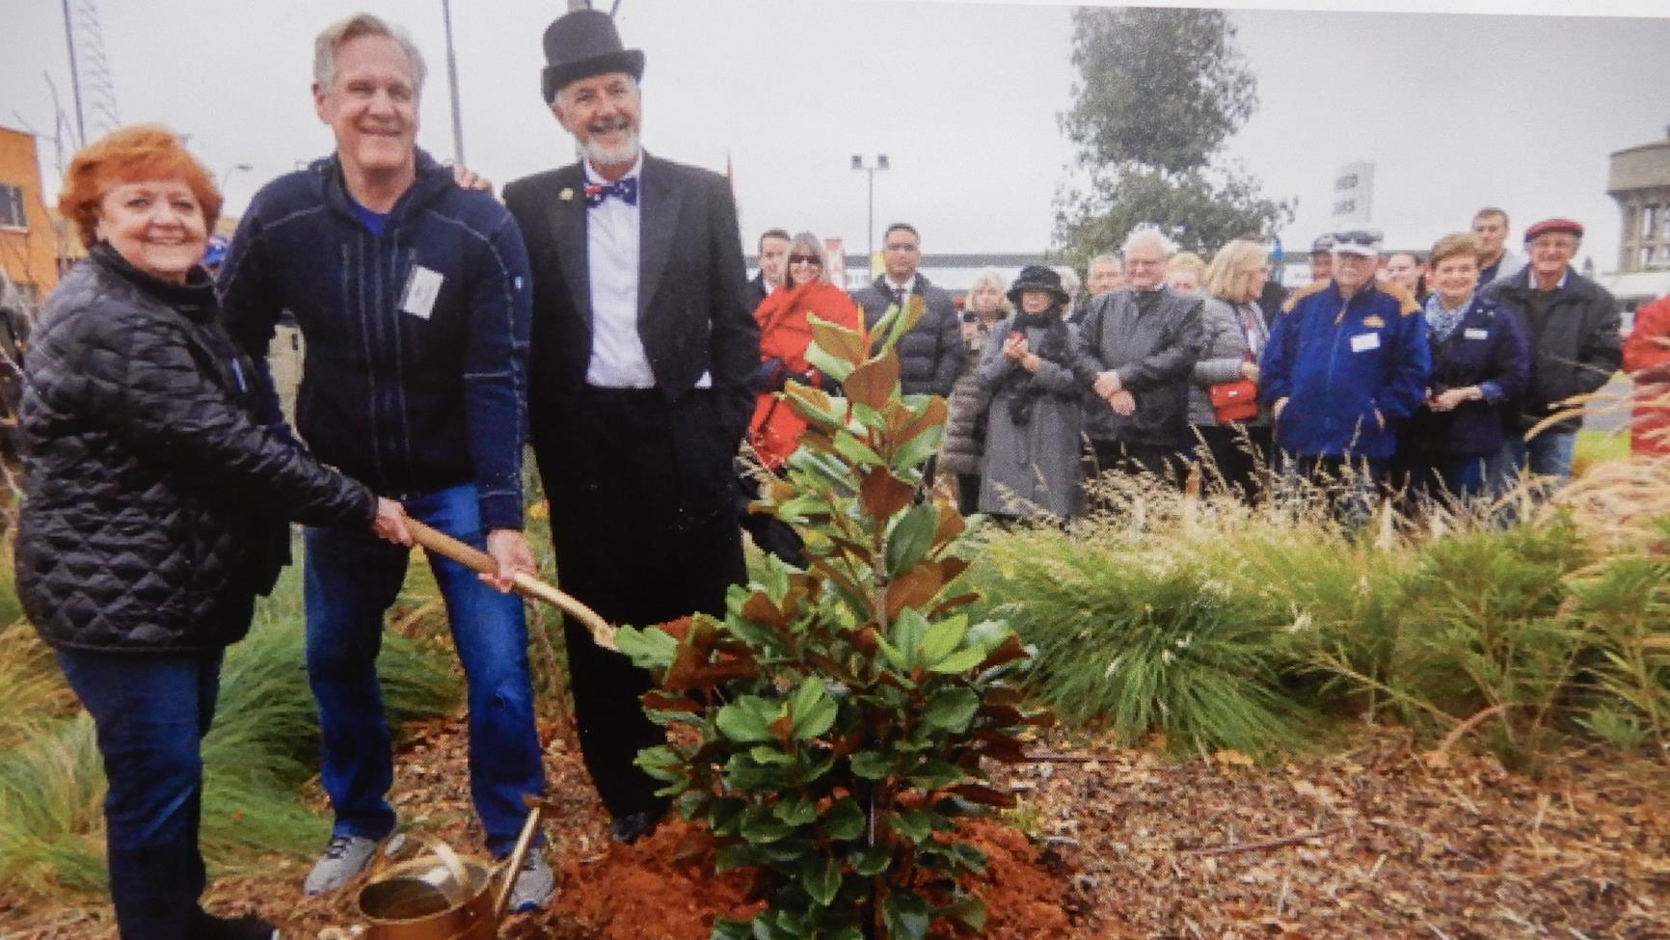

Slide 10
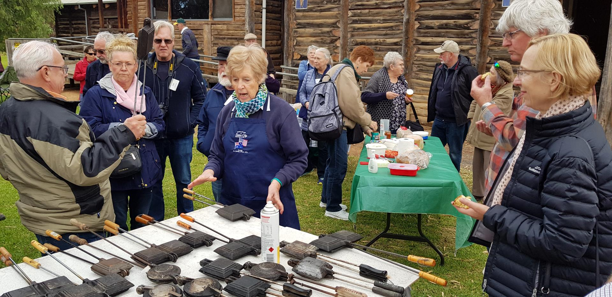

Slide 11
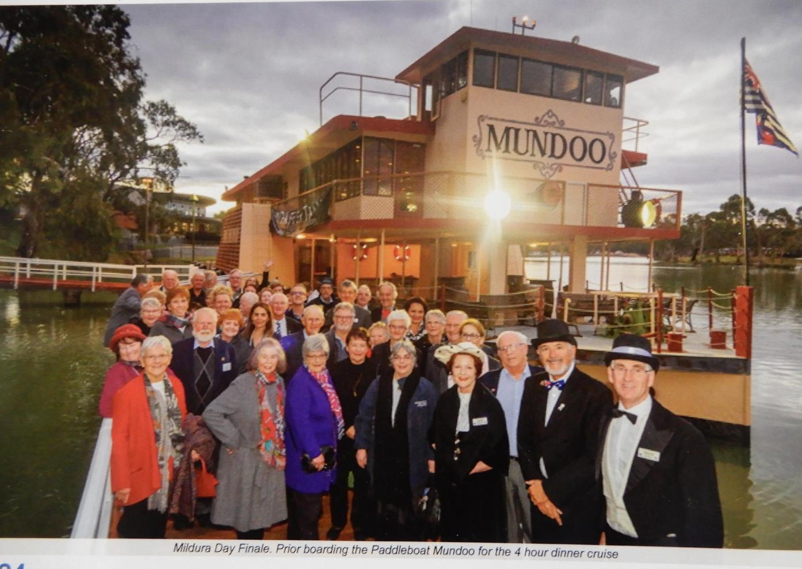
Mildura Day celebrations conclude with a night on the Paddleboat Mundoo – Mildura
Partnership with Chaffey Trail Reference Group and Chaffey family

Slide 12
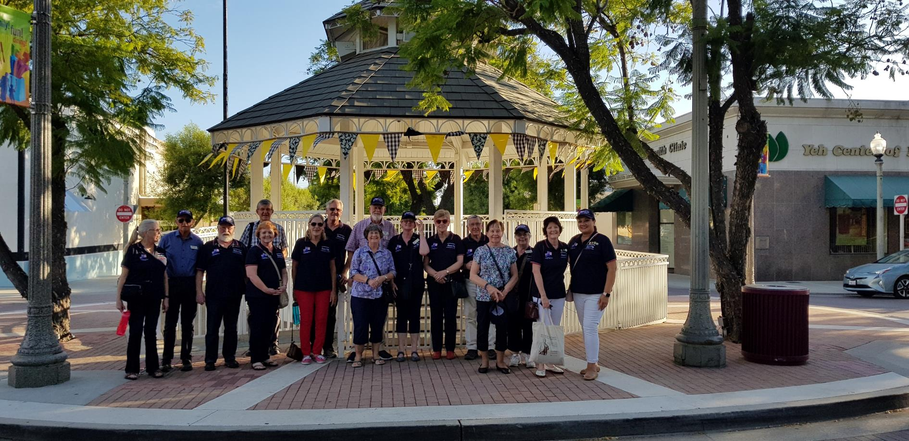
50th Anniversary Celebrations continue in Upland in October

Slide 13
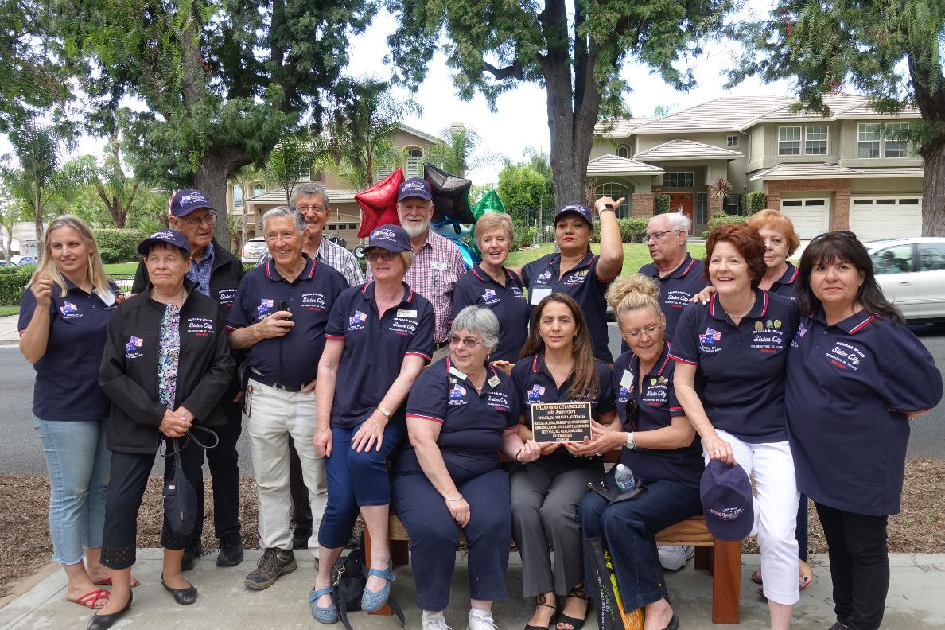
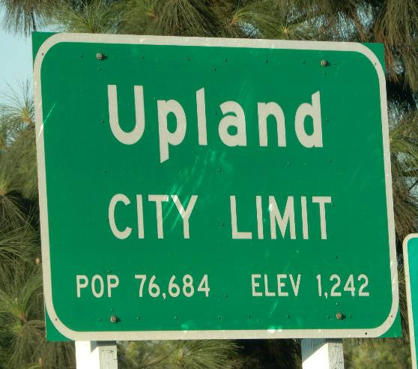
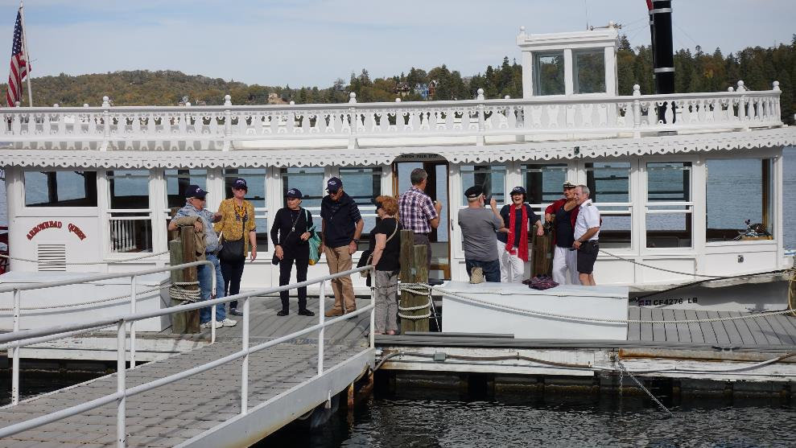
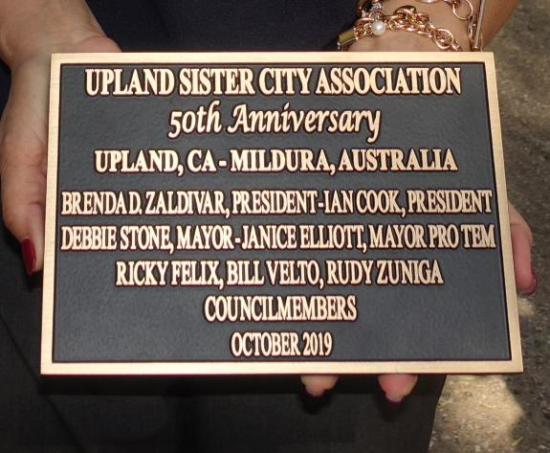

Slide 14
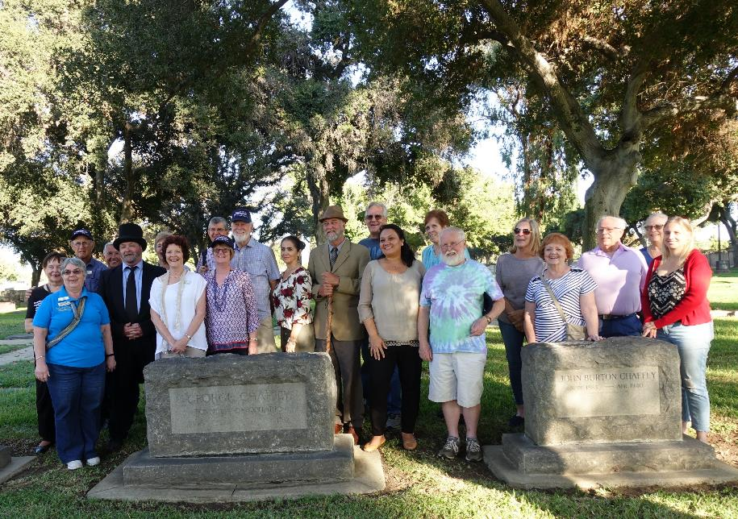
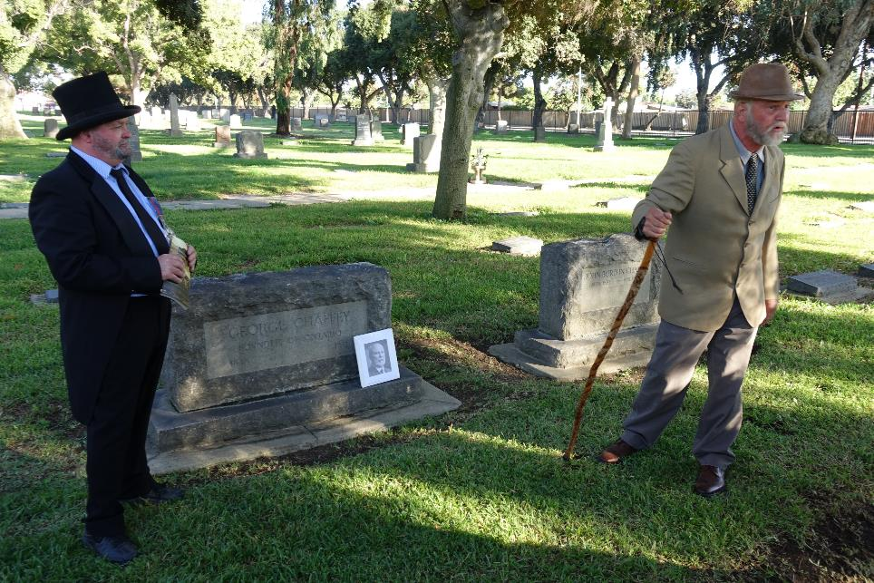
Bellevue Cemetery – George Chaffey headstone
Chaffey Bros (George & WB) re-enactment of their life…

Slide 15
2020
Feb: Klopps competition with shared meal (outdoors) - cancelled
May: Zoom Board Meeting
July 1: Canada/Brockville Flag Raising
July 4: American /Upland Flag Raising
December: Thanksgiving Dinner
Lockdown summary - Zoom meetings with Upland and local committee, phone calls, Facebook and reliving memories.

Slide 16
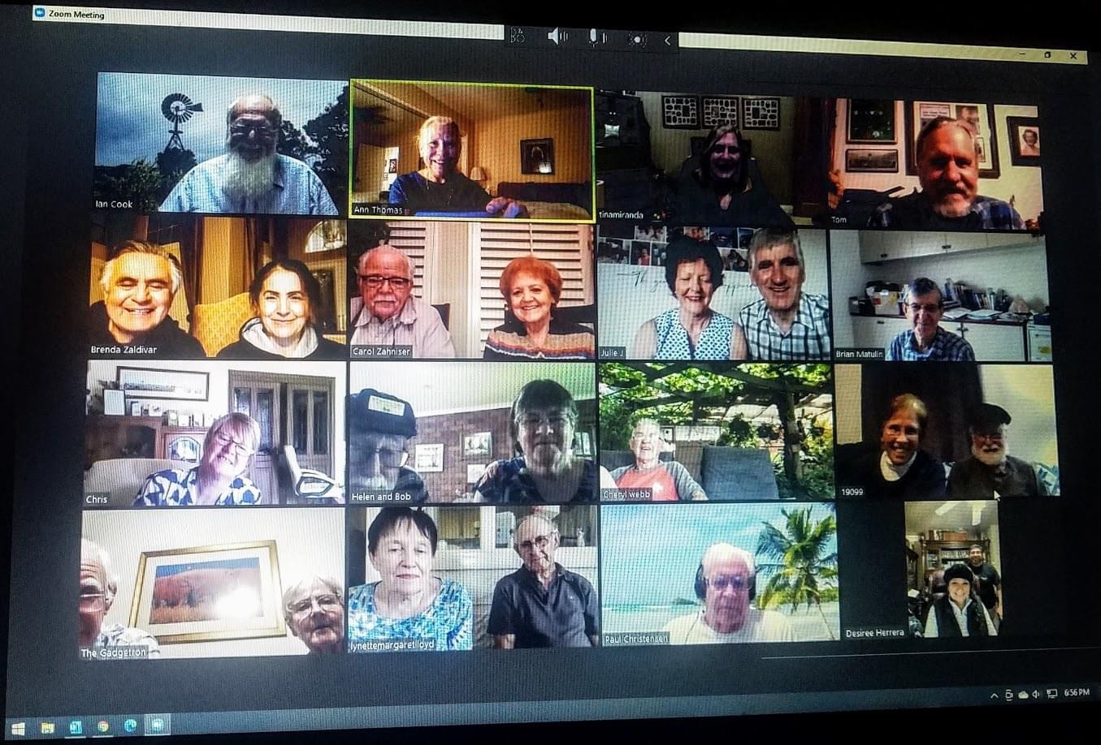
Regular Zoom ‘hello’s ‘
* Keeping everyone in touch, particularly elderly
*Communication in the lead up
* New ‘computer’ skills

Slide 17
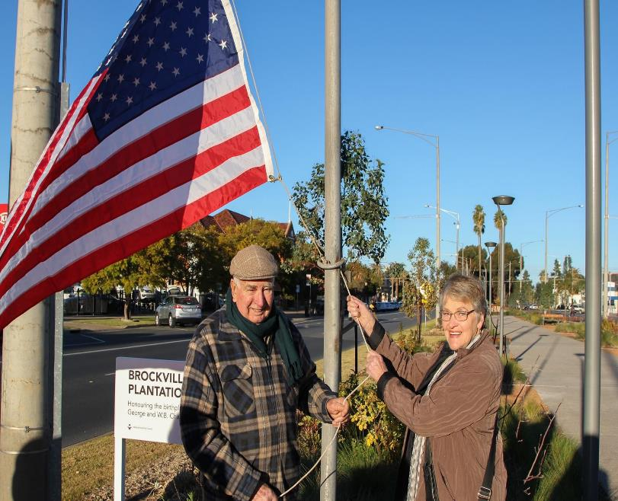
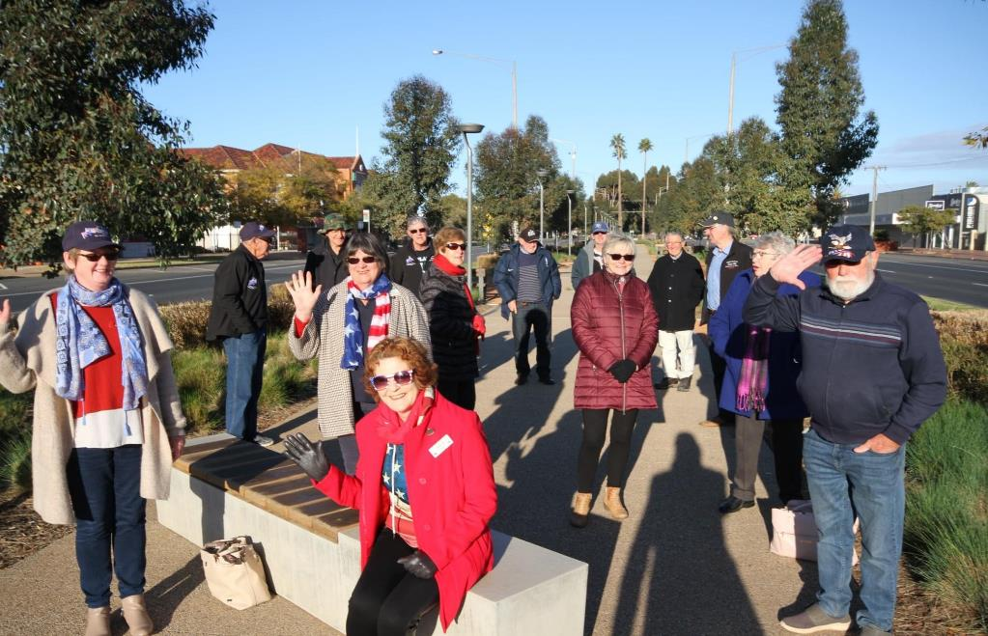
Annual Flag Raising 9am – 4 July, followed by coffee (2020) Social distancing

Slide 18
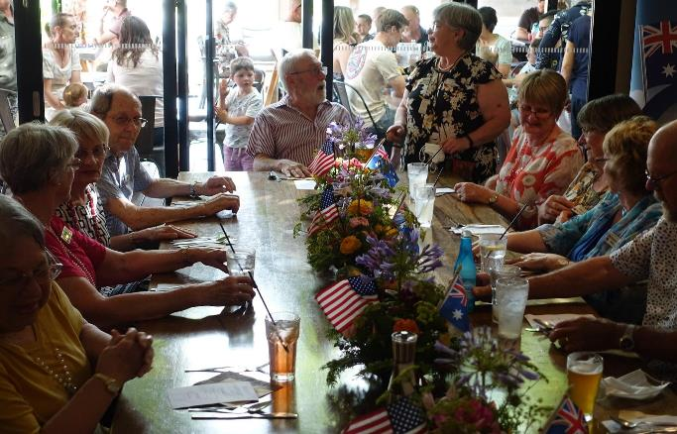
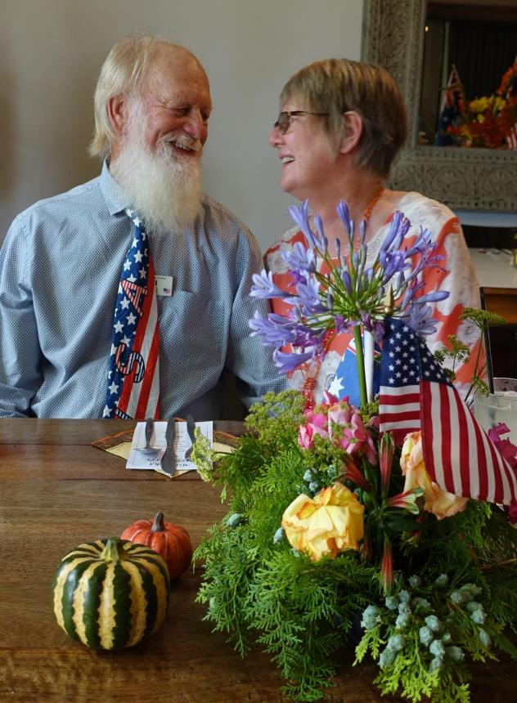
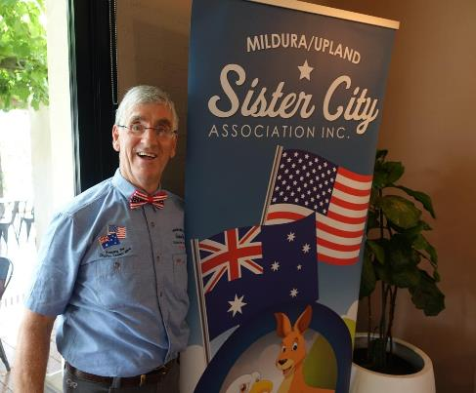
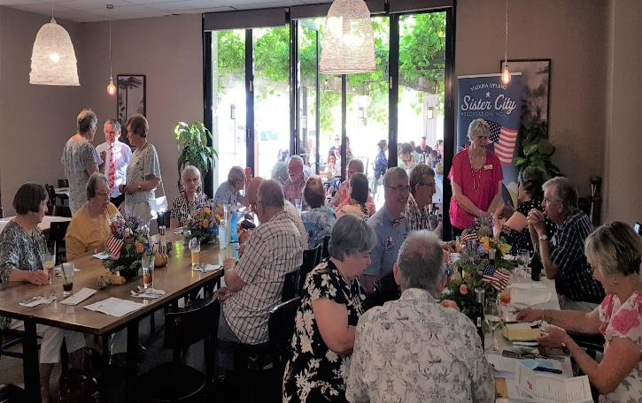
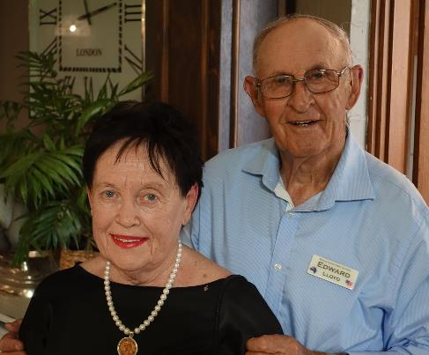
Thanksgiving AGM 28 Nov 2020 with Kris Kringle

Slide 19
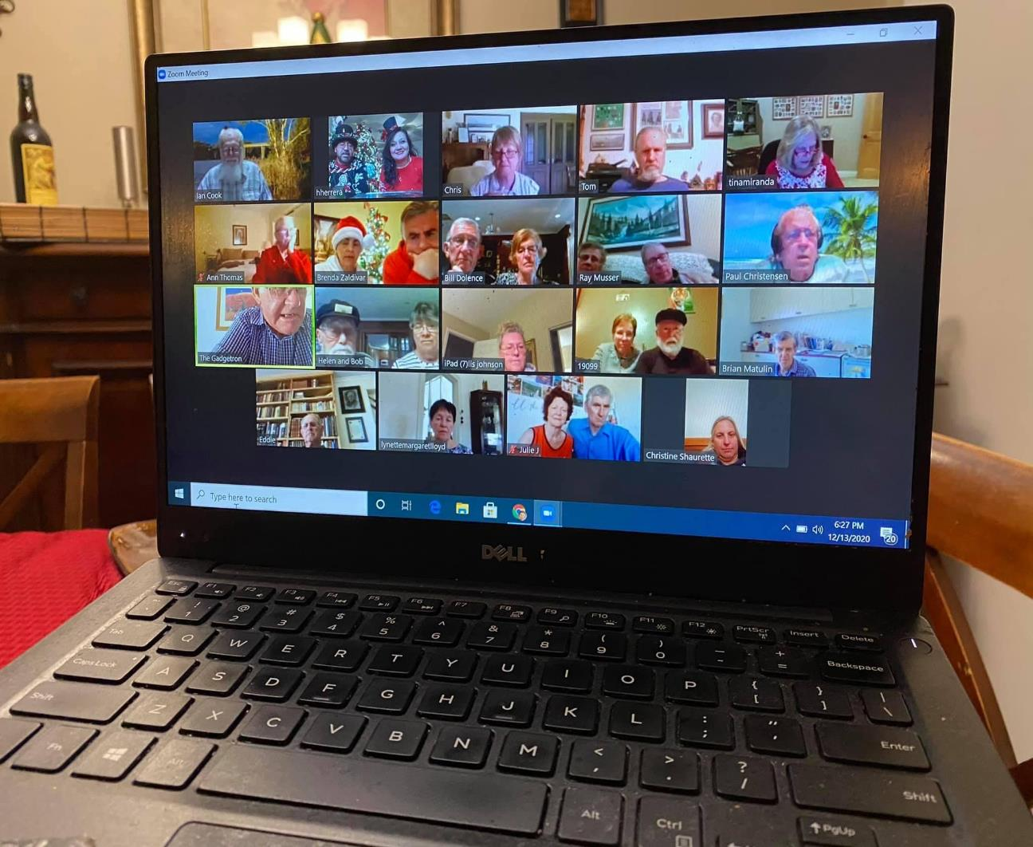
Christmas Zoom new screen backgrounds for some…
Christmas Greeting shared

Slide 20
2021
Much liaison with both members and Sister City members Upland re recipes, history updates, office bearers and exchanges
Feb: Klopps competition with shared meal (outdoors) - cancelled
Feb: Bunnings BBQ, involving about 15 members
Feb: Bench unveiling in Upland – live streamed
March: Mural Walk, involving 35 persons
April : Much contact/publicity between members about anticipated launch.
    Launch of 50 year Commemoration Book –Mildura and Upland members
May: Link with Mildura Day – Function at Langtree Hall

Slide 21
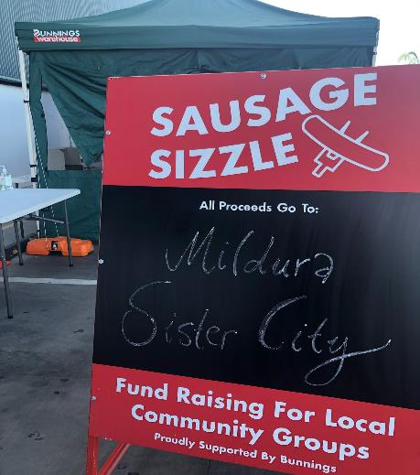
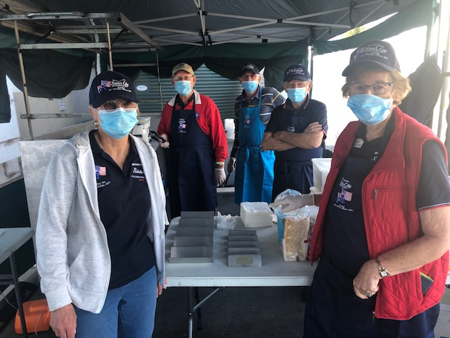
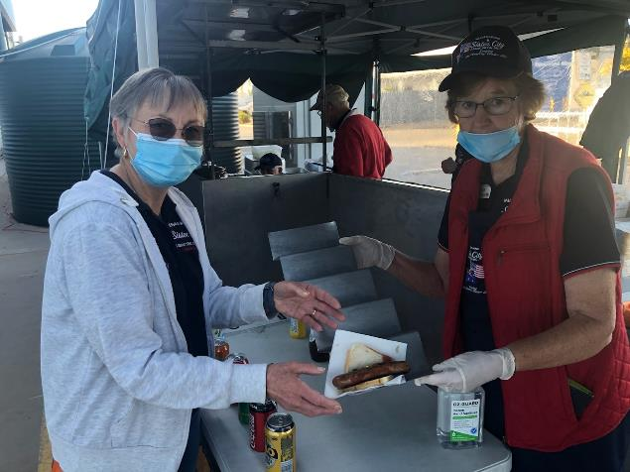
Bunnings BBQ - Fund raising

Slide 22
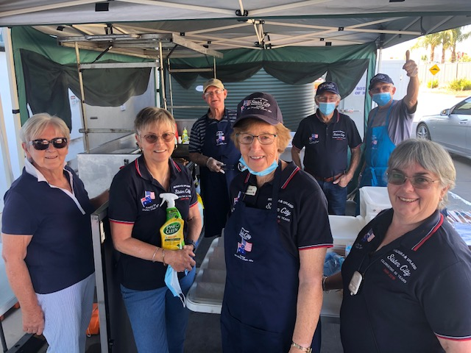
27 Feb 2021
Bunnings BBQ
Change of Shift – masks, sanitise, wipes, laughs as you enjoy the company of our community

Slide 23
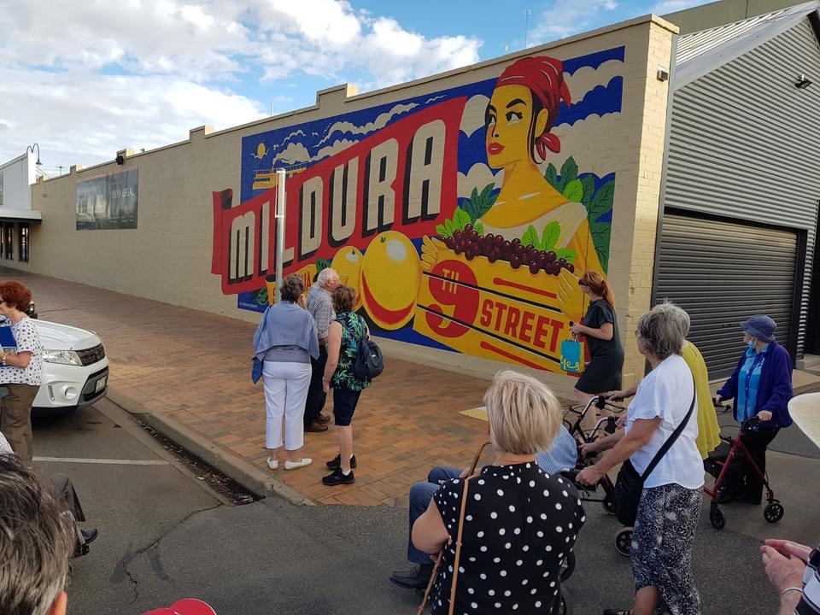
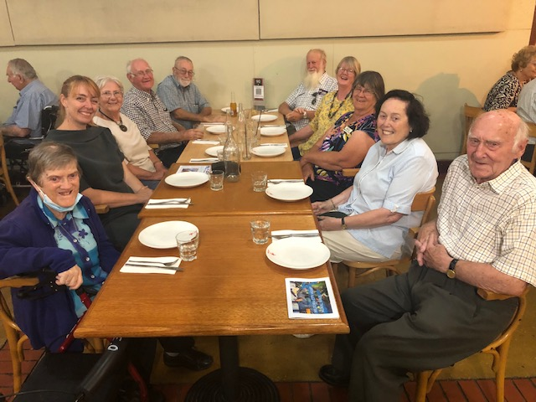
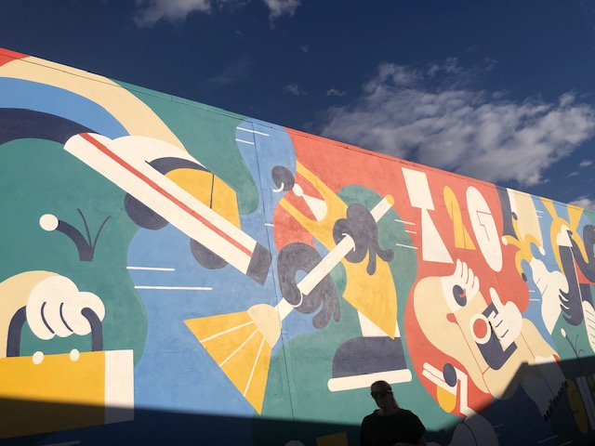
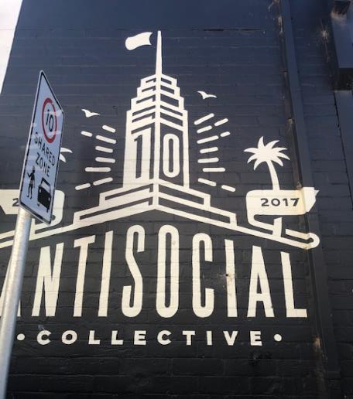
Mural Walk, followed by Pizza café for
35 members and friends

Slide 24
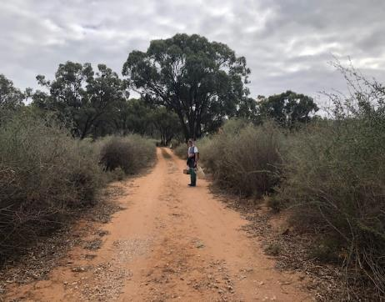
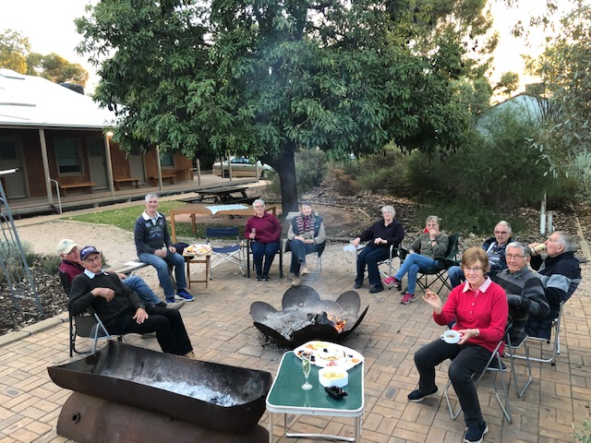
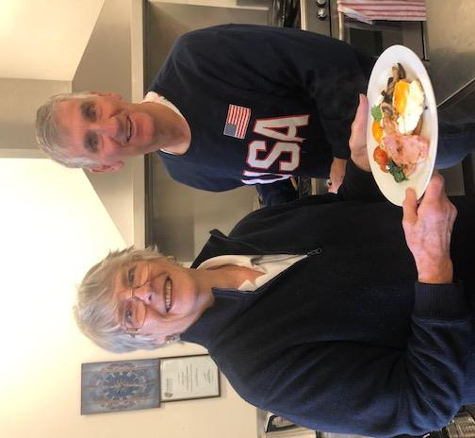
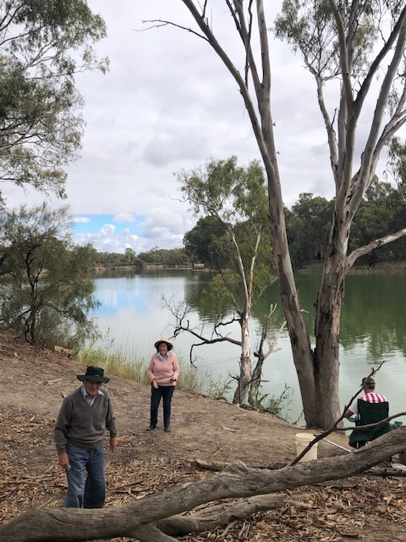
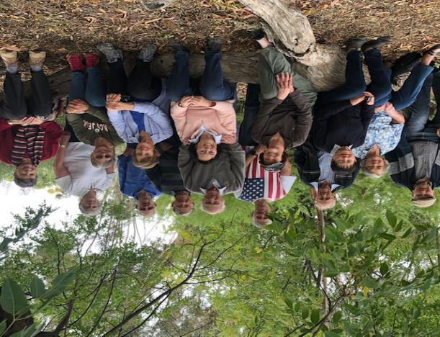
Ned’s Corner weekend getaway

Slide 25
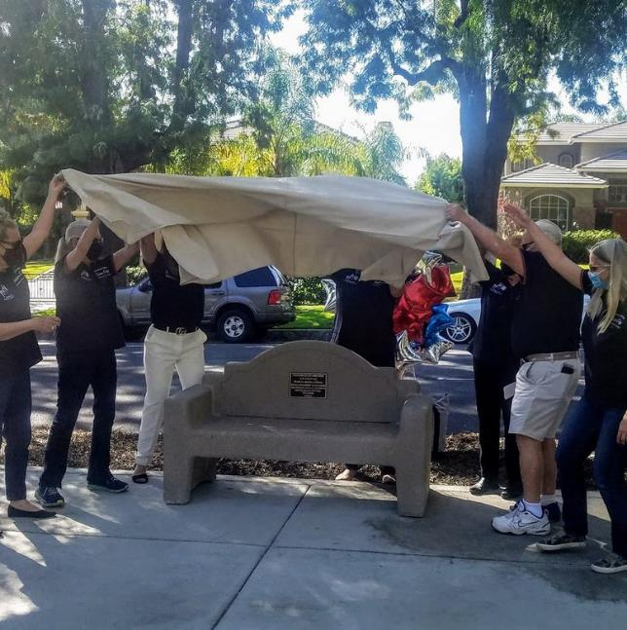
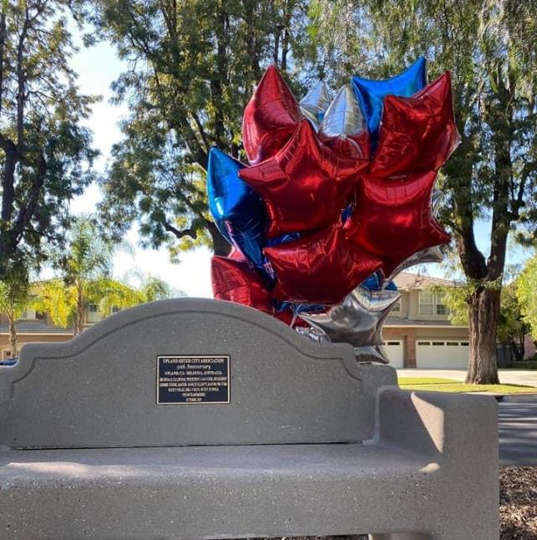
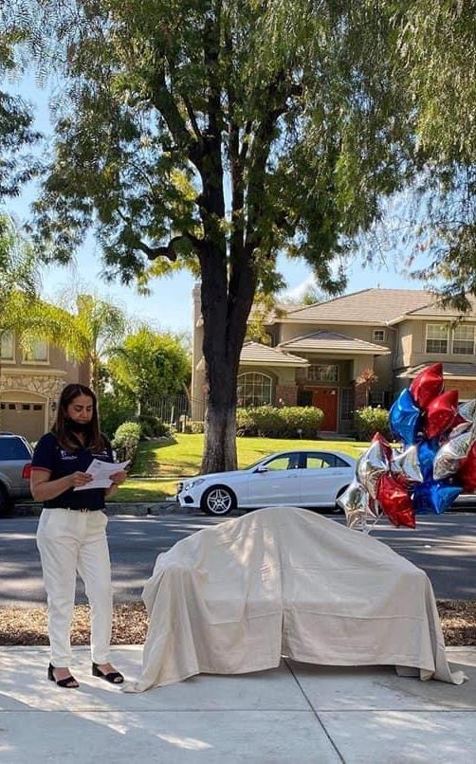
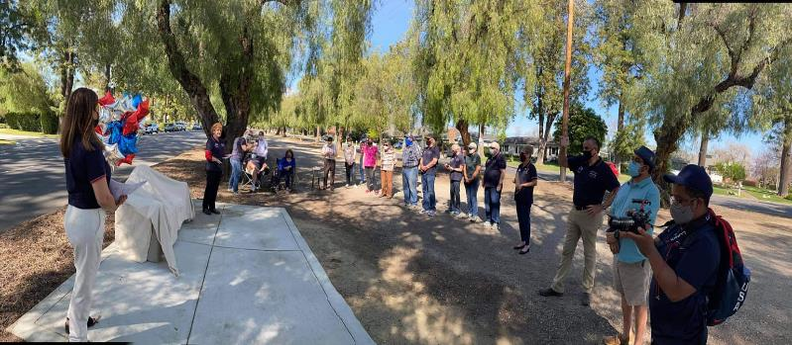
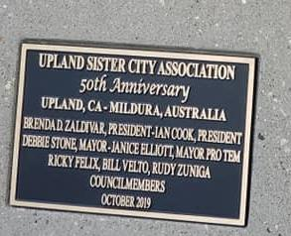
Upland unveil the new dedicated Mildura Sister City Bench (Euclid Ave, Upland) - we all watched live on Facebook messenger Live from their fb page
Made contact with our fb messenger friends.

Slide 26
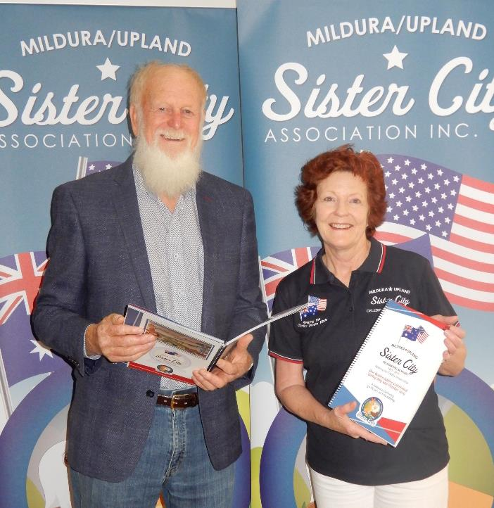
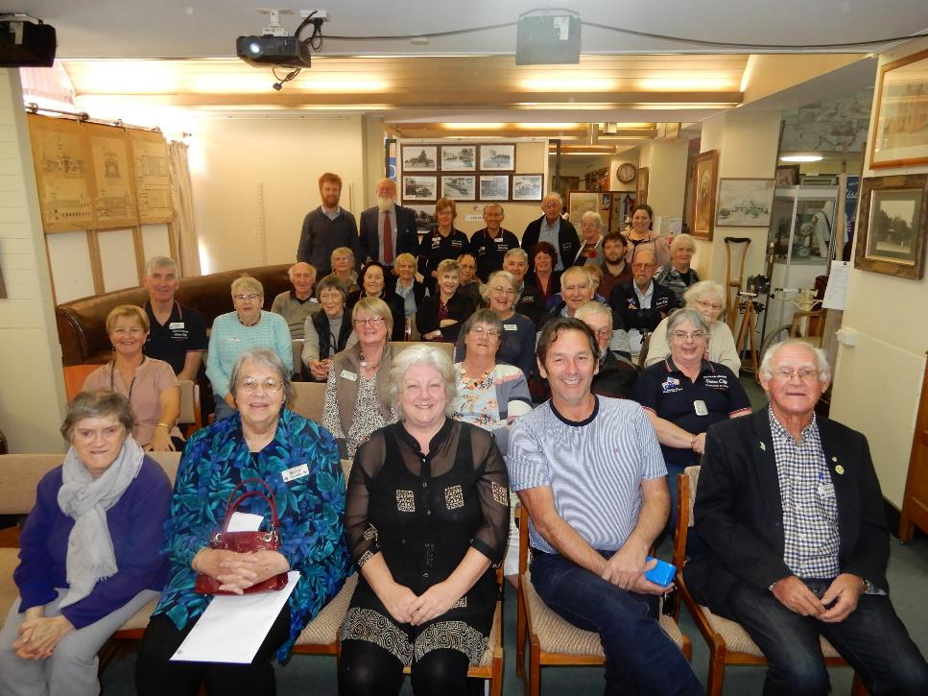
Our 100-page Sister City Book is launched, includes a bit of City history, our history, exchanges, visits, and even included about 100 recipes from both Upland and Mildura members

Slide 27
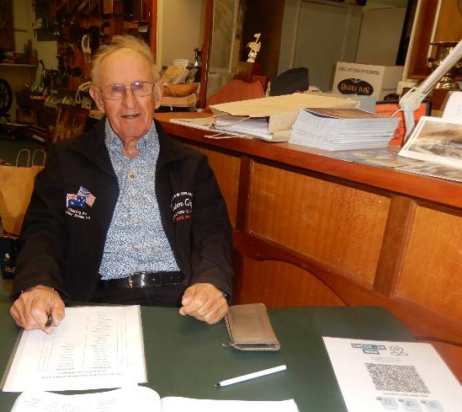
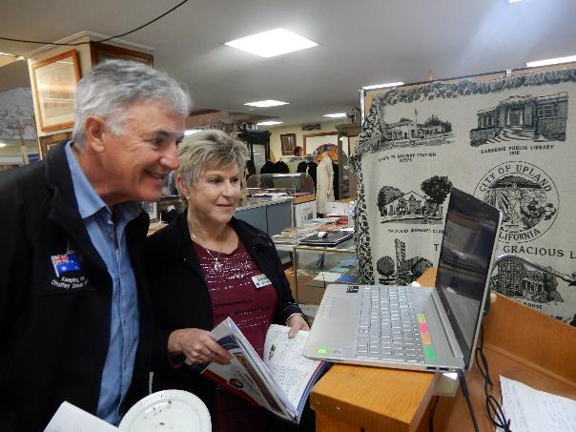
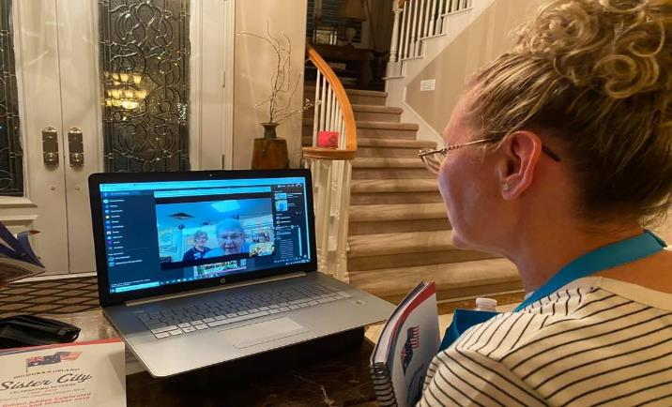
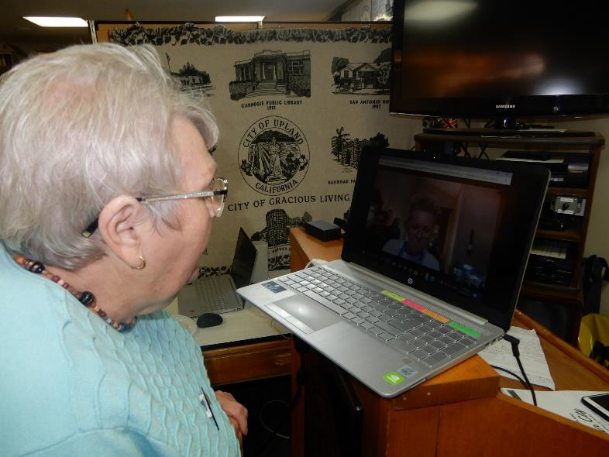
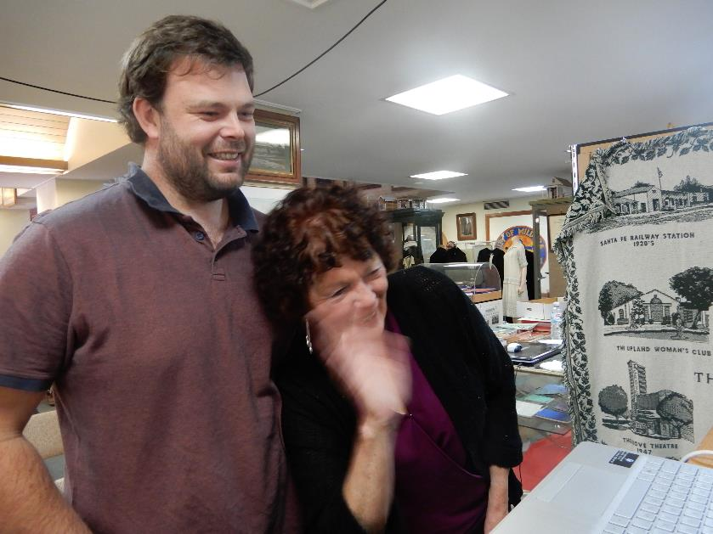

Slide 28
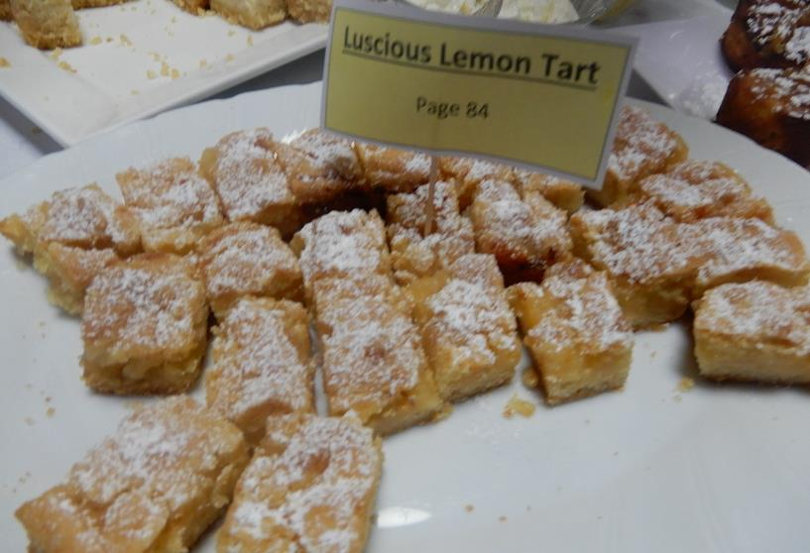
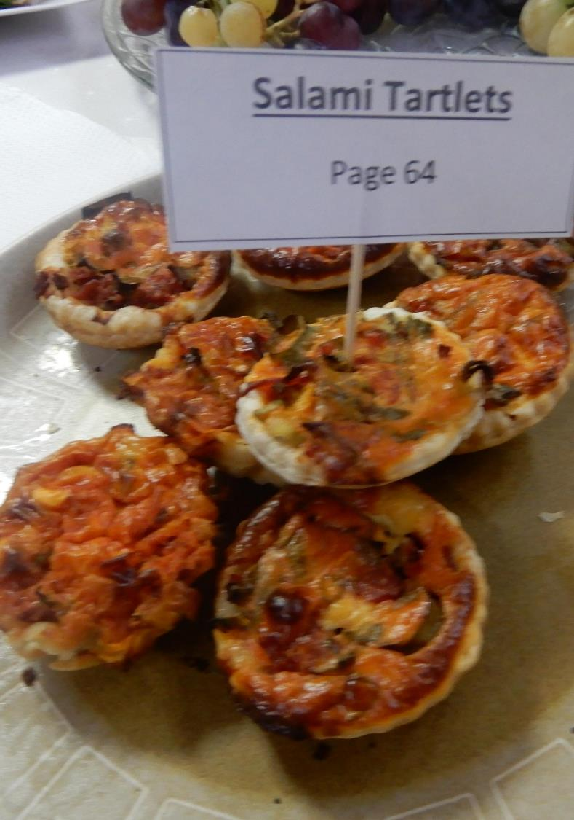


Launch Day – Recipes from the Book….

Slide 29





Launch of the Publication in Upland – simultaneously 7pm Friday Upland
(12noon Mildura)
Followed by individual chats

Slide 30


Featuring Pakistan
2021 International Dinner

Slide 31





Back to (Almost) Normal
Not just an Association but extended Family friendships

Slide 32




ZOOM & Facebook helped us keep in touch

Slide 33

Riovista Mildura

